Slide 1

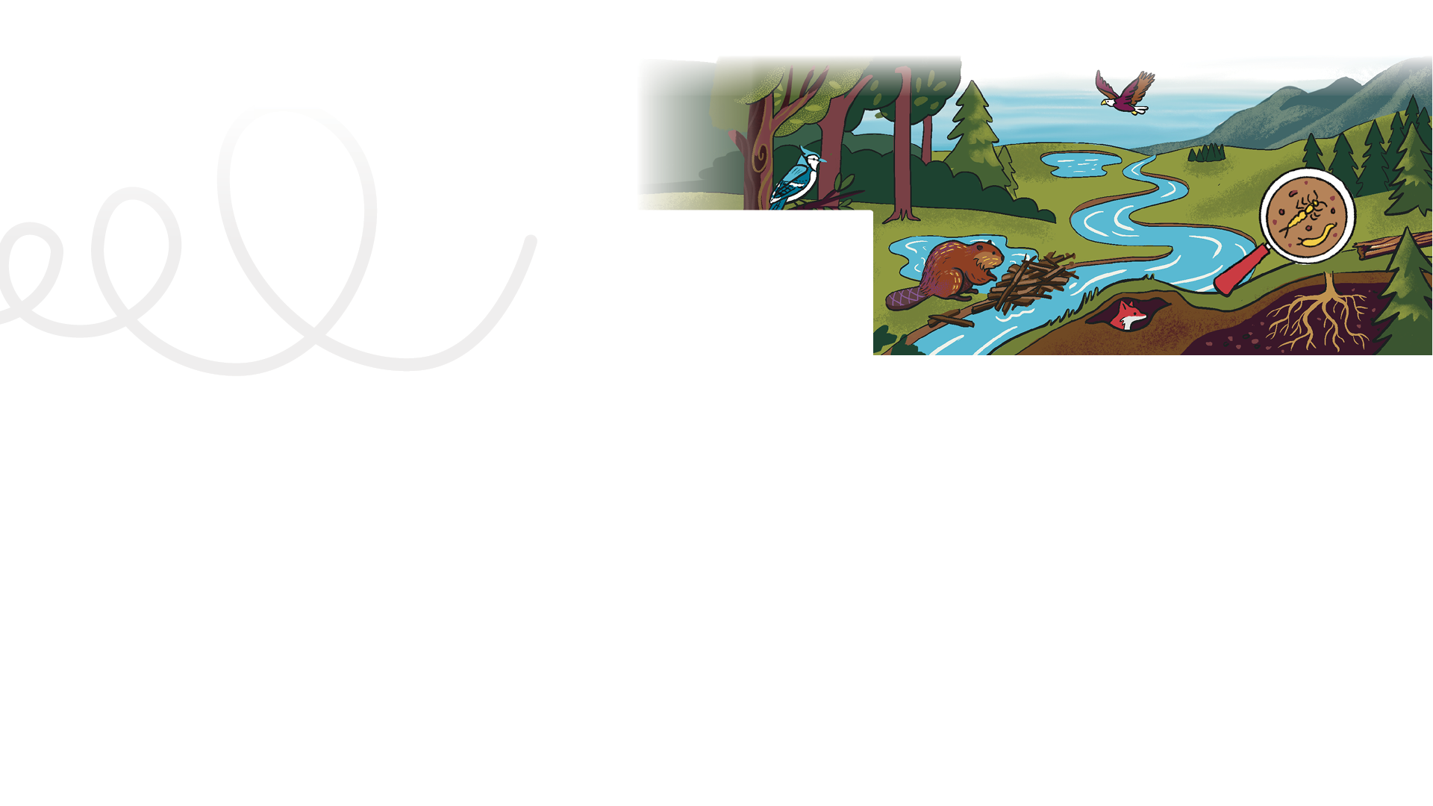



LESSON PLAN
Living Planet Report Canada for Kids
1
LAUNCH
Grade levels: four to six
LENGTH OF LESSON:
One to two class periods (120 to 90 minutes), depending on how many extension activities you include
Main objective:
Students are introduced to the mission, explore the Living Planet Report Canada (LPRC) for Kids website (wwf.ca/lprckids), and begin to engage with the content in a self-directed, curiosity-driven way.
Skills developed:
Managing time, communicating effectively, conducting research, thinking critically, and navigating digital content.
Background information:
This lesson launches the exploration of WWF-Canada’s LPRC for Kids website. Launching this lesson in a way that perks up the curiosity of your students or group will help boost their level of engagement in the goals of Mission: Explore to Restore.
ASSESSMENT TOOLS:
Student: Back of Mission #1 card Teacher: Quick Assessment or Inquiry Learning Rubric
MATERIALS REQUIRED:
Teacher copy of “Mission: Explore to Restore” card
Student mission cards
Access to the LPRC for Kids website (wwf.ca/lprckids)
General learning outcomes:
Please see Appendix 1 for general outcomes that apply to your province/ territory.

Slide 2

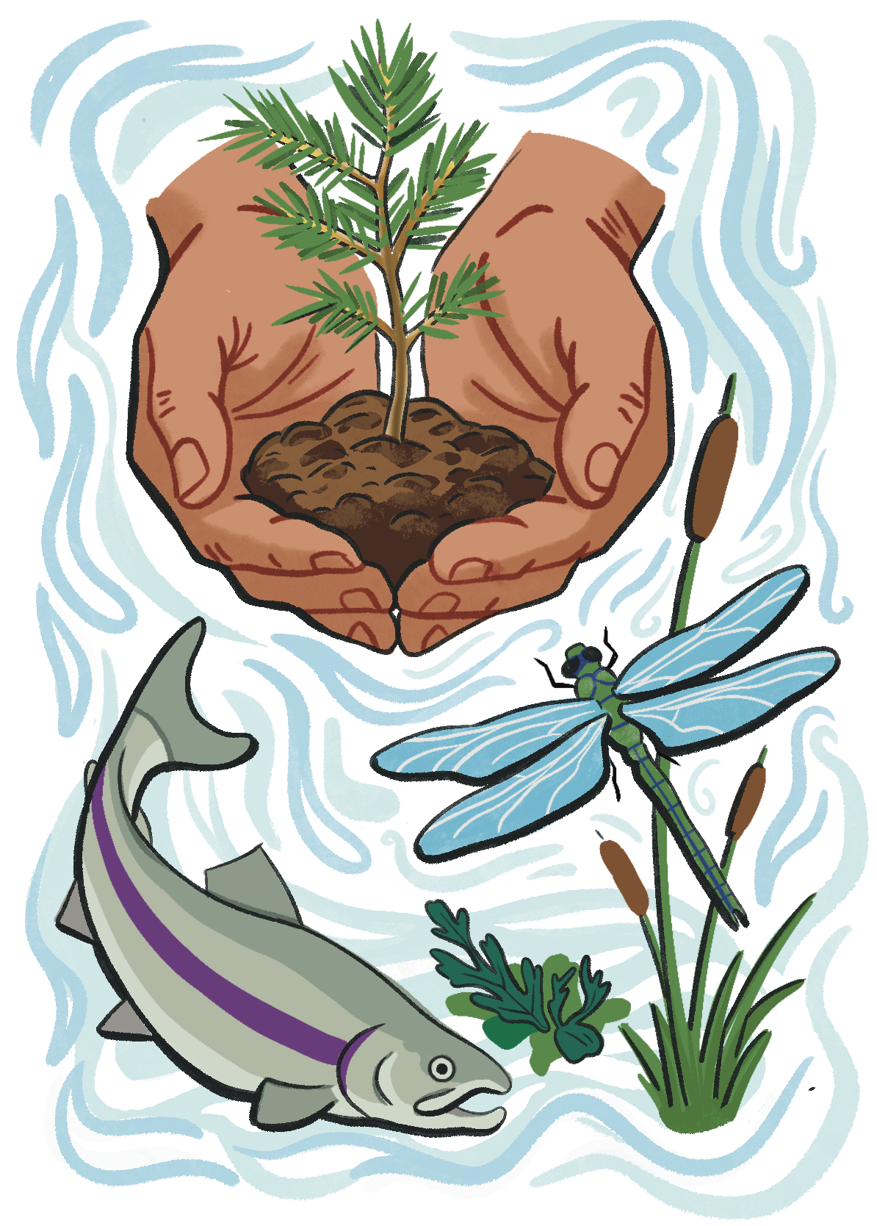
Bringing together
ways of knowing
— Indigenous perspectives:
Teacher note:
Upcoming lessons will include excerpts from the Living Planet Report Canada 2025 with expertise and experiences shared by contributors from Indigenous communities in different parts of the country. You can read these aloud as story-like connections at any point during the lesson that feels appropriate. Full perspectives are available in the report for reference (wwf.ca/lprc2025).
READ ALOUD:
Indigenous knowledge is a broad term used to describe knowledge held by Indigenous Peoples derived from careful observation and interaction with the land, its species and their relationships over many generations. It includes not only information about animals, plants and ecosystems, but also the ways people relate to nature, including cultural, spiritual and community connections.
By exploring Indigenous knowledge alongside scientific approaches, we can get a better understanding of ecosystems, how they have changed over time, and the best ways to protect them.
Teacher engagement:
Before the lesson, print off the teacher version of the “Mission: Explore to Restore” card. You will also require the student version of the mission card for each individual student. The key point of the introduction is to add some interest and mystery to the mission!

Slide 3
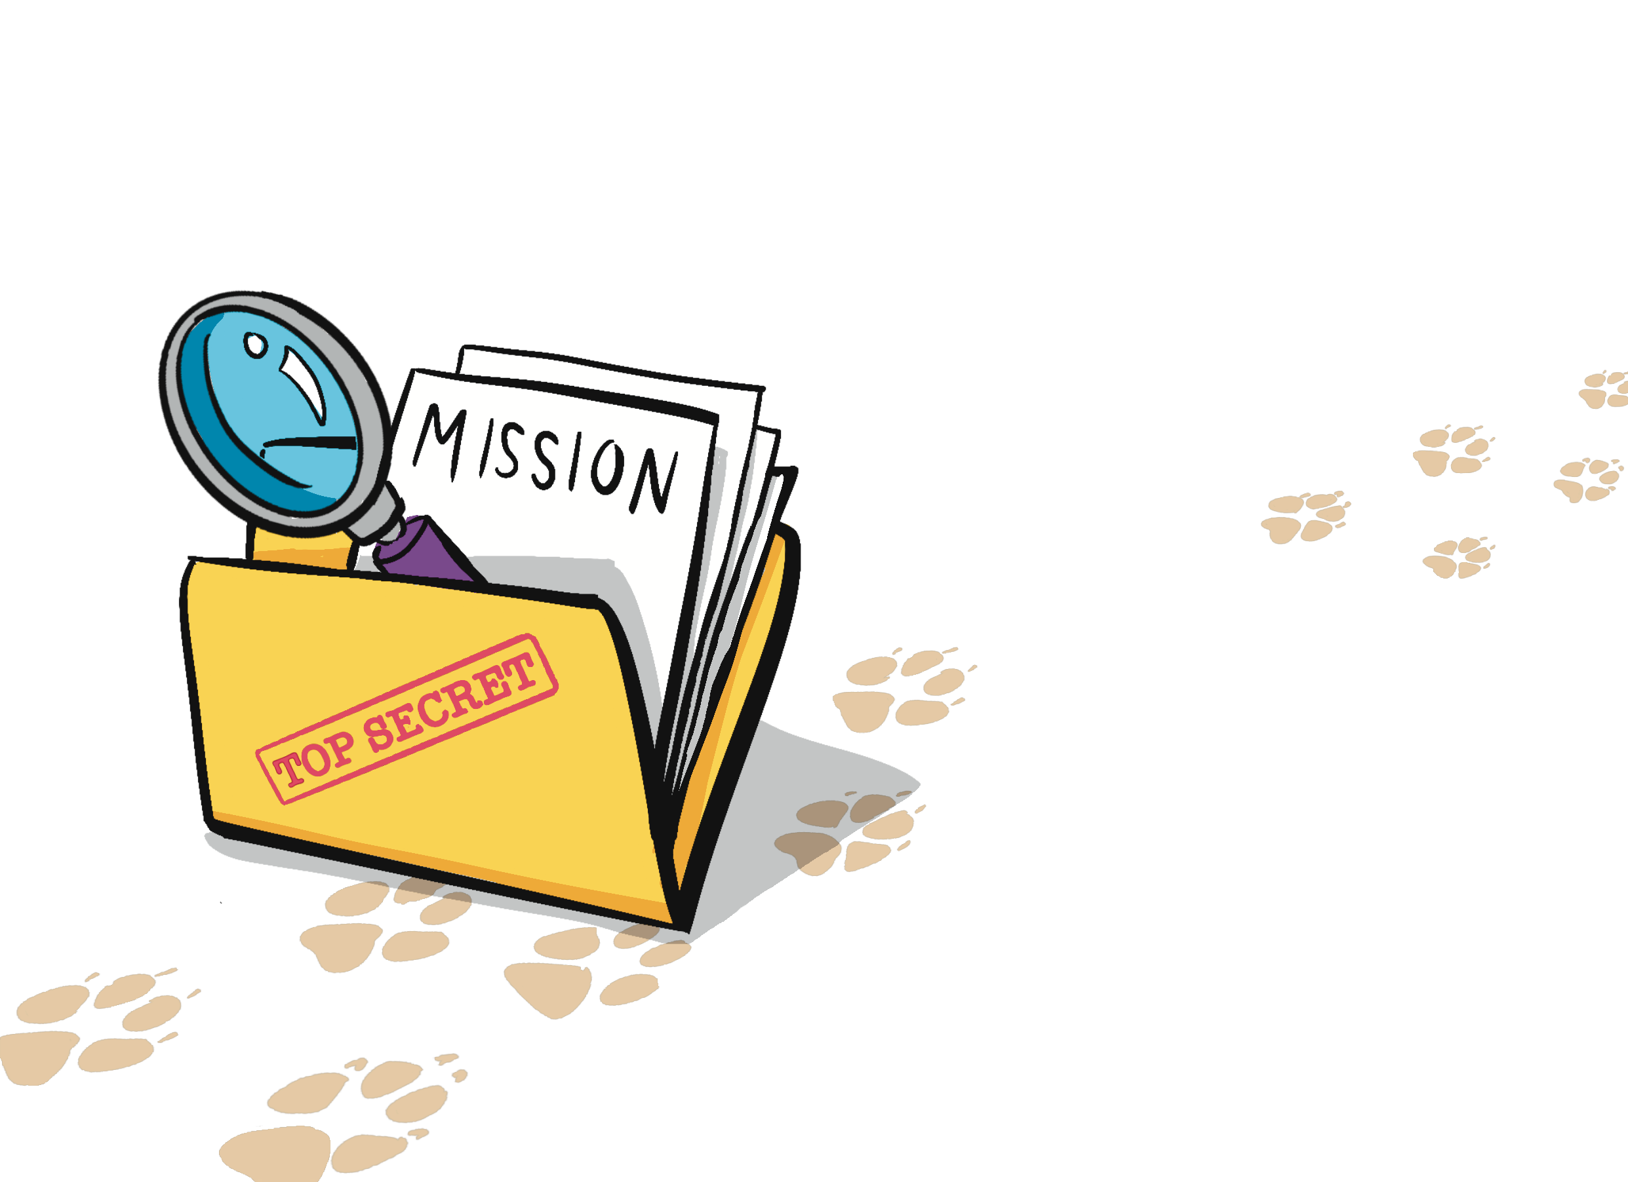
Ideas for adding mystery to the launch:
PLEASE NOTE: Each of the following lessons will refer back to the theme “Mission: Explore to Restore.” Each subsequent lesson will have a new mission card to complete. Take time
to get the students' attention about the importance of this mission and that it is based on real data, real science and real wildlife in Canada.
Before the class, place the mission card in an envelope with the word “URGENT” written on it. During the launch, tell
the students it has just been delivered to your mailbox.
Or, you can get more elaborate, and recruit someone to knock on the door, get your attention in a serious way and deliver the “Urgent” envelope.
You can have the Mission Impossible theme song playing in the background when the envelope is delivered. Be creative and have fun!
Important note!
You may want to instruct the students not to explore the Q & A video series with scientist Jessica Currie (“Reporting in for wildlife in Canada”) yet, since that will be explored in depth in the next lesson.

Slide 4
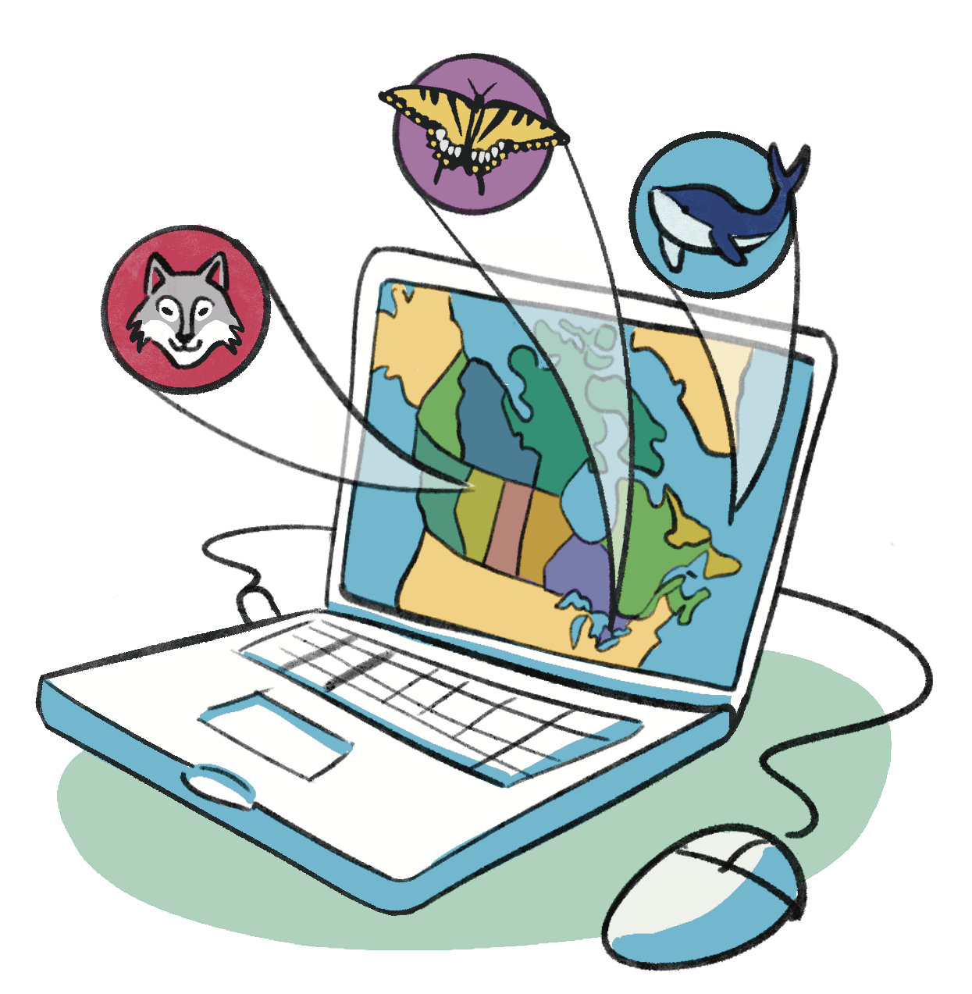
Mission activity instructions
Step 3 Provide time for the class to explore the website. Circulate, prompt and praise as you see students fulfilling their first mission.
Step 4 After the students have had some time to explore the website, ask them to gather for a quick discussion.
Step 1 If a computer lab or projector is available, take students there and review appropriate computer lab etiquette.
Step 2 Depending on group size and tech availability, assign the students to a computer or tablet. Their first mission will be to explore the website and:
Learn about what is happening to wildlife in Canada,
understand why these changes matter and
think about how people, including young people, can help.
Post or write those three points on the board or in the room where the students will be exploring the
website. This will help in the discussion afterwards.
Discussion questions can include:
What caught your attention when you looked around the website?
What part of the website did you spend the most amount of time on? Why?
What evidence did you find that wildlife need our help?
What questions are on your mind? What surprised you the most?
Step 5 Students complete an “exit ticket” on the back of their student Mission #1 card.

Slide 5
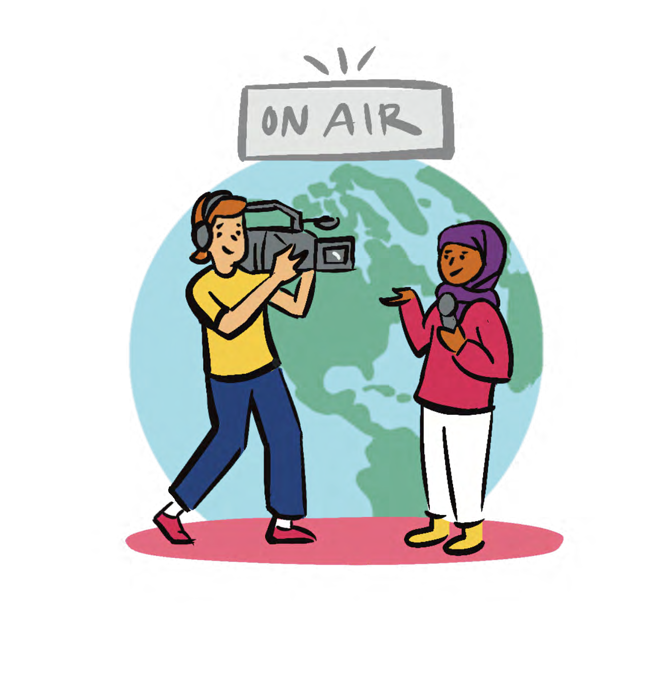
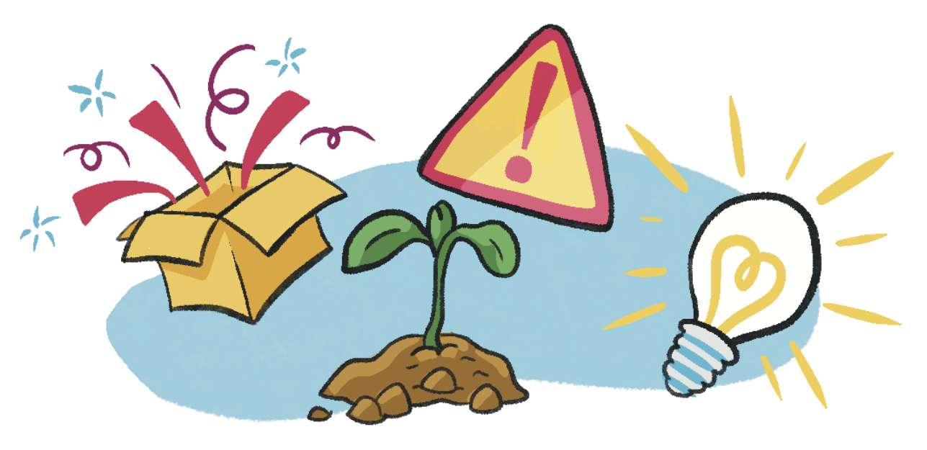
Extension activities
Four corners opinion activity
How it works
When you give a signal (clap hands, say “go”, or turn on/ off the lights) students walk to the corner that fits their thinking and share one thing they learned. (Note: Activities such as these can make the students feel like they have to run to the corner. Remind them it’s not a race!)
Put signs in the corners of the room:
  Most surprising fact
  Most important problem
  Most interesting animal
  Most hopeful solution
When the students get to their chosen corner, they can talk to the other students who made the same choice and take turns sharing their opinion.
Why it works
Leads them to identify the most important ideas
Builds stpeaking skills
Takes about five minutes total
Wildlife news flash: The 30 ⎯ second wildlife news report
Students pretend they are reporters.
How it works
  Students work in pairs or small groups.
  They create a 30-second news update about what they learned in the lesson.
  Example:
“Breaking news! Scientists studying Canadian wildlife have discovered…”
Why it works
They are picking the opinion, so they own the decision of which corner to go into
It gives the students a chance to move and chat with each other
They are sharing one thing they learned, but they are also hearing about what others learned, therefore expanding their perspectives and seeing how different people can learn different things from shared experiences

