Slide 1

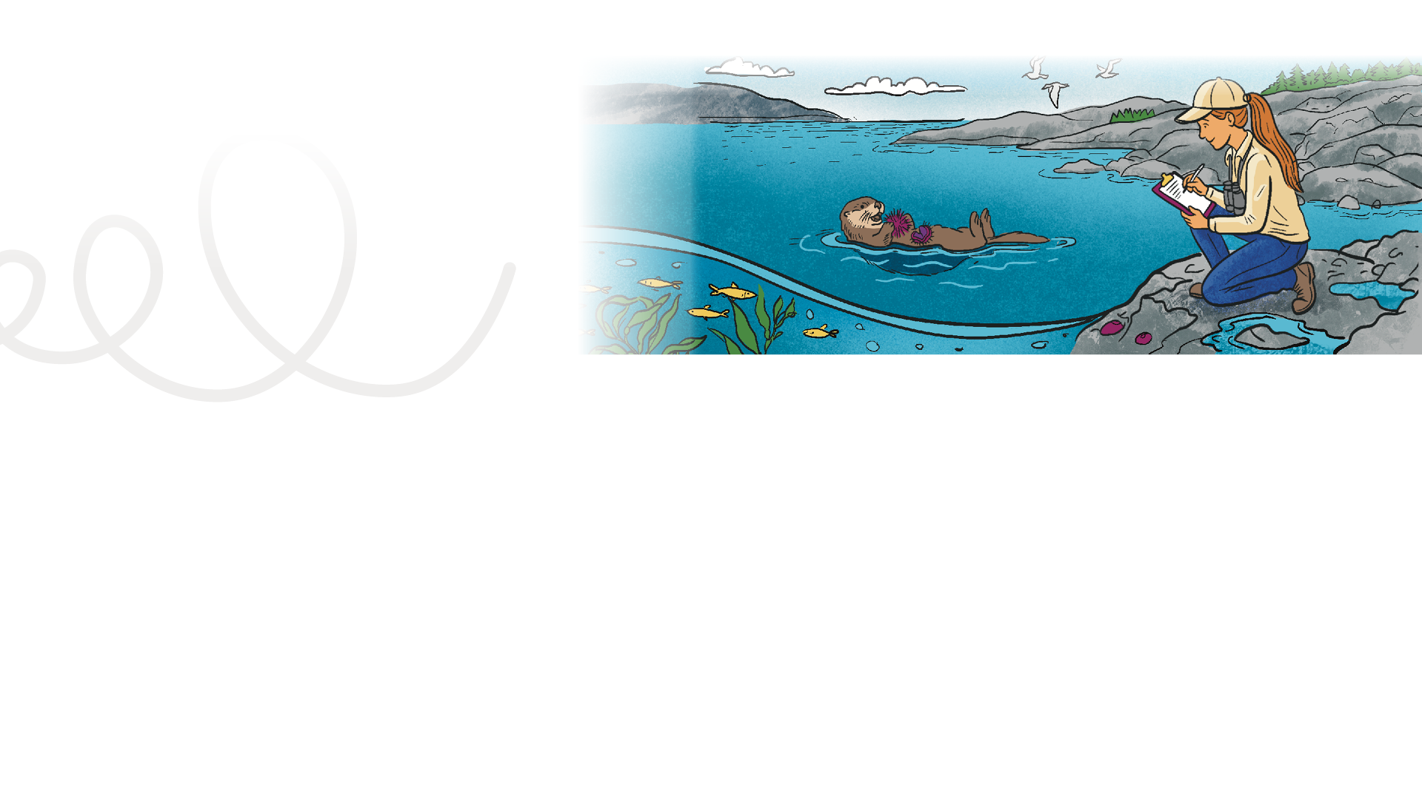

LESSON PLAN
Living Planet Report Canada for Kids
2
Grade levels: four to six
LENGTH OF LESSON:
One science class (40-60 minutes)
Main objective:
Focus on the scientist Q & A video series, “Reporting in for wildlife in Canada.” Explore how scientists study wildlife and ecosystems, introducing observation and evidence-based decision-making. Students will watch a video series of questions and answers with WWF- Canada research scientist Jessica Currie. The students will learn how wildlife population data is collected and why it matters, the Living Planet Report Canada data trends and how youth can contribute to meaningful ways to help wildlife.
General learning outcomes:
Please see Appendix 1 for general outcomes that apply to your province/ territory.
Skills developed:
Active listening to a guest speaker, introduction to scientific data trends, introduction on how to inter-pret graphs, how data is collected and how it can be used, answering learning reflection questions.
ASSESSMENT TOOLS:
Student: Back of Mission #2 card
Teacher: Quick Assessment or Inquiry Learning Rubric, class discussion to check for understanding
MATERIALS REQUIRED:
Computer/projection to screen videos. Print off a Mission #2 card for each student.

Slide 2


Provide some guidance to students on how they will treat the videos
as if there was a real guest in the classroom.
What would that look like?
What questions would you ask?
Prior to viewing the videos brainstorm a few questions and write them on the board. When it gets to the point in the video where scientist Jessica Currie is answering questions, see if any of them match the class’s questions. You can assign a class recorder to listen to the questions on the video and then they can check off any that match the class’s questions.
Background information:
In Lesson 2, students understand that the Living Planet Report Canada 2025 is built from real observations and real questions, which makes their exploration and follow up actions much more meaningful.
Tip:
You can use your own words for the introduction, but try to cover all
three points so students understand what to focus on while watching.
Connect the learning:
Remind students that the scientist will be talking about the Living Planet Report
Canada 2025, and that they have explored the LPRC for Kids website in the previous lesson. Now, they will get to learn more about what is happening to wildlife across the country. The goal is to help students understand how scientists gather and
use data to track wildlife populations, and why that knowledge matters for protecting interconnected ecosystems. This lesson centres the scientist's voice and positions the Living Planet Report
Canada 2025 as something created by real people doing real work.
Introduce the mission and explain the process
(active listening):
“Your mission is to listen like a scientist. As you watch the videos, listen for clues about how scientists know how wildlife is doing in Canada, what happens after a report is released and how young people can help.”
Vocabulary building blocks
Before showing the videos, brainstorm a list of science vocabulary words and write them on the board. Whenever the scientist says one of these words, you can put a checkmark. Don’t stop the video, just keep a running tally.

Slide 3

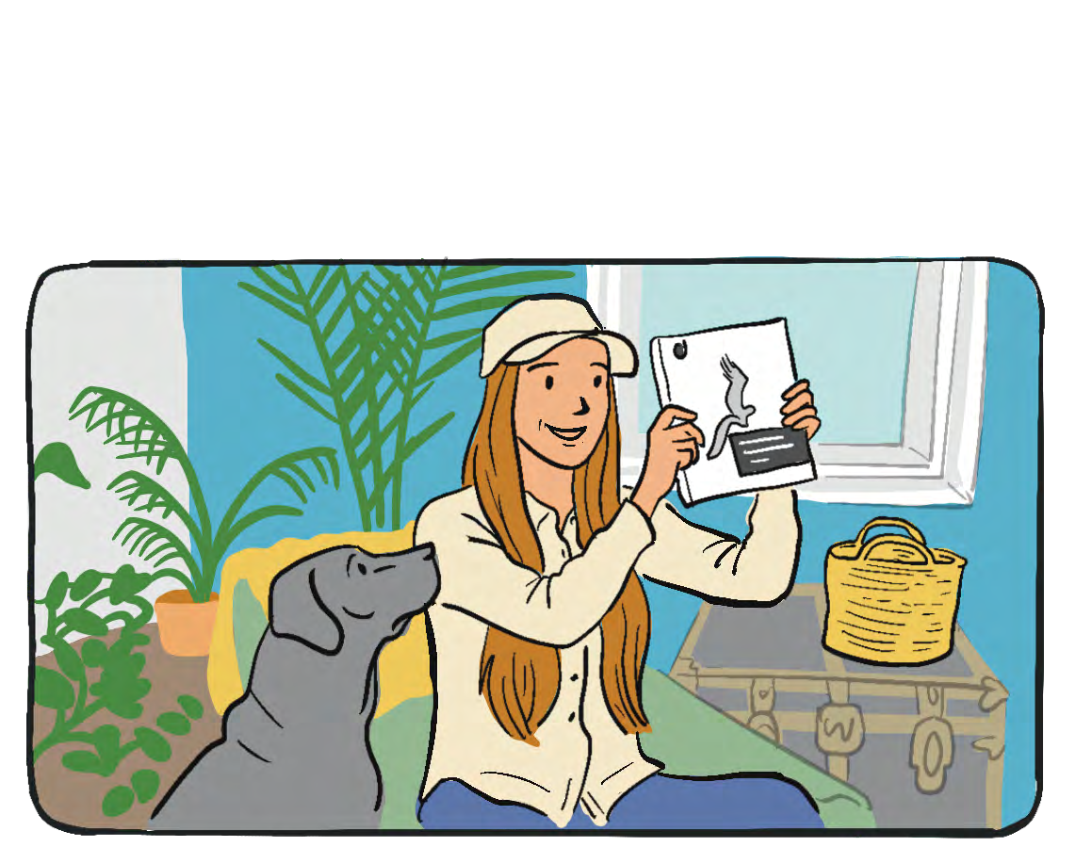
Mission activity instructions
Step 3 After watching the videos, guide the students in a discussion. Some types of questions could include:
Noticing and wondering (What stood out? What surprised you? What did you find most surprising about what’s happening to wildlife in Canada?)
Sorting ideas (What is the scientist trying to figure out? Why?)
Making connections (How does this relate to what we explored on the website in Lesson 1? How did today’s lesson connect to something you already knew? Did it change or enhance your understanding in any way?)
Reflection (How did your understanding of wildlife in Canada change today?)
Action (What should I do with what I learned and know? What will I be able to do with this knowledge? Who should I tell or share this with? Who would care or benefit the most?)
NOTE: We will revisit the evidence-to-action idea later in Lesson 6, when students are ready to apply it themselves as ‘student scientists.’
Step 1 In this lesson, the students are learning how science works and why it is important. The main focus of this lesson will be a listening activity and focusing on what scientist Jessica is saying. Prepare the students for what active listening looks like. Role play a few scenarios to practice not interrupting, raising a hand when asking a question, taking notes, etc.
Step 2 Group the students so that they can view the screen where you will be showing the videos. Show the videos; there are four short videos (1-3.5 minutes each) with WWF-Canada research scientist Jessica Currie.
Step 4 Ask the students to complete the exit ticket on the back of their Mission #2 card.
Teacher tip
These videos can be downloaded ahead of time and viewed without an internet connection.

Slide 4
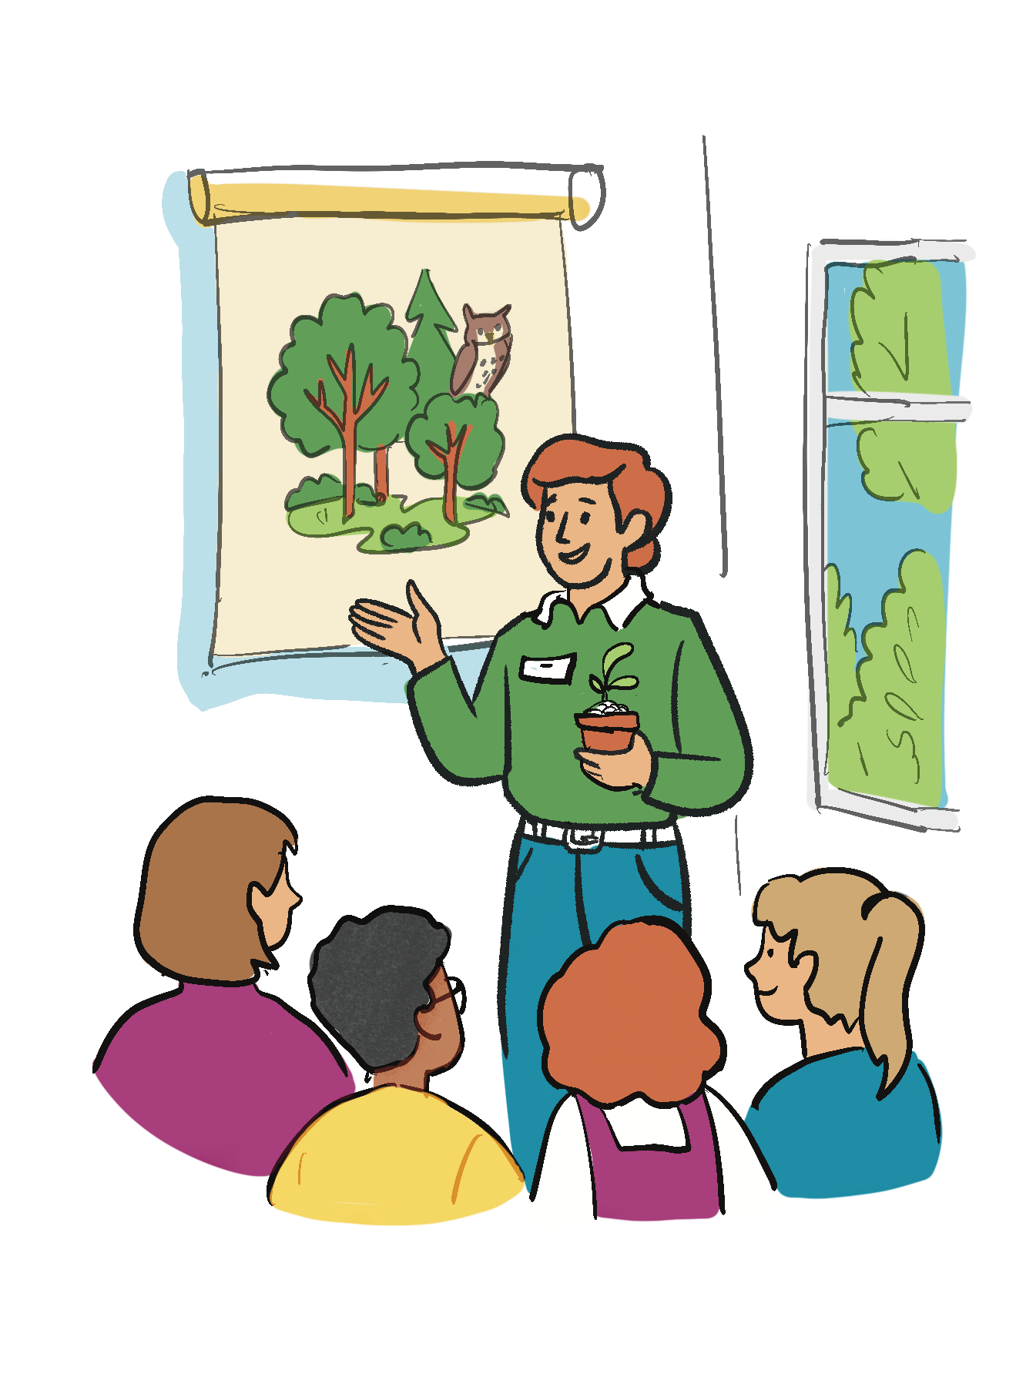
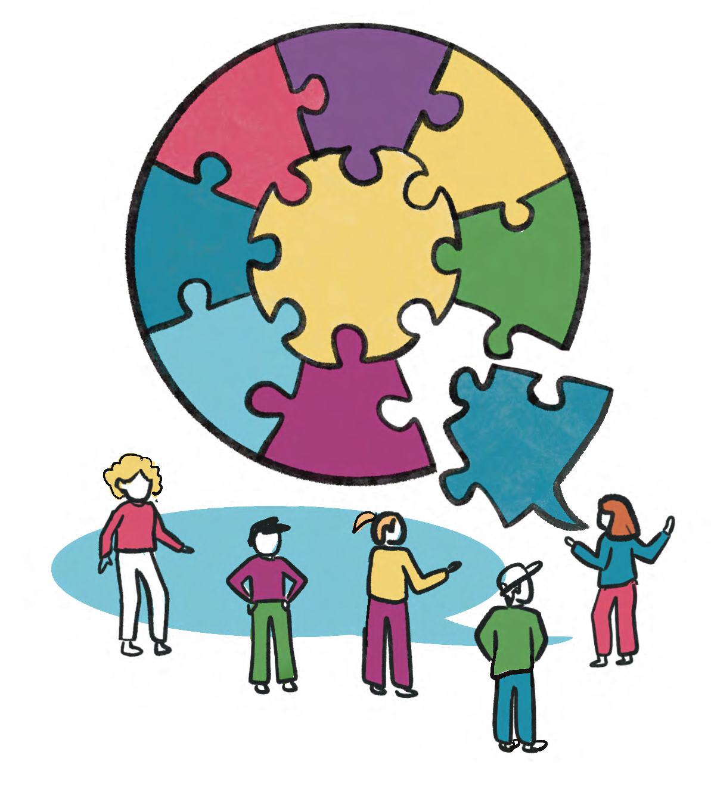
2. 'Pass the idea' circle
Students stand in a circle. Or, this idea could be useful when they are lining up for recess or their next class after this activity.
One student starts with:
“One thing scientists discovered is…”
The next student must add a new idea from the lesson. You go around the circle building a chain of learning.
Extension activities
Local perspective (separate session)
  Invite a guest who is a local scientist, researcher, conservationist and/or Indigenous community member to speak with the class.
  Prepare the class on appropriate behaviour when having a special guest in the classroom.
  Students prepare one or two questions in advance.
  After the guest speaker presents, ensure there is time for the students to ask their questions. Also ensure that there is time to properly thank the guest for their time.
  Debrief: compare local perspectives with what they learned from the video series.

