Slide 1

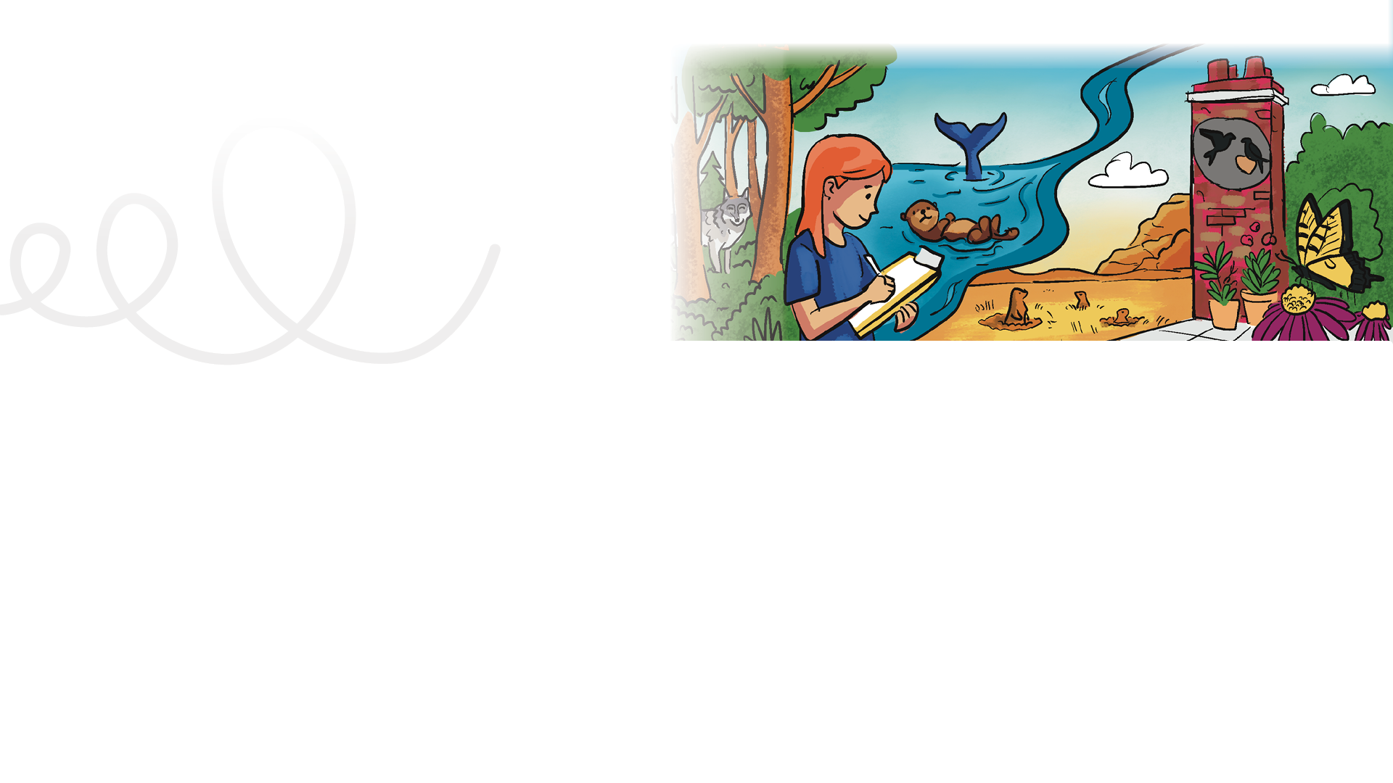


LESSON PLAN
Living Planet Report Canada for Kids
3
Grade levels: four to six
LENGTH OF LESSON:
One to two class periods (40-90 minutes)
ASSESSMENT TOOLS:
Student: Wildlife Investigation Worksheet and back of Mission #3 card
Teacher: Assessment Rubric (choice of Quick or Inquiry Learning version)
Skills developed:
Time management and communication skills by engaging with various online resources and activities, research abilities, critical thinking, navigating digital content, learning about species across Canada, selecting a focal species to research, and why understanding species and ecosystems matters.
Main objective:
This lesson builds understanding of biodiversity through species stories and quizzes.
MATERIALS REQUIRED:
Access to the LPRC for Kids website
(wwf.ca/lprckids)
One copy of the Wildlife Investigation Worksheet per student
General learning outcomes:
Please see Appendix 1 for general outcomes that apply to your province/ territory.

Slide 2
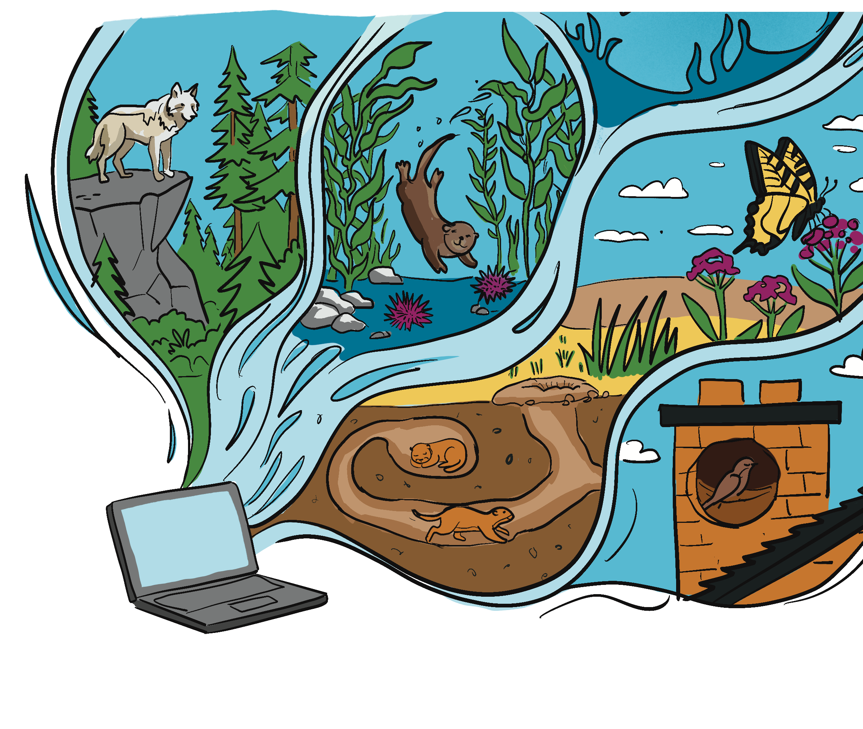

Background information:
The homepage of the LPRC for Kids website
(wwf.ca/lprckids) has a wealth of information that will provide the foundation for today’s investigation. If possible, gather the students together while you project the home page. Read the content aloud, and ensure that your students are understanding that the report is based on real data. And while sharing space with humans in our modern world creates challenges for wildlife, humans are also learning how to help wildlife. In this lesson, the students are going to investigate one of the six species featured on the website and complete short interactive quizzes.

Slide 3
Indigenous perspectives:
TEACHER NOTE
Read aloud this perspective from Ross Hinks from page 31 of the Living Planet Report Canada 2025. If you have a map of Canada in your classroom, take a moment to locate Conne River, Nfld.
Follow-up questions
Observation and connection: What changes does Ross Hinks describe in the rivers and fish near his community?
Reflection and impact: How do these changes affect people’s lives, traditions and culture?
Critical thinking / future-oriented: If a species that is important to your life or
community began to disappear, how would you feel? Why would that loss matter to you?
Ross Hinks, Director of Natural Resources, Miawpukek First Nation
Ross Hinks has spent most of his life living on Miawpukek First Nation. A small Mi’kmaq community in Conne River, Nfld. Hinks grew up fishing on the river with his father — their
livelihood depended on what they could get from the land and sea. He’s worked for the Nation
for roughly 45 years and now serves as the
community’s director of natural resources, where he advocates for Miawpukek’s involvement in development projects.
A Mi’kmaq man, Hinks holds vast knowledge of the land and the species that occupy it. He’s
spent his life accumulating knowledge and beliefs about the relationships between the species in his region and how to respectfully coexist with them. This knowledge he’s inherited has been passed down from generation to generation and is built on thousands of people’s direct contact with the environment.
Ross: I’ve been on this earth for 62 years now and, during that short period of time, I certainly have seen dramatic changes — and a lot is because of development.
The fish in our area have been in decline over the last 30 years. We used to be able to catch capelin right below my house, catch cod anywhere in the bay, mackerel, all of that. Now there’s nothing coming near us. The salmon have dropped off since industry came in and we’re very concerned that the stock will get on the endangered list if nothing is done. Right now, we have to travel far out to sea in order to get any type of fish.
…
Loss of species is a loss of tradition, loss of livelihood, loss of everything we stand for.
…
Our new generation will probably never know what a wild salmon looks like. The only one they’ll probably see is in a grocery store, not in our rivers.

Slide 4

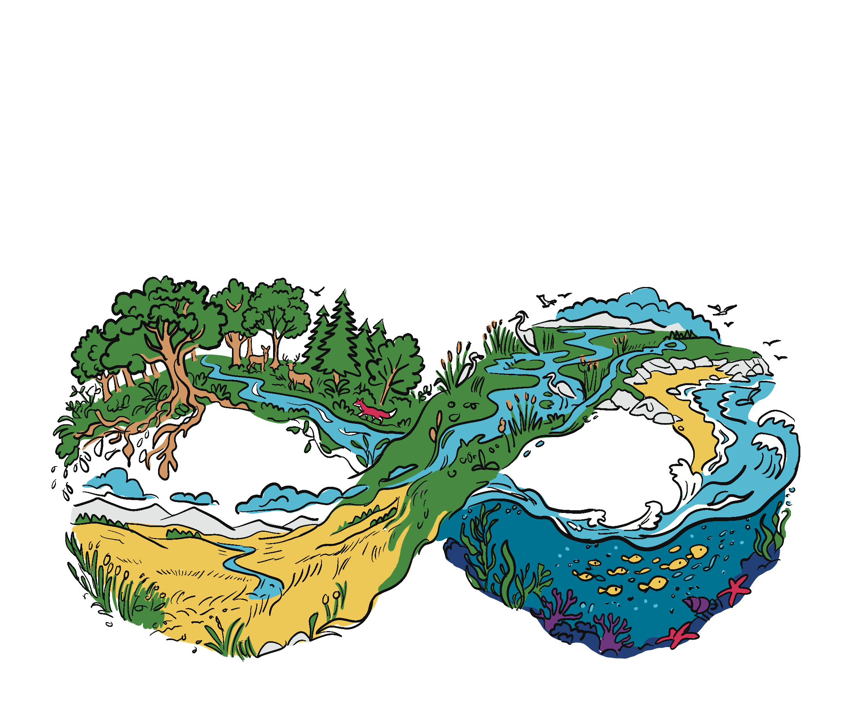
Mission activity instructions
Step 4 Ensure that the students have read their selected species' story and completed the related quiz. Eager finishers can go on to explore the other species' stories and quizzes.
Step 5 At the conclusion of the lesson, they will need to hand in their Wildlife Investigation Worksheet. They also need to complete the exit ticket on the back of the Mission #3 card.
Completing these tasks will finish their third mission!
Step 1 If there is access to a computer lab/computer projector, take the students there. Review appropriate computer lab etiquette.
Step 2 Depending on class size and tech availability, assign the students to a computer or tablet and provide them with their LPRC for Kids Wildlife Investigation Worksheets. Their third mission will be to explore the species stories section of the website to:
Learn about what is happening to wildlife in Canada,
understand why these changes matter and
think about how people, including young people, can help.
Step 3 Provide time for the class to complete their investigation on their chosen species. Circulate, prompt and guide as you see students fulfilling their third mission. Students should be filling out their investigation worksheet while reading the species stories.

Slide 5

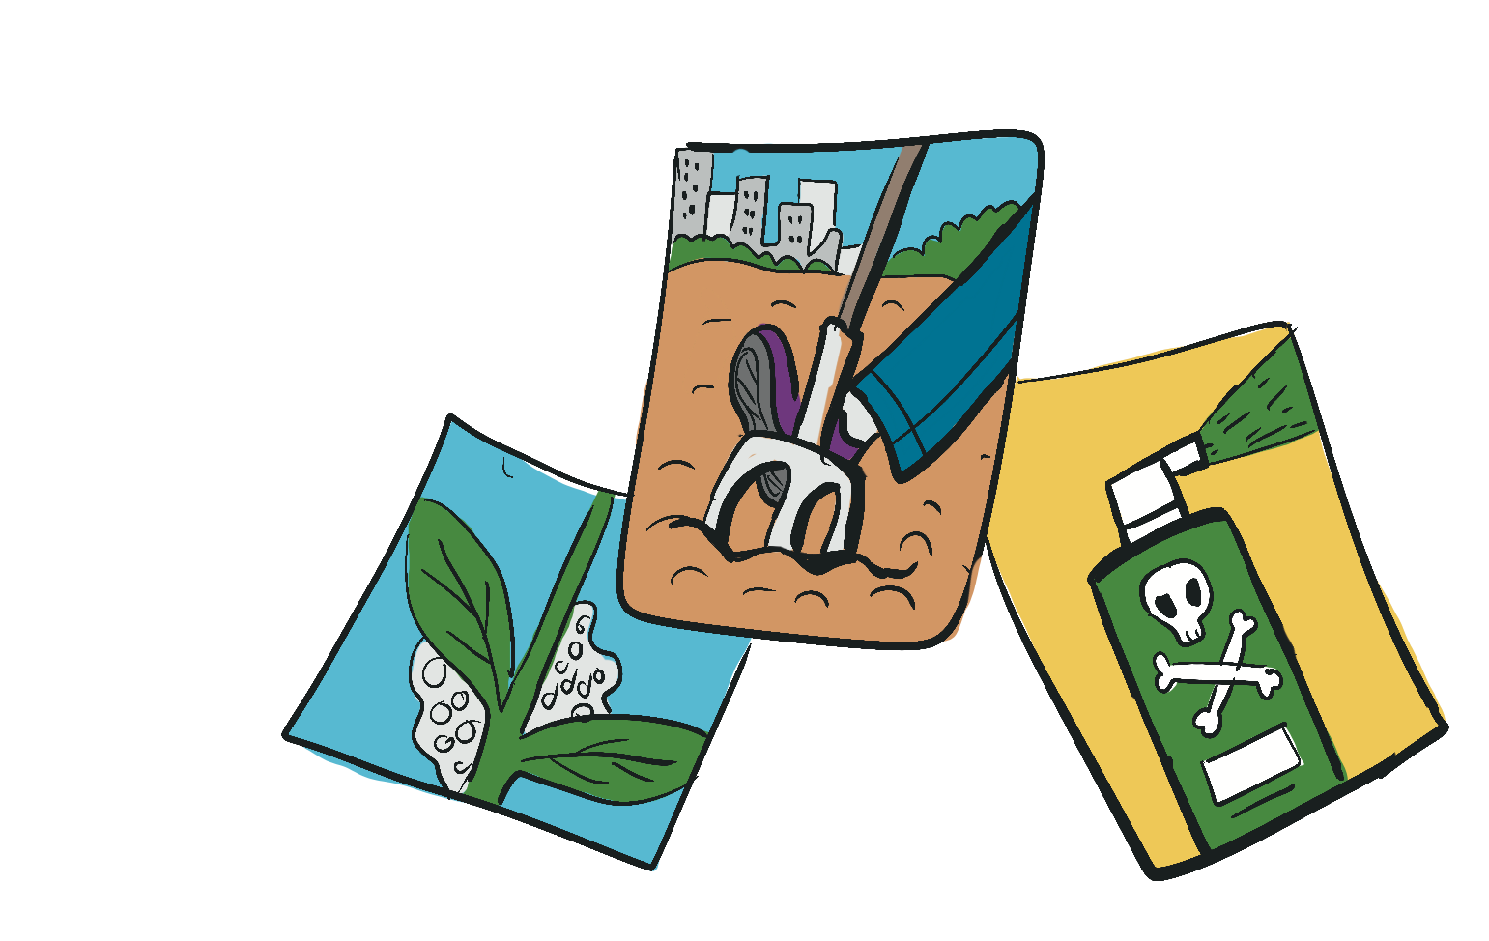
2. Mission card challenge
“Explain the biggest threat to this animal.” Examples: People turning forests into cities, noise pollution from ships interfering with communication (e.g., for whales).
“Suggest one action people can take.” Examples: Growing wildlife habitat by planting native plants at home or at school, asking the government to strengthen laws to protect wildlife.
Students create a mini-poster or whiteboard sketch to explain their mission.
How it works:
Gather the students into small groups based on the species they studied in the wildlife investigation.
Materials: Wildlife Investigation Worksheet, paper and pencils or mini-white boards and dry erase markers.
Give groups a mission challenge such as:
“Show the public why this species matters.” Examples: It helps to keep other species’ populations in balance, it is a well-loved symbol of our country/region.
Extension activities
2. One-minute sketch notes
Materials: Paper, pencils, coloured pencils or markers
Instead of writing sentences students draw three quick sketches representing:
  something they learned
  a problem facing wildlife
  a possible solution
Stick them on the wall for a gallery walk. This works great for mixed ages and language abilities

