Slide 1

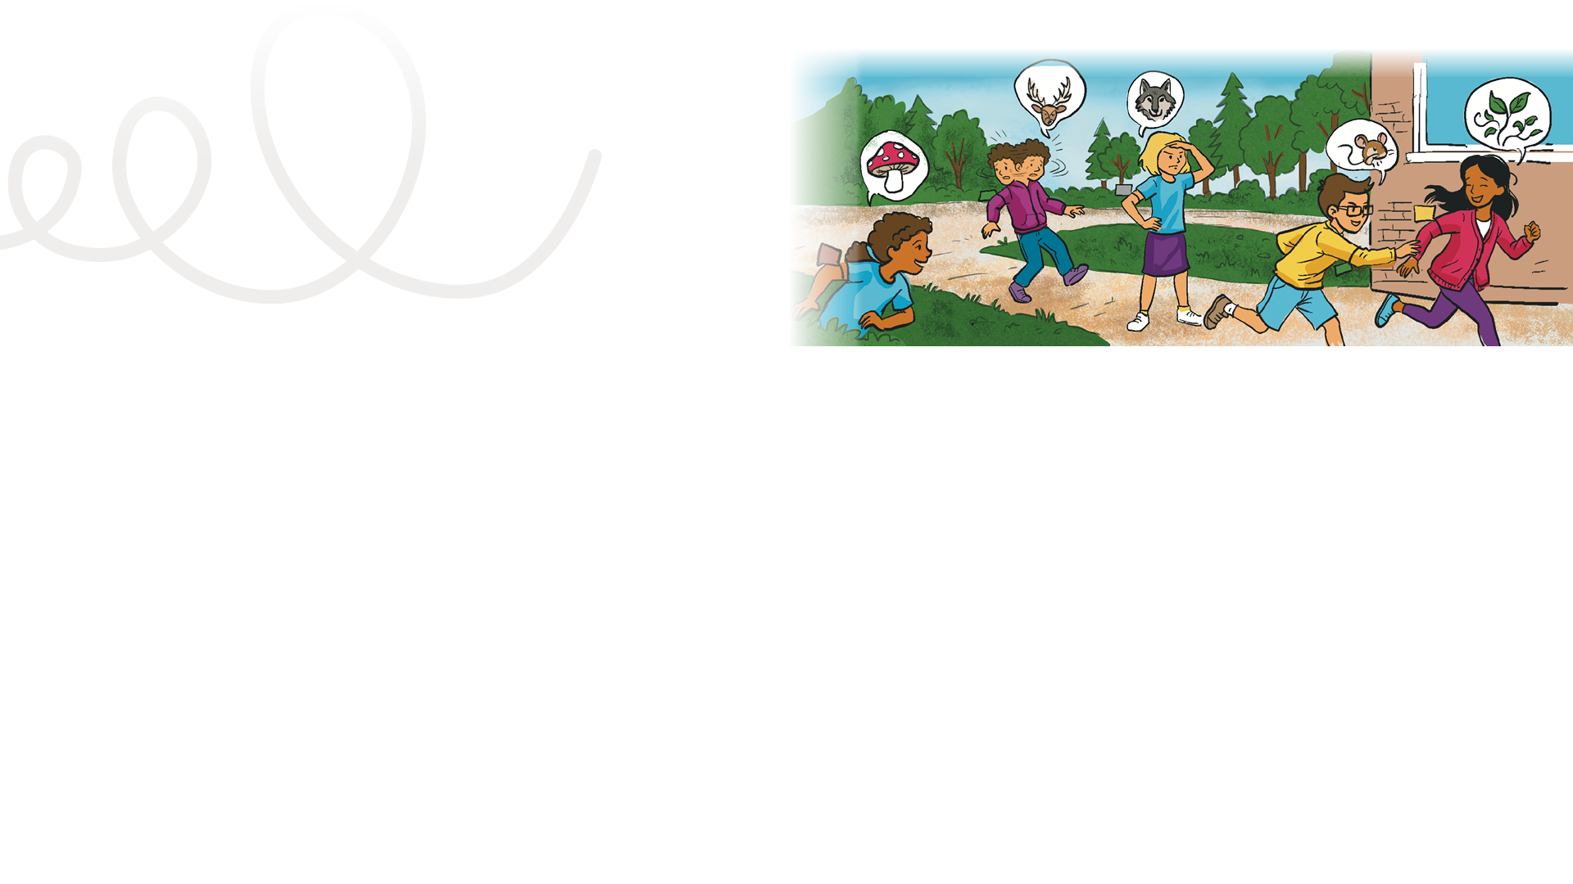

LESSON PLAN
Living Planet Report Canada for Kids
4
LENGTH OF LESSON:
Two class periods (e.g., a double time block of gym and science; approximately 90 minutes)
Grade levels: four to six
ASSESSMENT TOOLS:
Student: Back of Mission #4 card
Main objective:
Students participate in an active eco-system game to experience how changes to one species can ripple through a food chain and affect the whole ecosystem. Students assume the role of producer, consumer (both herbivore and carnivore) and decomposer.
Skills developed:
Modelling ecosystems via a food web game, communication, critical thinking, creativity and innovation, personal growth and wellness
Teacher: Assessment rubric (choice of Quick or Inquiry Learning version)
MATERIALS REQUIRED:
Yellow, green, grey and brown construction paper cards cut into small squares to represent the four different character types in the game.
Alternatives to construction paper:
Coloured pinnies or vests (assign one colour per role)
Arm or leg bands (assign by colour or pattern)
Masking tape: Make different stripes or “x” patterns to rep-resent different character types
Background information:
This lesson is the pivot point of the unit: Students move from learning about biodiversity to thinking about their role within it. It’s time to get them moving. Students physically experience how changes to one species affect others.
General learning outcomes:
Please see Appendix 1 for general outcomes that apply to your province/ territory.

Slide 2
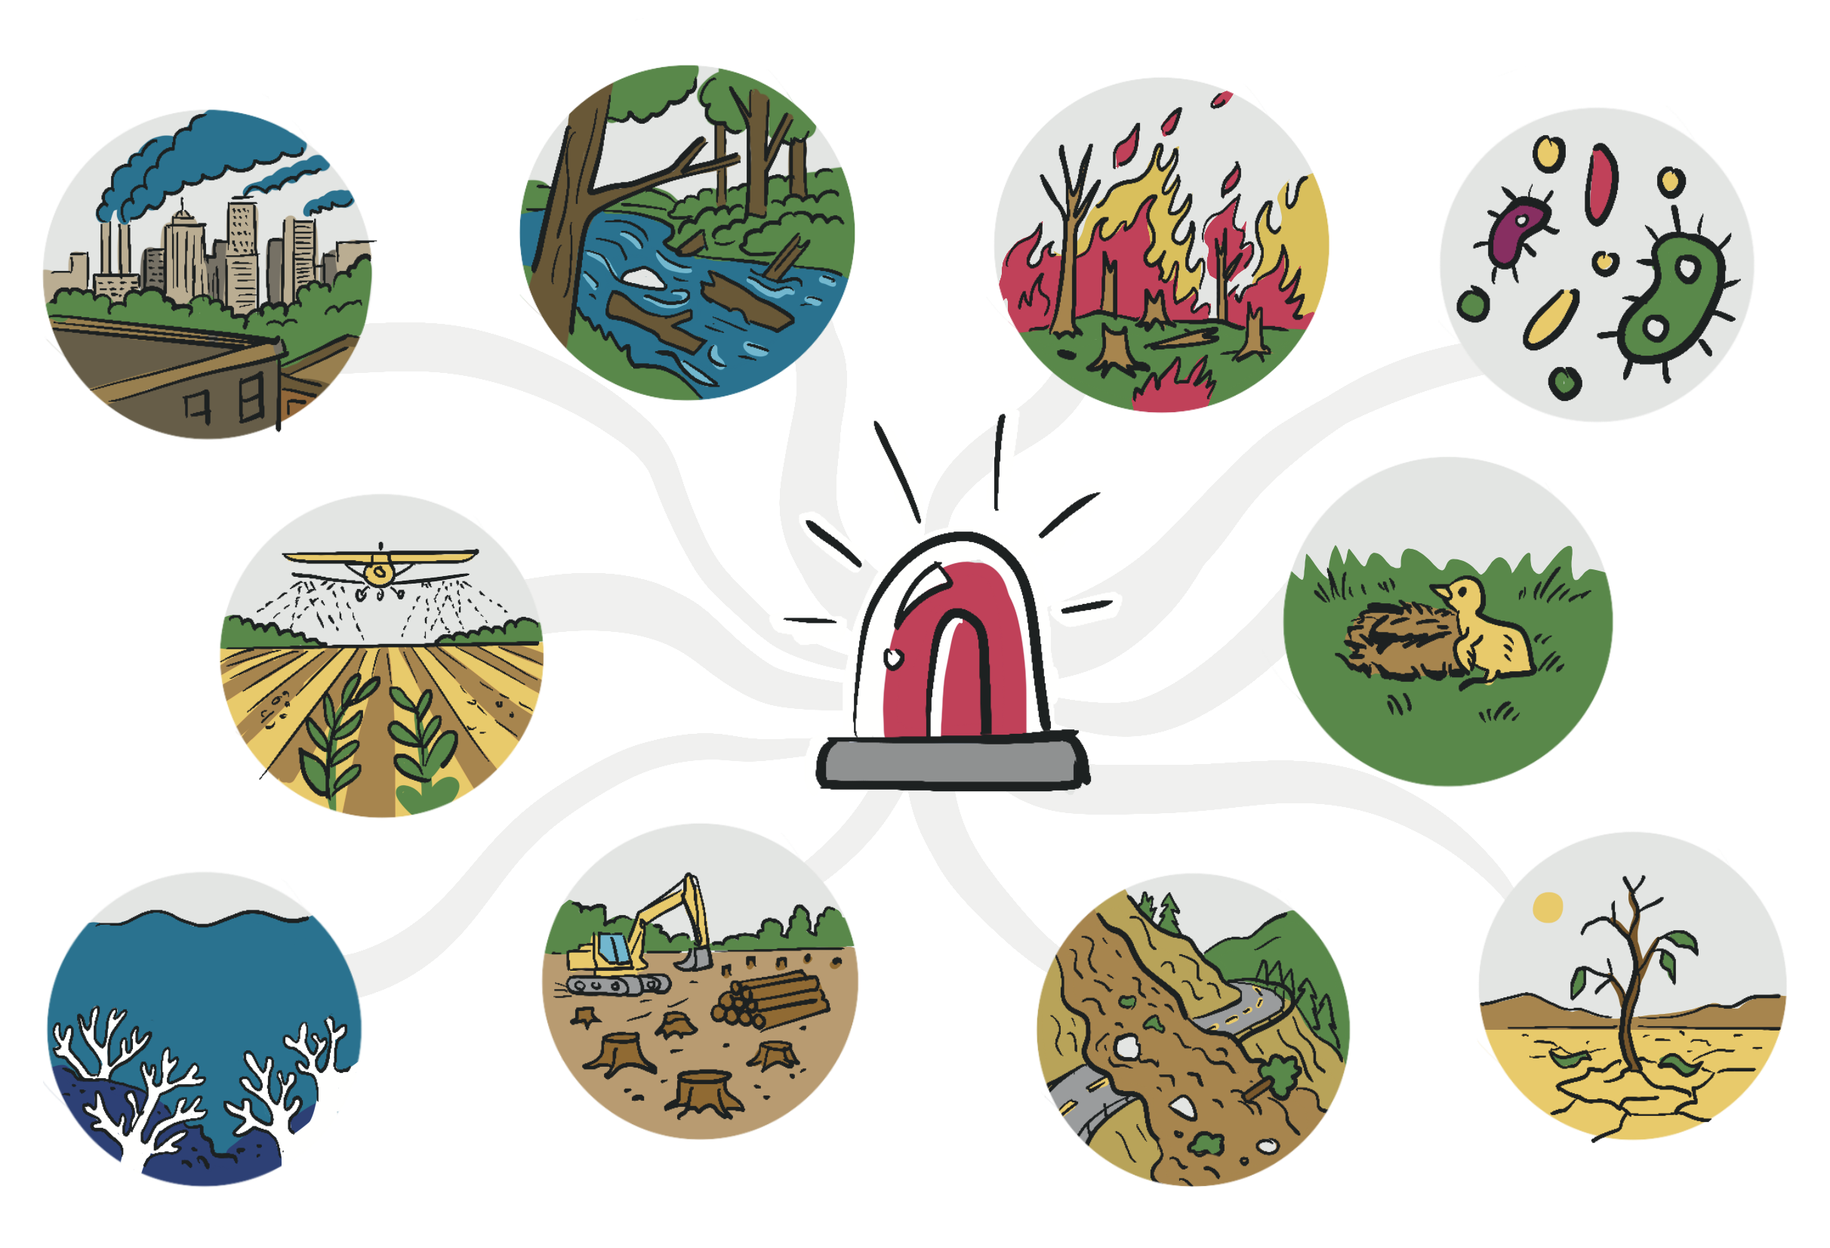
A note about simulations
Simulations are very engaging for students, and it is possible that they become so involved in the role they are playing that they forget to relate the objects, events and processes to what they represent in nature, and they may tend to become competitive. The students identify subjectively with the role they have been given, and it is important as part of the powerful learning that is possible through simulations. However, it is important to link the
subjective experience with the objective concepts. Therefore, after the activity, it will be important to distinguish what is realistic and not realistic about the simulation.
In this activity, there are only four character types in the food chain game. In reality, there would be many variables, including weather, habitat to hide in, whether the individual species was healthy or stressed, young or old, etc. A discussion after a simulation activity is very important. In a follow-up discussion, teachers should help students understand
how the simulation is like and
unlike the real situation.
Adapted from “Using Simulations for Instructional Purposes," Project WILD, Association of Fish & Wildlife Agencies (https://www.fishwildlife.org/application/ files/4615/6780/2150/Using_Simulations_for_Instructional_Purposes.pdf).

Slide 3

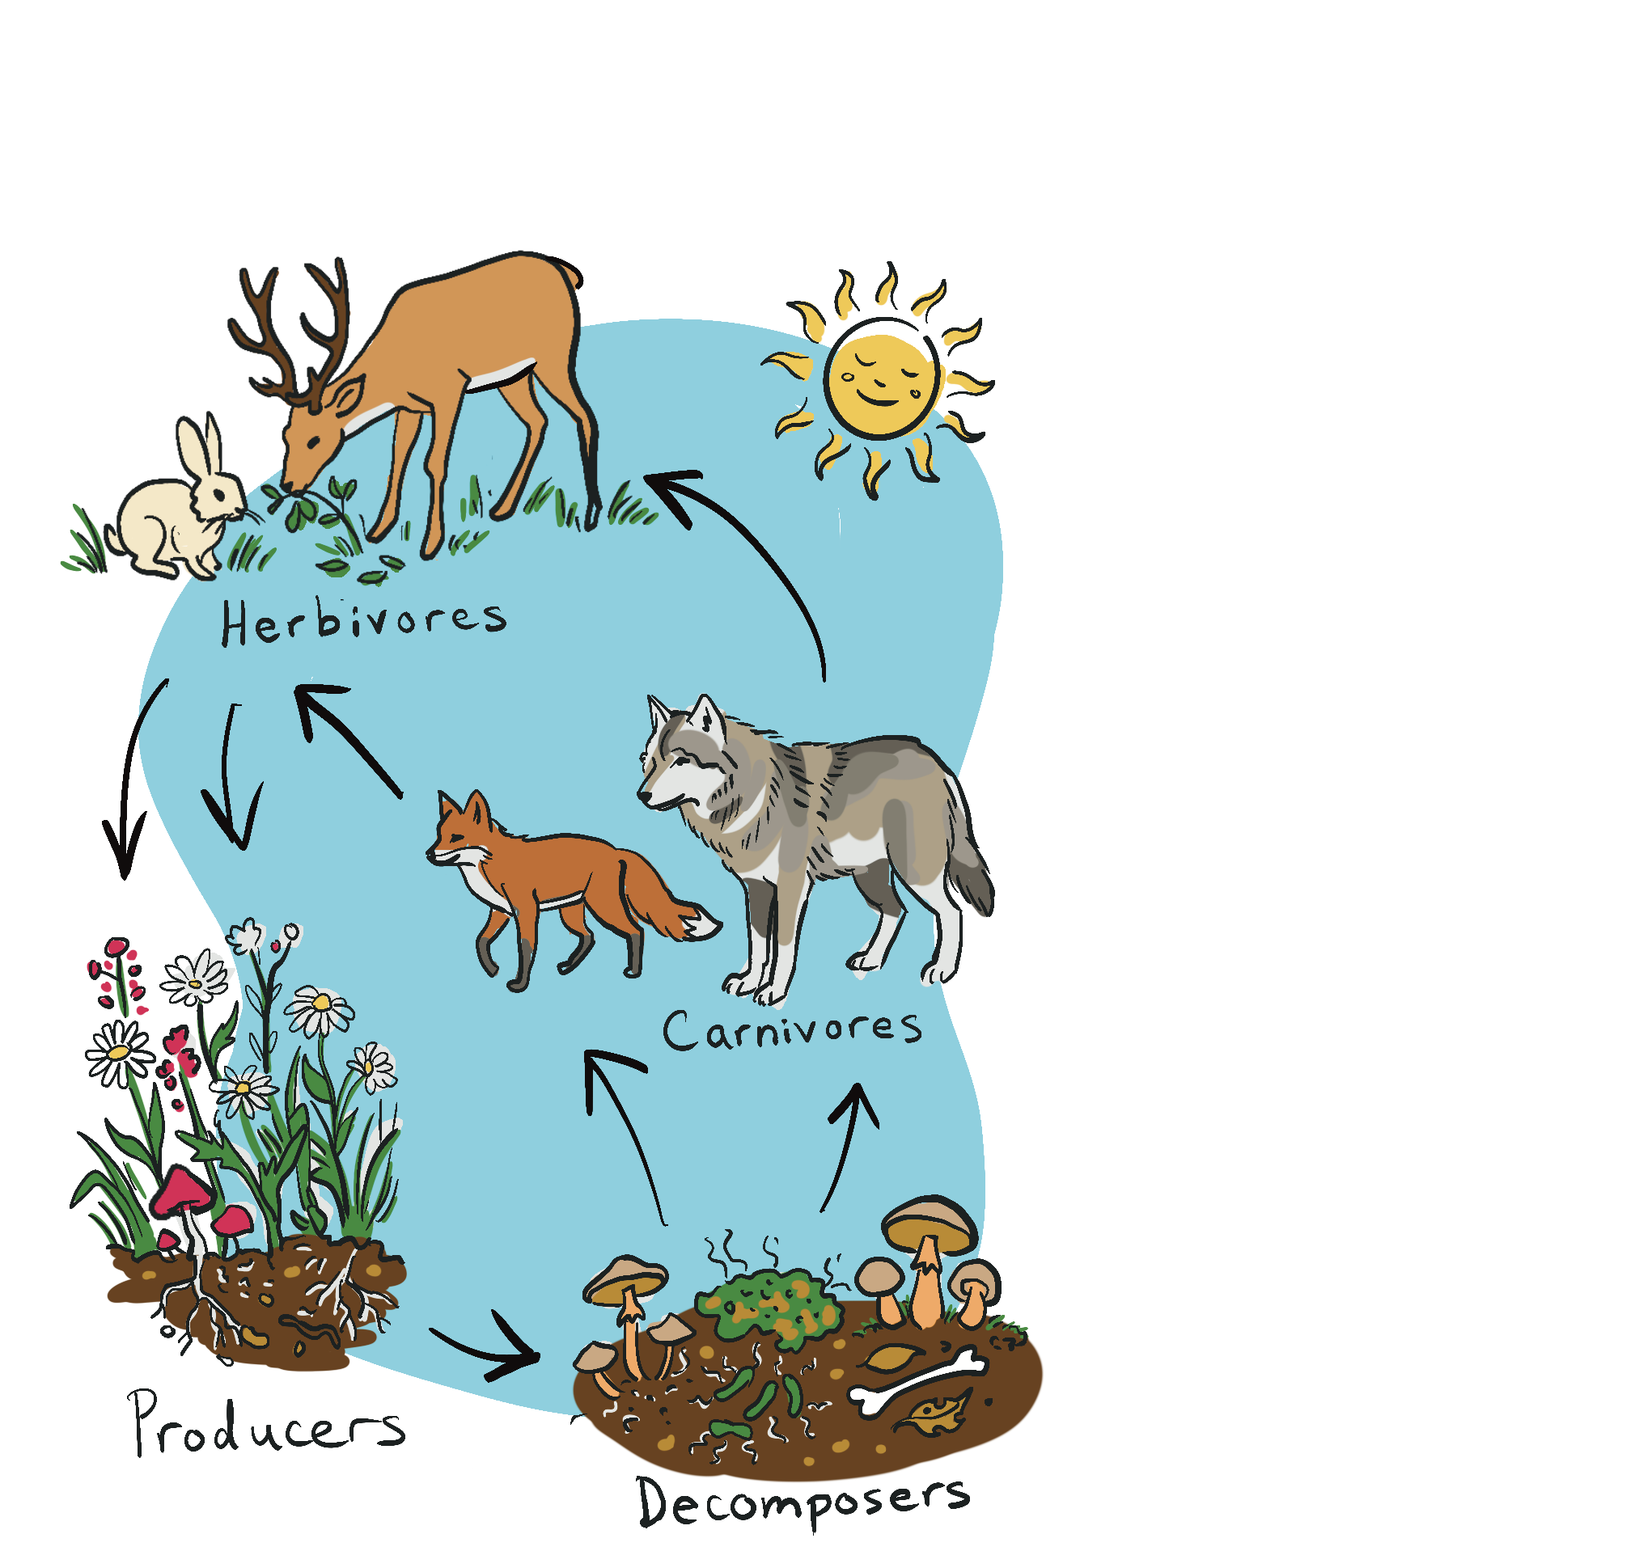
Who’s who in the food web
Mission activity instructions
Producers: Plants that use energy from the sun to make their own food (e.g., sugar), which other animals can then get energy from by eating the plant (e.g., grasses, trees, wildflowers).
Herbivores: Animals that eat only plants (e.g., rabbits, deer, prairie dogs).
Carnivores: Animals that eat only other animals (e.g., owls, sea otters, wolves).
Decomposers: Bacteria and fungi that break down dead organisms and return nutrients to the soil (e.g., mold, mushrooms and bacteria).
In this interactive food web game, students role play as producers, herbivores, carnivores, or decomposers — key parts of a food web. Through game play, they explore how organisms survive by finding food and avoiding predation. Students begin to see how these roles are interconnected within an ecosystem. Following the game, facilitate a post-game debrief to help students connect their role into a broader understanding of ecosystem connections.
Step 1 Tell the students that this mission is called “All species are connected” and that to complete this mission, everyone will need to be prepared to go outdoors.
Step 2 Before going outdoors, introduce the food web character types one at a time. Refer to Table 1 as you describe the goals and roles of each character. Be very clear on who the characters chase and who they need to avoid. Emphasize that the goal will be to collect as many life unit cards as possible to survive. You will hand out the life unit cards in Step 4.

Slide 4
Table 1 : Ecosystem characters and what they do in the game
Step 3 First take a walk with the class to clearly point out the boundaries of the game. Be very clear with the boundaries! If you are in a shared space when other people are out, it will be important that the boundary area is clearly defined. Also point out hazards (poles, garbage cans, playground equipment, edging around walkways, etc.). The students can get very invested in their role and become distracted by their surroundings. Therefore, try to find the most open and largest space within walking distance.
Step 4 Now that you have described the roles and outlined the area of play, you can hand out the colour coded life unit cards. Refer to Table 2 for guidelines on the number of different cards to make depending on the size of your group. Most ecosystems have many more producers than herbivores, more herbivores than carnivores, etc.
CHARACTER TYPE | GOAL IS TO… | CHASES... | COLLECTS… | CHASED BY...
PRODUCER (yellow construction paper cards or tape) | Survive! | No one | Nothing | Herbivores and decomposers
HERBIVORE (green construction paper cards or tape) | Catch producers, avoid carnivores and decomposers | Producers | As many producer cards as possible | Carnivores and decomposers
CARNIVORE (grey construction paper cards or tape) | Catch herbivores, avoid decomposers | Herbivores | As many producer and herbivore cards as possible | Decomposers
DECOMPOSER (brown construction paper cards or tape) | Tag dead organisms to recycle nutrients | Dead organisms only | As many cards from dead organisms as possible | No one

Slide 5

Table 2 : How many game cards/strips of tape should I make?
Teacher tip
CHARACTER TYPE | PERCENT OF TOTAL CARDS | GROUP OF 20, MAKE THIS # OF CARDS | GROUP OF 25, MAKE THIS # OF CARDS | GROUP OF 30 STUDENTS, MAKE THIS # OF CARDS
PRODUCER (yellow card) | 70 | 12 (+11 extra) = 23 | 16 (+10 extra) = 26 | 20 (+ 15 extra) = 35
HERBIVORE (green cards) | 20 | 4 (+3 extra) = 7 | 5 (+4 extra) = 9 | 6 (+ 5 extra) = 11
CARNIVORE (grey paper) | 5 | 2 (+1 extra) = 3 | 2 (+2 extra) = 4 | 2 (+ 2 extra) =4
DECOMPOSER (black) | 5 | 2 | 2 | 2
Each time a player is caught, they need to give up one card.
One other variation would be using small strips of tape.
Masking tape can be found in
a variety of colours, and each student could have strips of tape stuck to their arm for others to pull off. Experiment with what you have on hand and what your students can use appropriately.
NOTE: Why make extra cards? The first number refers to the cards given out to students before the game begins; the extra number refers to the extra cards you can distribute to “dead” students (those who have lost all of their cards).
Therefore, create the total number for each section.

Slide 6
Step 5
As the teacher, you will play the role of the sun and will be in the centre of the activity. Without the sun, there would be no life on earth. As the sun, you can decide on when to give students a few extra cards to the “dead” students who lose all their character
cards. The decomposers can tag those students who have lost all their cards and walk them to the compost pile (The compost pile is an “out of bounds” area of the
game near the sun). This is where
the “dead” students sit until you provide them with a few more cards.
You can also experiment with the ecosystem, and after each game concludes, talk to the students about what would happen if you added more decomposers? More carnivores? Time permitting, give the different scenarios a try.
Step 6
Tell the students approximately how long the game will last (Try 10-20 minutes depending on the age and maturity of the group). Explain and model the signal that you will use to end the game (e.g., whistle, small drum, waving a flag). You are now ready to begin! Important note: When starting the game,
give the producers a 10-second head start, followed by herbivores, carnivores and the decomposers.
Facilitation tip:
Allow a short “think time” before discussion begins. Invite a variety of participants to share their ideas.
Sample questions to promote discussion:
Thinking about the game:
How did you feel when you were playing the game? Which role in the game did you prefer playing, and why?
What did you do to avoid getting caught? Do animals and plants use similar strategies?
What strategies did you use to catch other students? Do animals and plants use these strategies?
If we added humans to the food chain, what rules would we add?
What would happen if we added disease?
What would happen if we added a natural disaster, such as a wildfire that burned up most of plants or a flood?
Discussion
After the game, collect the cards and return to the classroom, or stay outside if the weather is nice. The students may need a quick
water break before you have the discussion.
Please note: It is very important to have a discussion after having an interactive simulation game. This will help to consolidate their learning.
Adapted from “The Food Chain Game”, Canadian Parks and Wilderness Society - Southern Alberta (https://cpaws- southernalberta.org/education-program/food-chain-game/).

Slide 7
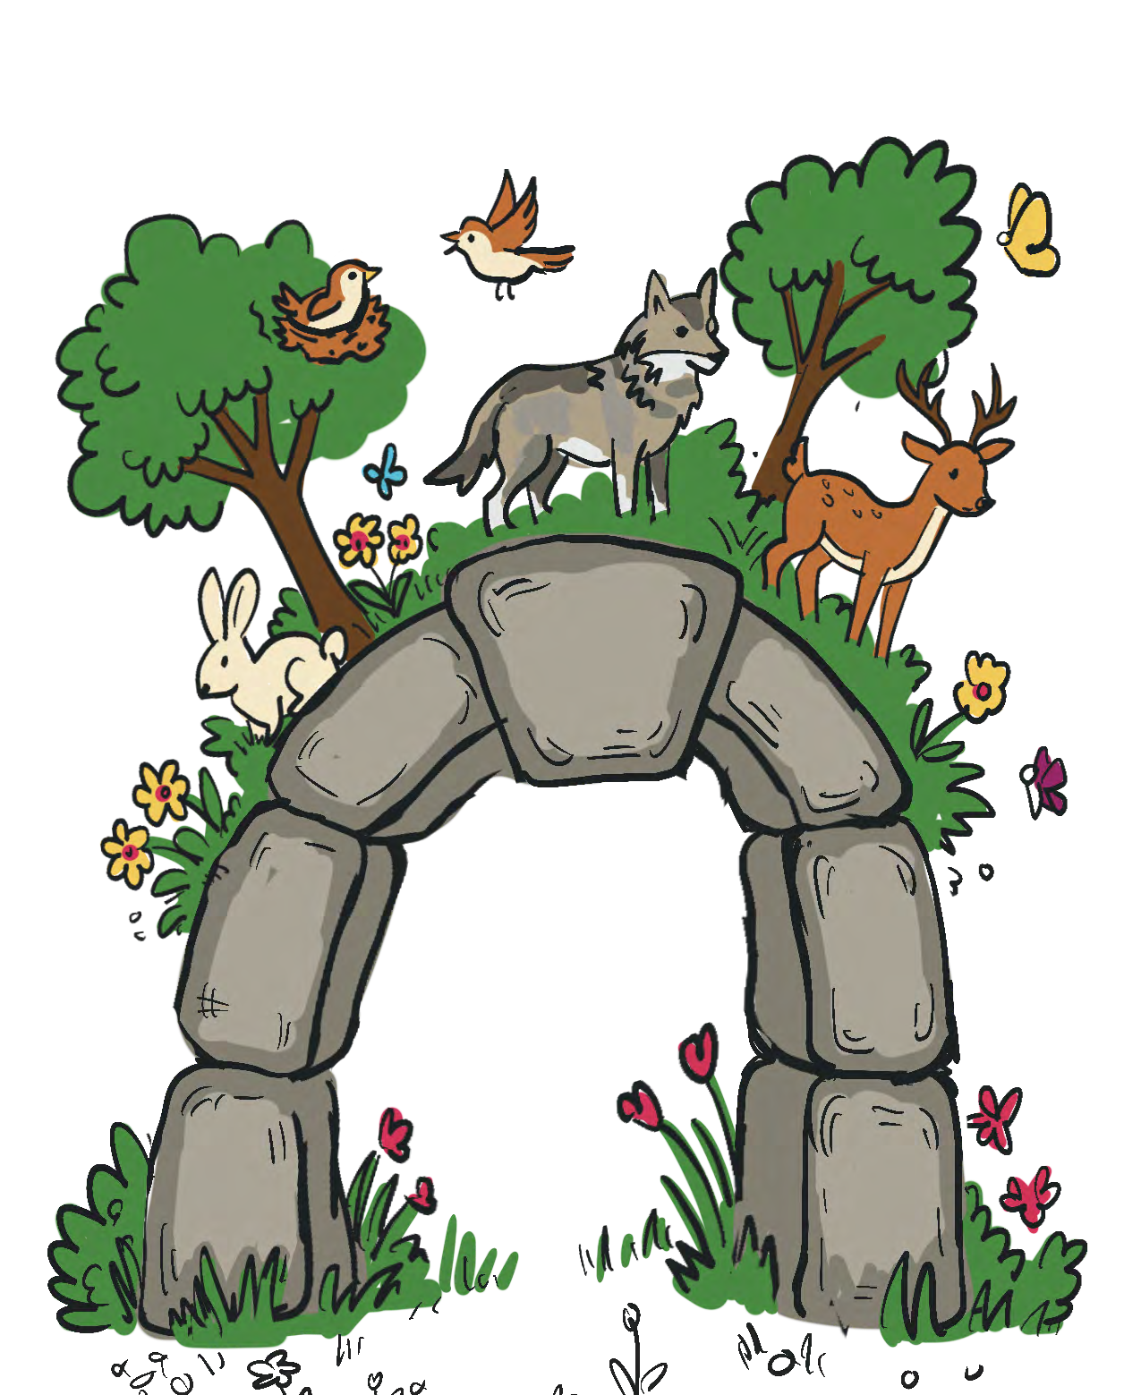
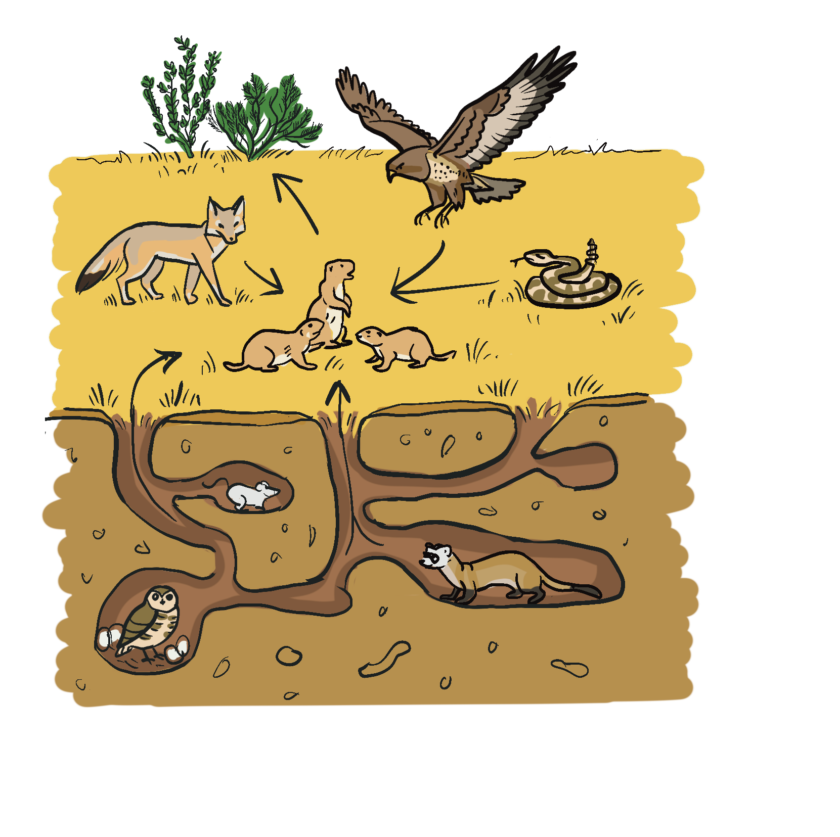
Extension activities:
Thinking about real world ecosystems:
THINK - What might happen to the balance of an ecosystem if a species — especially a keystone species — disappeared?
CONNECT - What might happen to other species in the ecosystem if that species disappeared?
CONCLUDE - What does this tell us about the importance of biodiversity in keeping ecosystems healthy?
EXTEND - Why is it important for people to protect species, even ones that may seem small or unimportant?
Life as a
Ask students to write about their experience. What do you think life is like being a herbivore,
carnivore, producer or decomposer? Is there one type of organism
(character type in this game) that you think has an easier time surviving?
Draw it out!
Ask students to research and draw a diagram of the food chain requirements for the species that they chose in Lesson 3.
Step 7 Students complete the exit ticket on the back of the Mission #4 card.

