Slide 1

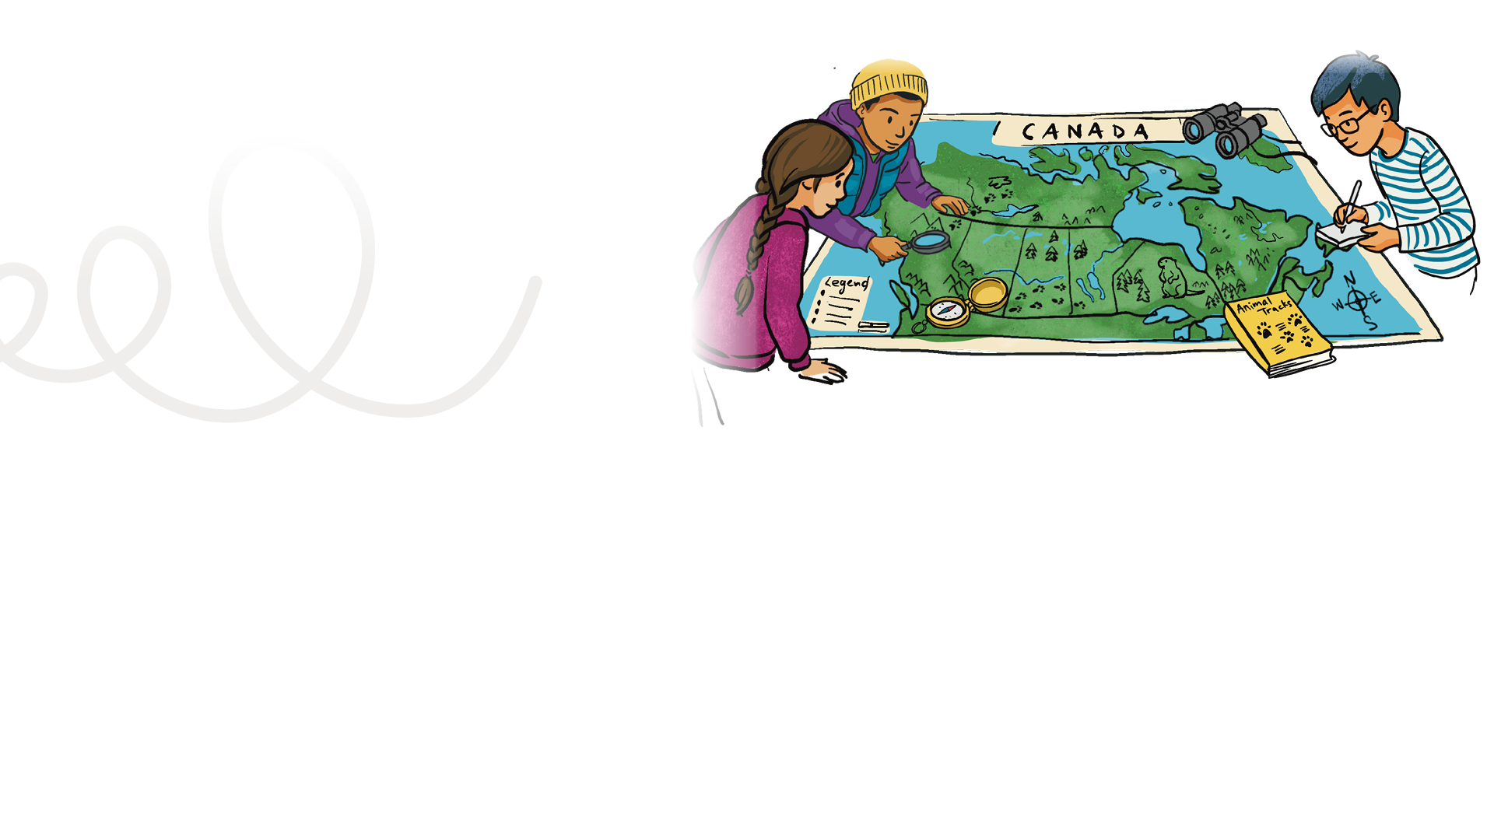


LESSON PLAN
Living Planet Report Canada for Kids
5
Grade levels: four to six
LENGTH OF LESSON:
Two class periods, e.g., social studies and science (approximately 90 minutes)
Main objective:
Students use species stories on WWF-Canada’s LPRC for Kids website (wwf.ca/lprckids) and visual mapping to explore biodiversity by identifying connections between species, habitats and ecosystems.
ASSESSMENT TOOLS:
Student: Map and back of Mission #5 card
Teacher: Inquiry Learning Assessment Rubric
Skills developed:
Students will learn about different regions, provinces, territories, communities, bodies of water, natural resources, mapping symbols and kinds of maps. They will develop skills such as locating places on a map, labelling and colouring maps, recognizing different types of maps, and determining the characteristics of a region and how it supports specific wildlife species in Canada.
MATERIALS REQUIRED:
Access to a variety of maps. Road maps, atlases, a large map of Canada, and a computer/set of computers with access to a printer. Provide the students with the largest pieces of paper you can — 11x17 inches (ledger size) if possible. They will also need pencils, erasers, markers, pencil crayons and thin line markers.
General learning outcomes:
Please see Appendix 1 for general outcomes that apply to your province/ territory.

Slide 2

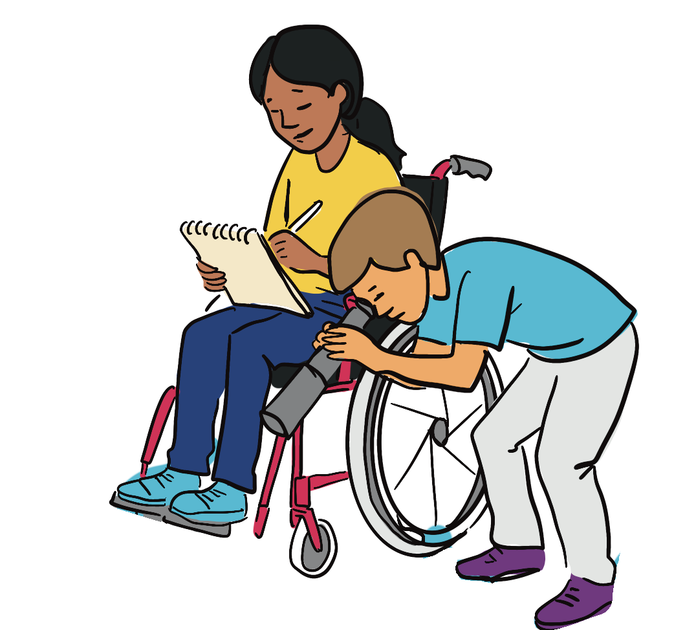
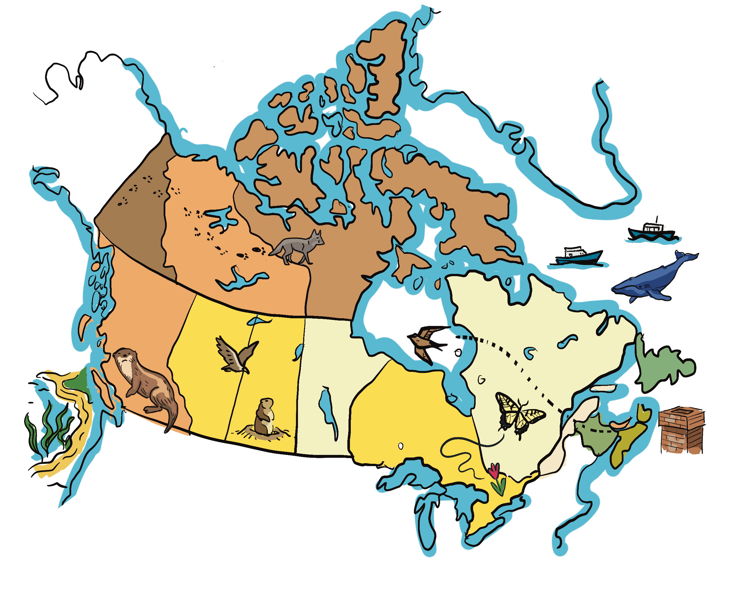
Background Information:
In previous lessons, the students have been learning about WWF-Canada’s LPRC 2025 report. They have listened to WWF-Canada scientist Jessica Currie explain why it’s important to study wildlife.
They have selected a species to research and they participated in a simulation of what it is like to be part of a food chain. Now, the students are going to learn how to map important information for their species, which will support their understanding of the interdependence of ecosystems.

Slide 3
Indigenous perspectives:
TEACHER NOTE
Read aloud this personal perspective by Jared Davis from the Living Planet Report Canada 2025. If you have a map of Canada in your classroom, take a moment to locate the area of the Blueberry River First Nations, approximately 80 km northwest of Fort St. John, B.C.
Follow-up questions
Observation and connection: What changes does Jared Davis describe in the moose and elk populations near his community?
Reflection and impact: How do these changes affect people’s lives, traditions and culture?
Critical thinking / future-oriented: Jared describes hunters and trappers noting where animals are seen as well as using wildlife cameras. Why is it helpful to record the locations of animals?
Jared Davis, Cultural Protection Manager, Blueberry River First Nation (Page 53 of LPRC 2025)
Jared Davis, a member of Blueberry River First Nation in northeastern B.C., is the Cultural Protection Manager with his community’s Lands Department.
After earning a degree in Native Studies from the University of Alberta, he realized “there is only so much you can learn from a book and how important it is to reconnect with community and be on the land.” He moved back after he graduated.
Working as a cultural protection manager, he gained an understanding of the land and hunting and fishing regulations while building familiarity with the area’s wildlife and habitat.
Jared: I talked to my Elders and my dad, and they said the moose and elk populations definitely declined from when they were younger.
Before, you could walk out into trails nearby and you would find large bull moose and elk. They would be everywhere, and they would be much healthier than they are now.
Now, they are maintaining their populations but they are not growing, they are not thriving. The cumulative effects of more roads and development not only cause roadkill, but have changed their habitat and calving grounds, which affects their populations and how healthy they are.
…
Through the subsidy program, we make sure that our trappers and hunters are reporting any wildlife — taking pictures and detailing where they see it. They also note which roads are being used and what areas they’re in. We also have multiple wildlife camera projects underway to help us understand what animals are out there, and how many.

Slide 4

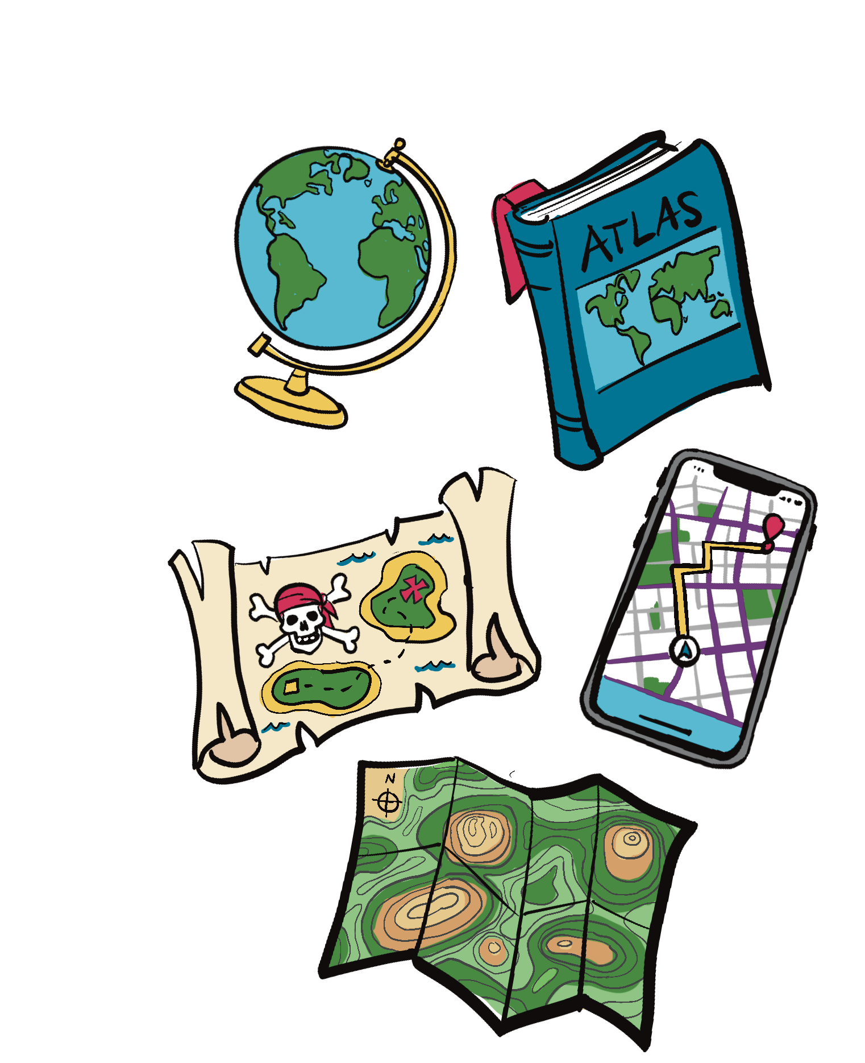
Lead the class in a general discussion about maps. Do a “Think, Pair, Share.” Ask the students about the last time they used a map, such as Google Maps or a vehicle-based GPS system. Have them “think” about what they know about maps, “pair” up with another classmate (or two, depending on group size) and then each little group does a quick “share” with the class. You can keep track of the ideas on a white board or large
piece of chart paper (this is preferable so the class can refer to it later).
Mission activity instructions
Step 1 Start by asking “How do you think scientists use maps to understand and protect animals and ecosystems?”
Share with students that WWF-Canada scientists create maps to communicate important information. For example, they map:
places in Canada where restoring converted landscapes could make the biggest positive impact on biodiversity and climate
(https://wwf.ca/restoration-analysis/)
carbon stored in Canada’s ecosystems (https://wwf.ca/carbonmap/)
You can explore many more examples with WWF-Canada’s Living Planet Data Hub (https://datahub.wwf.ca/).
Teacher tip
The teacher’s introduction should include a large map of Canada. Or a projection screen of a map of Canada connected to a computer. Make a connection with the LPRC for Kids website (wwf.ca/lprckids) and mapping by highlighting how WWF-Canada scientists make maps to communicate important information.

Slide 5
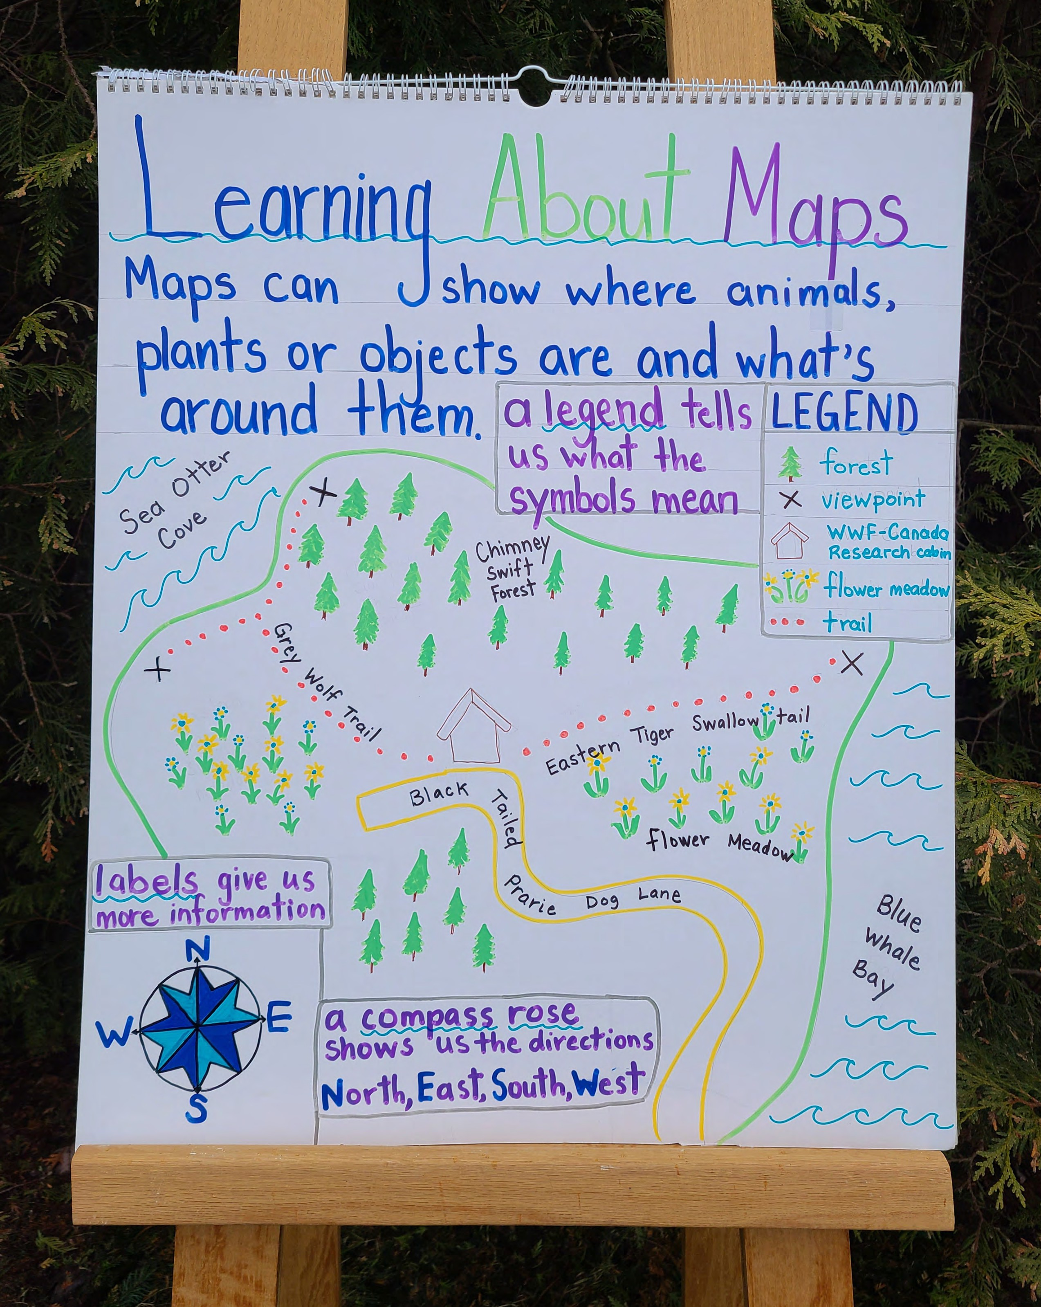
Step 2 Based on what the class knows, you can develop a “Know, Wonder, Learn” chart. After listing all that the class “knows” in the knowledge section of the chart, ask the students if they “wonder” anything about maps. Give them time to think. Be prepared to prompt if necessary. Once you have recorded their thoughts and wonders, it’s time for the “learning” part of this activity!
Step 3 Depending on the class’s level of knowledge about maps, you may wish to create an anchor chart about maps. Please see Figure 1 for an example. If necessary, develop the anchor chart together, before you ask the students to create their own maps. This may require a full class period.
Step 4 Provide the students with paper and drawing and colouring supplies. The students must refer to their completed LPRC for Kids Wildlife Investigation worksheet from Lesson 3. They will need to refer to the section about the range where their species can be found in Canada. Today, they are going to do their best to create maps of the range for their species. In this case, they can be grouped according to their species: grey wolf, chimney swift, sea otter, black-tailed prairie dog, blue whale and eastern tiger swallowtail. Tell the class that today, they are going to be researchers and cartographers (map makers).
TEACHER NOTE: To show the species featured on the LPRC for Kids site, you can use a large map of Canada for an overall view. Alternatively,
a smaller-scale map of your community, region, province or territory can be used to focus on species that live locally.
Figure 1. Anchor chart example

Slide 6
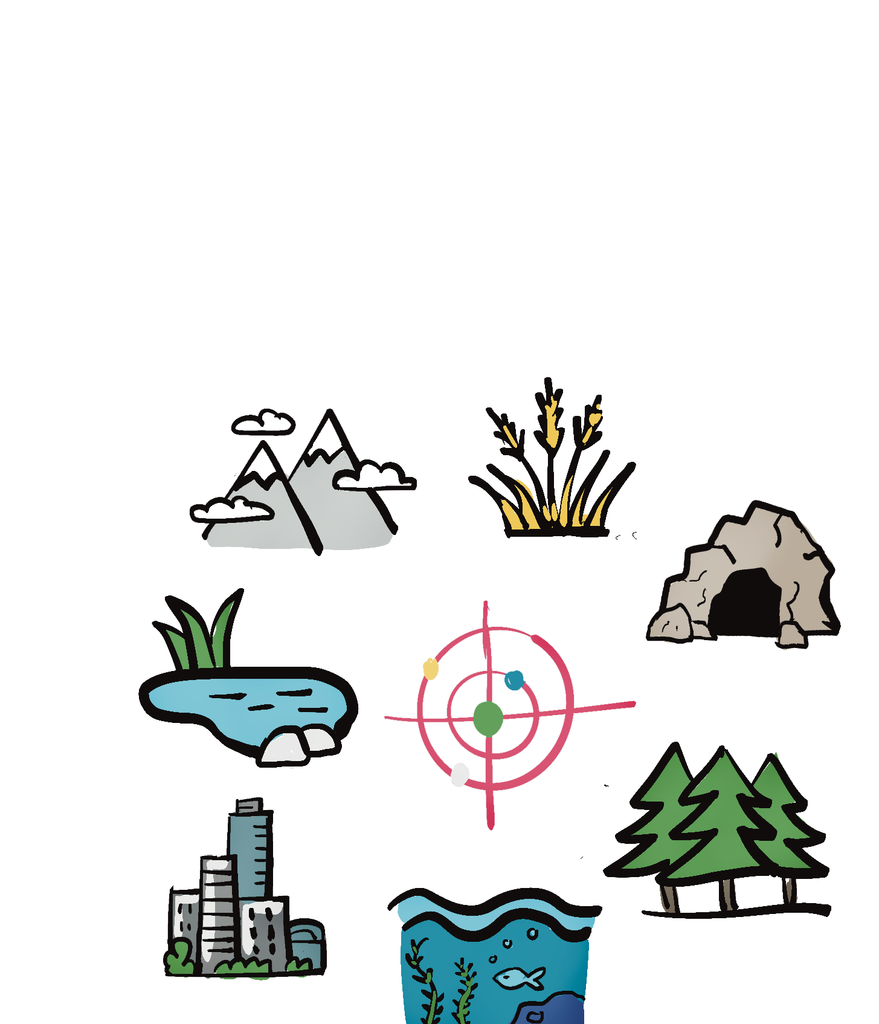
Teacher tip
The size of each group (four to six students per species group) and the supplies available will determine the type of maps that will be created. If students can work on the map co-operatively, then they can be given the tasks below and add to the main map. If these students are happier working on their own, they can do a separate map for their specific task, creating a map “collage” of their work. In each species group, assign different students with the task of highlighting different information on the map.
Habitat type: The habitat could include grasslands, rocky areas (caves and mountains), cities, forests, marine and coastal habitats and freshwater. Research the species’ habitat and colour it in.
Threats (What is causing this species harm?): Students can refer to the species stories section of WWF-Canada’s LPRC for Kids website (wwf.ca/lprckids) for information about threats to their species.
Students may illustrate specific threats and attach them to their map. For example, a blue whale map
could include ships (e.g., tanker ships, container ships, cruise ships) placed around the edges.
Some elements of the map can be based on research (e.g., the species’ general distribution or range), while others may be more approximate or imagined (e.g., where specific threats are located). This also helps prepare students for the optional
extension activity, Wildlife Movement Explanation, where they will imagine how animals move through their habitat.
NOTE: Students will revisit these or similar threats in the next lesson as they explore how citizen science
projects help scientists monitor and protect wildlife.
Range: The range map requires knowledge of the area where the species can be found. The wolf group will need to make a map of Canada, the black-tailed prairie dog group will make a more focused map of the southern Prairies, etc.
Please note: Because the wolf has a much wider range than most of the other species, the wolf group might need a few more cartographers.

Slide 7

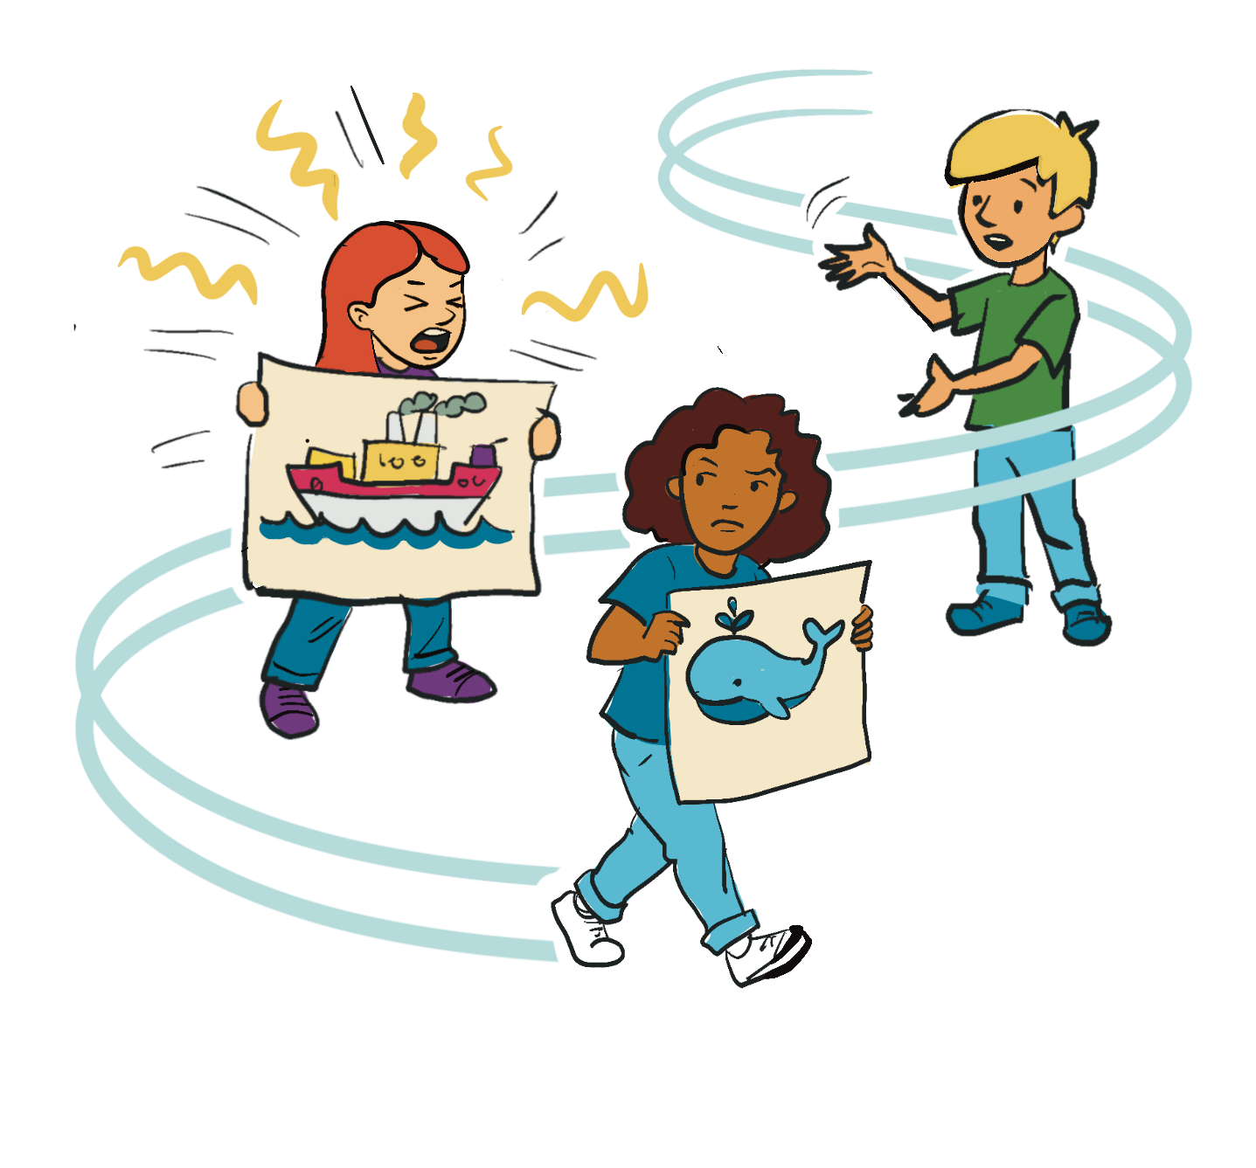
Step 5 Peer group map review (instead of group presentations to the class)
Student groups exchange maps with another group. Each group reviews the other map and checks for the following:
Clear title
Accurate legend
Compass rose (bonus point for North being in the correct position!)
Clearly labelled habitat features
Threats identified for the species
Each peer group review provides on Post It notes (for teacher assessment):
One positive comment about the map design or information
One suggestion that could improve clarity or detail
Extension activities
Wildlife movement explanation
Students write a short paragraph explaining how their species might move through the habitat shown on their map. They should identify where the animal could find food, shelter and safe travel routes.
Movement based alternate: Students may perform a short skit to demonstrate this concept. One student narrates the paragraph while the others act out the movement and behaviour of the species within its htabitat. As they describe or act out their species’ movement, students can highlight any “safe routes” or corridors their animal would use to travel between key habitat areas.
School wide extension
Make a display of their maps and supporting designs on a hallway bulletin board so the entire school can see their hard work.
Teacher prompt for students using the skit option
As you act out your species, think about where it needs to go to find food, water or shelter, and show how it moves safely through its habitat. You can use open spaces, “forest corridors,” rivers, or other features on your map to demonstrate safe travel paths.
Step 6 Students provide their maps for assessment and complete exit ticket on the back of the Mission #5 card.

