Slide 1

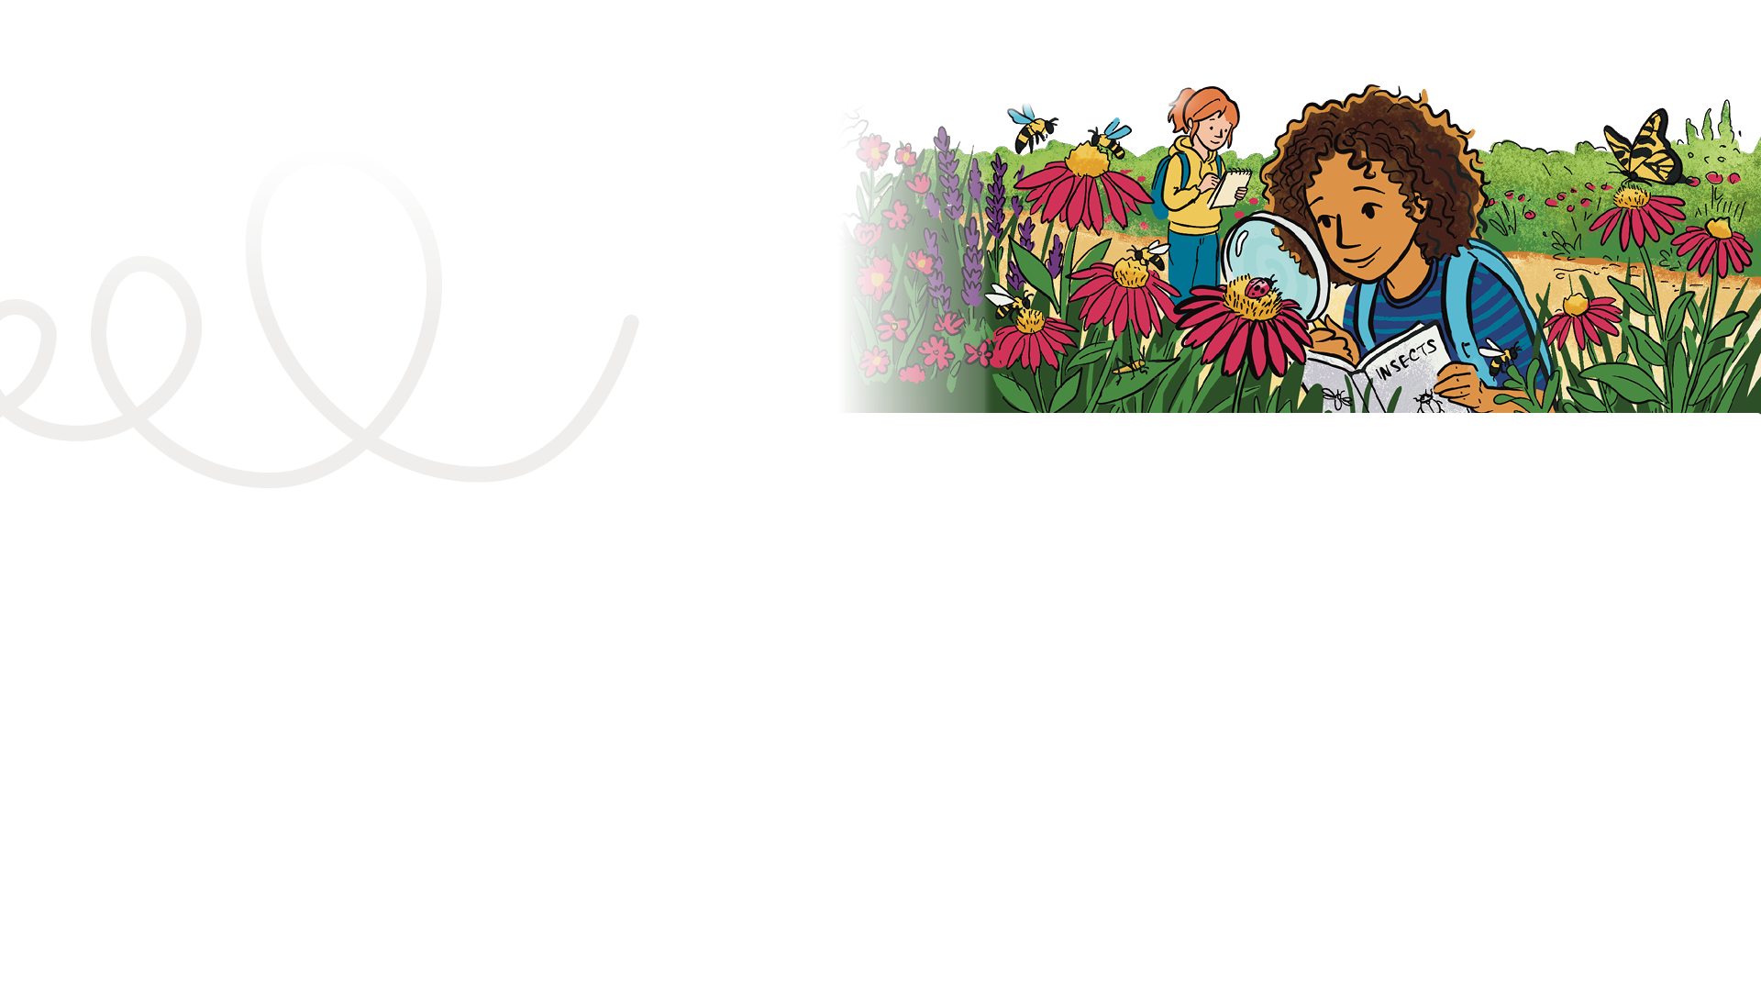


LESSON PLAN
Living Planet Report Canada for Kids
6
Grade levels: four to six
LENGTH OF LESSON
Main objective
This will vary depending on the monitoring project that is selected.
This lesson introduces students to wildlife monitoring (observation and data collection) and turning evidence into action! Students step into the role of scientists by exploring how wildlife observations and data collection lead to evidence-based actions that help protect species and ecosystems.
Skills developed:
Wildlife monitoring, observation, data collection
ASSESSMENT TOOLS:
Student: Self Assessment Rubric and back of Mission # 6 card Teacher: Inquiry Learning
Assessment Rubric
Background information:
In this lesson, students step into the role of scientists by exploring how wildlife observations and data collection lead to evidence-based actions that help protect species and ecosystems. This lesson is going to be unique to each student or group. It will depend on where they live in Canada because that will inform what they can do to contribute to monitoring or community science projects in their communities.
Materials Required:
This will vary depending on the monitoring project that is selected.
General learning outcomes:
Please see Appendix 1 for general outcome that apply to your province/territory

Slide 2
Indigenous perspectives:
TEACHER NOTE
Read aloud this personal perspective by Kianna Bear-Hetherington, Water Guardian, from the Living Planet Report Canada 2025. If you have a map of Canada in your classroom, take a moment to locate Fredericton, New Brunswick.
Follow-up questions
Observation and connection: What does Kianna say about why collecting data is important for protecting land and wildlife?
Reflection and impact: How can data help communities make decisions and protect what matters to them?
Critical thinking / future-oriented: How could using both scientific data and traditional knowledge lead to better decisions in the future?
Kianna Bear-Hetherington, Water Guardian, Wolastoqey Nation (Page 24 of LPRC 2025)
Kianna Bear-Hetherington is a proud Wolastoqey woman from Sitansisk, also known as St. Mary’s First Nation, in Fredericton, NB. She grew up swimming and fishing in the lakes and rivers of her community and has always had a deep connection to the land and waters.
Listening to Elders and Knowledge Holders taught her a lot about the sacred relationship with the land and water, such as not to separate ourselves from nature — a teaching that eventually led her to work on fisheries in her community. Through her work with Wolastoqey Nation New Brunswick — the technical advisory body for the six Wolastoqey communities in the province — she has been able to deepen her understanding of her own identity.
Kianna: Wildlife monitoring and data collection are central to everything that we do. The more information we have, the better equipped we are to protect the land and wildlife. It guides our decisions and ensures we’re taking the right actions to protect our territory.
This data also gives us the ability to advocate for stronger protections and to push for policies that align with our values. The data is a tool we used to make sure that our voice is heard, and that our traditional knowledge is being respected alongside that scientific data as well.

Slide 3

Mission activity instructions
Step 1 This mission starts with talking about what students have learned so far about wildlife in Canada. Referring to the maps they made in Lesson 5, do a quick “gallery walk” of the maps.
Step 2 Lead a discussion. What do they notice about the maps for these six species? You may need to prompt, but they should notice that there are threats in all areas. Areas where there are more people (southern part of Canada) tend to have more threats than areas which are less populated. Threats can include habitat loss, pollution, climate change and human activity.
Can each group (representing one species from the LPRC for Kids website) make one suggestion for something that humans can do to help their species?
Examples:
Grey wolf: Protecting and restoring habitats like forests across Canada helps a wide variety of species, including grey wolves.
Chimney swift: Protect their habitat. Encourage people to leave old snags standing on private property, in parks and conservations areas, and speak up to
preserve chimneys that swifts use instead of tearing them down.
Sea otters: Protect their coastal habitats by cleaning up shorelines or speaking up for measures to reduce pollution.
Blue whales: Learn about the impacts of underwater noise on whales and ask the government to do more about it. (More information at: https://wwf.ca/ underwaternoise/)
Black-tailed prairie dog: Habitat loss has been a major issue. Protecting and restoring prairie ecosystems will help support black-tailed prairie dogs.
Eastern tiger swallowtail: Anyone, including school communities and families, can create habitat for this pollinator by growing the native plants it needs to survive. (More information at: https://schools.wwf.ca/events/plant-for-wildlife/)
Step 3 Tell the class that they have done such an outstanding job with all the missions so far, that they are ready for a really important mission. In today’s mission, the class will find a project that will help wildlife in their school yard and wider community.
Depending on where you live, you might be able to do a project to help one of the species that the students have been
studying. However, the class can choose any local project. A key question for students
is, “If scientists can’t be everywhere,
how can they learn what’s happening to wildlife?” There is a solution. We know that monitoring wildlife is too big a job for just a few people, but if there are many people helping, it adds up to a big difference for wildlife. That solution has a few different names — it is often called “citizen science,” or sometimes “community science” or “participatory science.” These are science projects that anybody can contribute to.

Slide 4
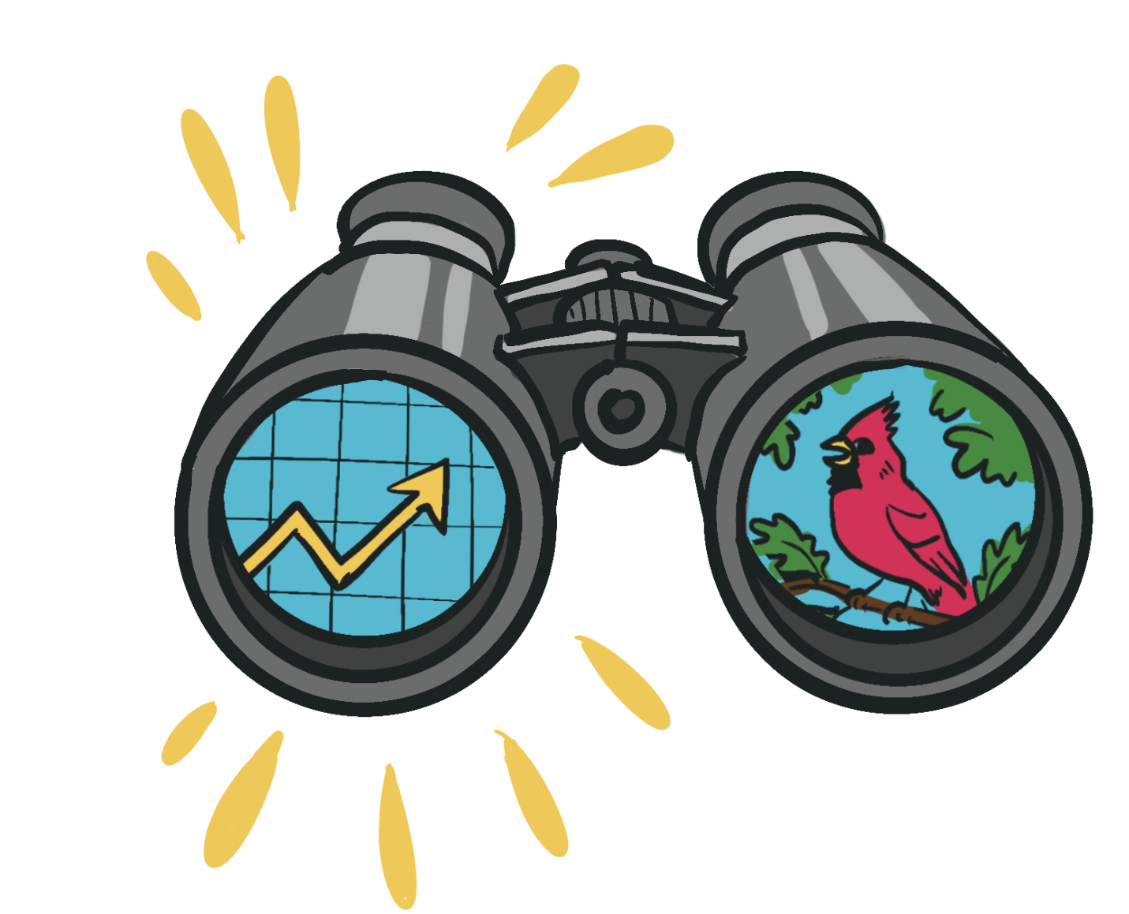
Introduction
Explain what citizen science is:
“Nature needs our help. We need thousands of eyes on nature across Canada to understand what’s happening. Today, you’re going to become those eyes.”
Show a short video, story or local example of a citizen science project. This could be from your school or local nature group, or a broader citizen science platform of your choice.
Emphasize why their observations matter: “Your data helps com-munities, scientists, organizations like WWF-Canada and everyone to better understand nature across Canada! Remember, this is the same kind of work scientist Jessica Currie talked about in Lesson 2.”
Choose a wildlife observation or data collection project
Pick a project that is fun, safe, and age-appropriate. Some favorites:
Pollinator tracking: bees, butterflies, and other insects
Water quality or pond studies: test water clarity, temperature, or invertebrates
Tree or plant monitoring: track seasonal changes (phenology)
WWF-Canada and teachers: Working together to help nature
Are you an educator interested in discovering more ways
to participate in wildlife monitoring with your class or group? Please visit
wwf.ca/monitoring-info to
receive information on future
opportunities to submit your observations and contribute to research with WWF-Canada.
Teacher tip:
Choose small projects that require minimal tools and can be done in your schoolyard or nearby park. Keep it hands-on, visual and interactive. Students love to see their observations come to life!
There are a lot of different options, and you will need to do a small amount of research to see what is already happening in your community. Places to start your research include environmental organizations and conservation authorities. Although websites can change, a simple search of “citizen science projects across Canada” or “community science projects” should provide you with up-to-date project ideas.

Slide 5
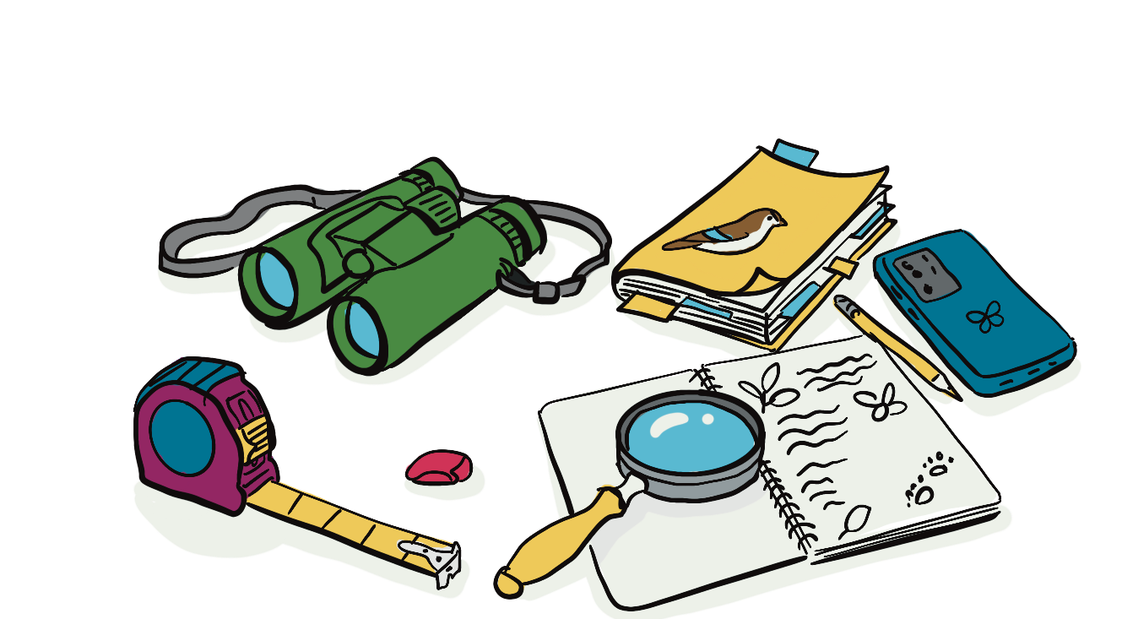
Teacher tip
If you’re not sure where to start with identifying species, check out iNaturalist.org. This website and
mobile app allows you to upload your photos of any species in nature. These observations are then shared with
the iNaturalist community, including
experts. If you’re not sure which species is in your photos, you can crowdsource the identification. You don’t need to be an expert yourself to participate, and it’s a fantastic way to learn as you go.
Step 4
After practicing with data collection, the class or group begins the project! Depending on the project selected, there may be more steps involved. You may need to dedicate a time block once per week, month or season to keep the momentum going on this activity.
Collect and submit data
Work in small groups to make it manageable. Designate one student to be the data recorder, another uses the technology with the identification app, another uses the binoculars, etc. Explain that each time you go out to work on the project, the group roles will switch. That way, everyone will get their turn doing a different role.
Keep sessions short (15–30 minutes) and structured.
Ensure students know how to submit their observations (website, app or classroom log).
Train students in data collection
Demonstrate how to observe and record:
  What to look for
  How to fill out worksheets
  How to use apps like iNaturalist or Seek app for identification
  How to safely take photos if needed
Practice in the classroom or schoolyard before submitting real data.
Practice will allow your students to learn what tools they will need to make the observations required for the project. Will they need magnifying glasses or binoculars? Field guides or devices with apps for identification? Try to have one set of data collection tools per group. For example: one set of binoculars, measuring tape and magnifying glass. If possible, have a community member who works or volunteers in this field lead a practice session.

Slide 6
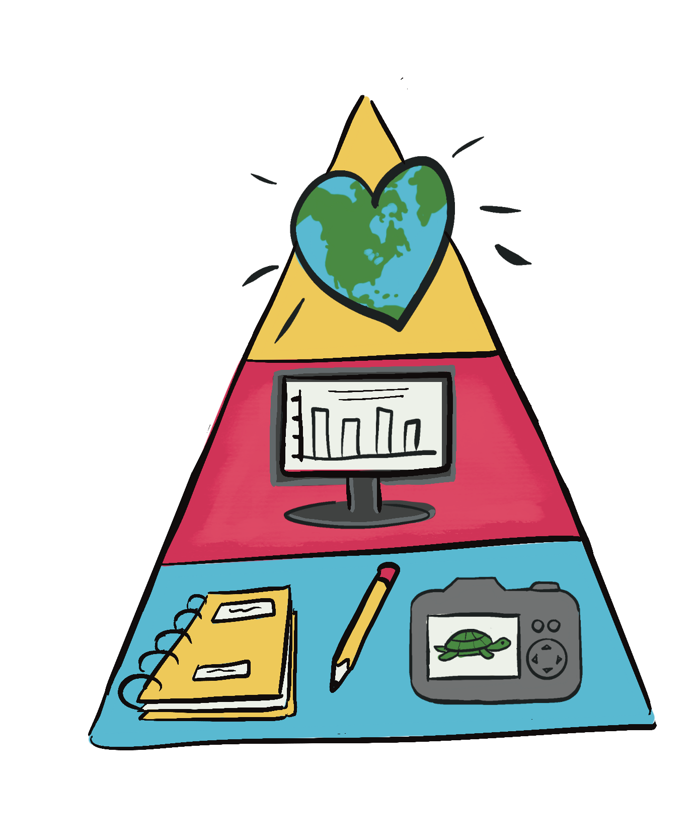
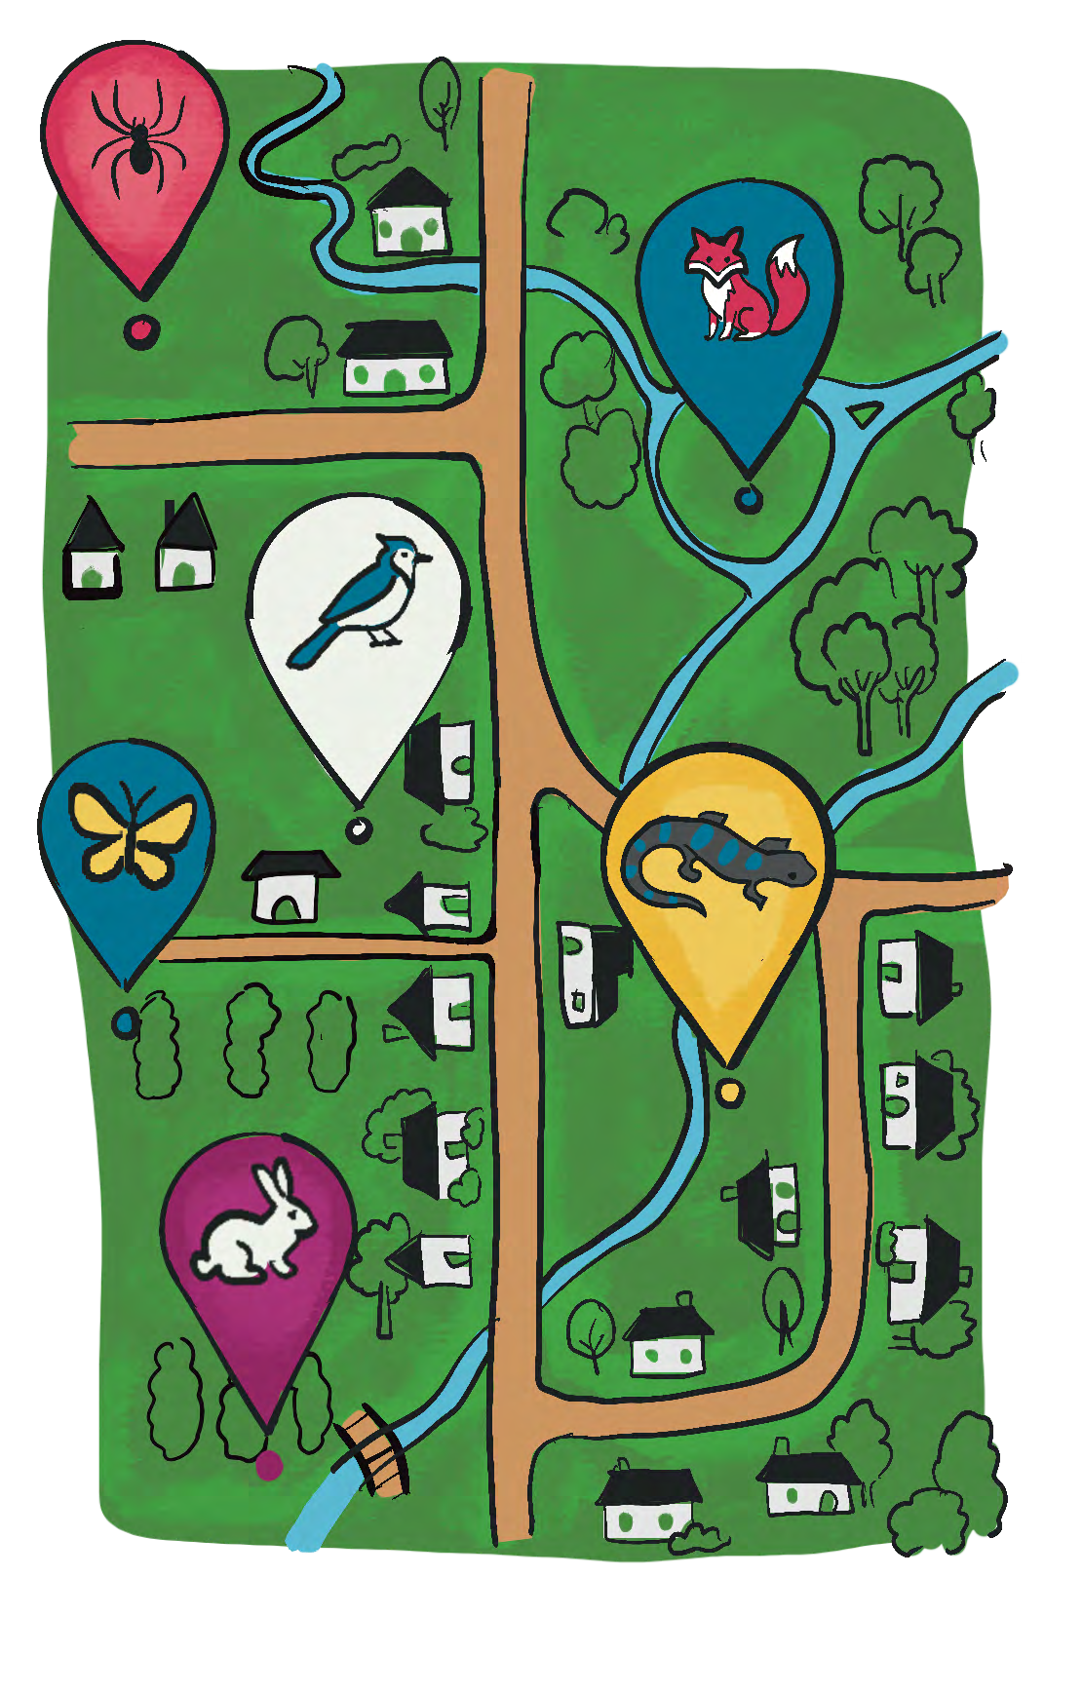
Step 5 Reflect and share
Review the data recorded.
Discuss:
  What did they find?
  Any surprises or patterns? See Extension activity 1 for a deeper dive!
Explain how collecting observations — following the project’s instructions — is similar to how scientists gather data about wildlife. Their contributions could become part of larger datasets that help inform reports or scientific studies. This real data is important and they should be proud of their contributions! Show how their data contributes to the bigger picture: adding observation points on maps, improving data quality in graphs and increasing personal enjoyment of nature.
Step 6 Celebrate participation
Highlight the students' real impact on science to build excitement.
Create a class display board or certificates of contribution.
Share the details of this class project with other classes in the school. See extension activity 2 for more information.
Step 7 Students complete their self assessment rubric and exit ticket on the back of the Mission #6 card.

Slide 7

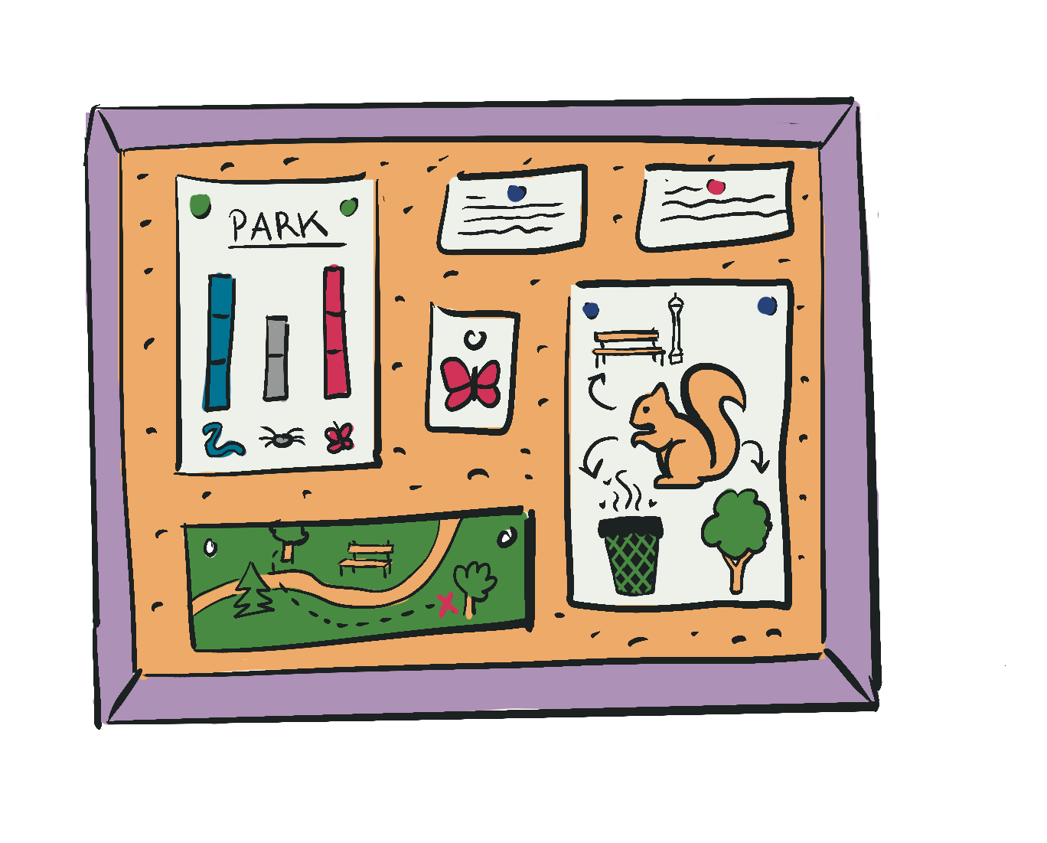
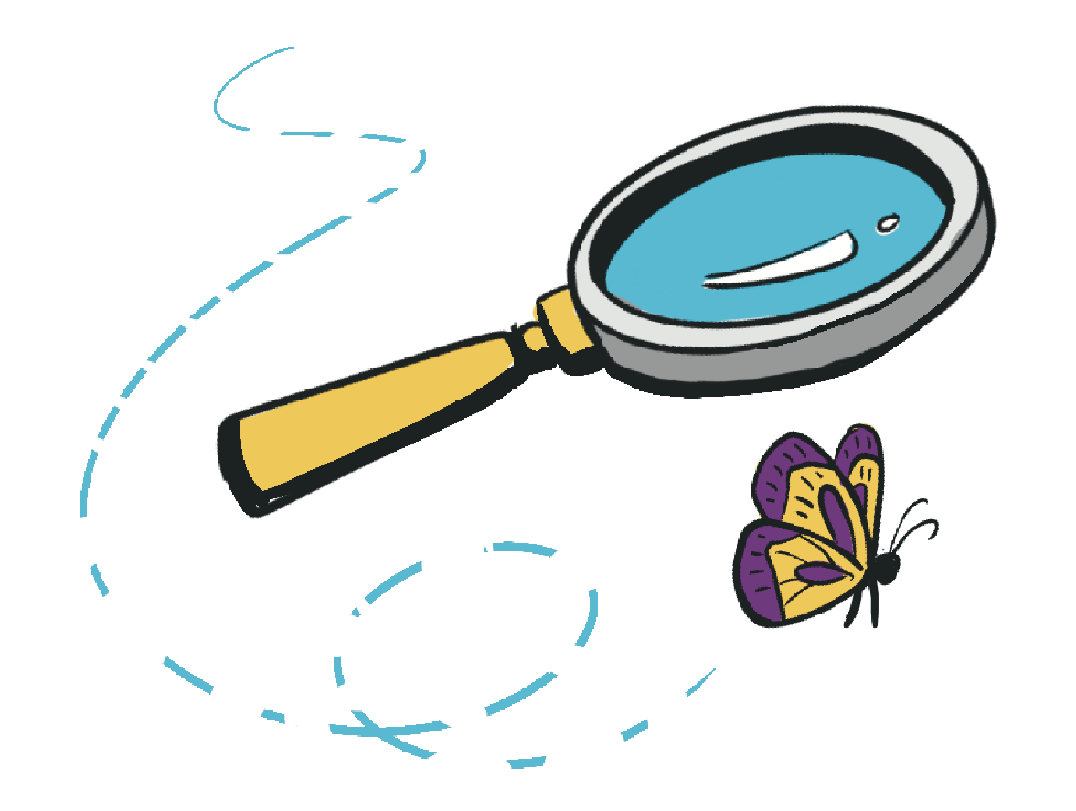
Extension activities
Share your adventure
Students communicate their findings to an authentic audience.
Instructions:
  Students create a short product to share what they learned from their monitoring project.
  This could include:
    a mini poster
    a short presentation
    a class bulletin board display
    a digital slide
Students should include:
    the species or wildlife they observed
    where observations took place
    why citizen science helps researchers
Optional authentic audience:
Students can share their work with another class, families or the school community.
Purpose:
Students practice communicating science, an important part of real scientific work.
Wildlife data detectives
Students analyze the observations they collected and look for patterns.
Instructions:
  Students review the data they submitted to their project.
  As a class, create a simple chart or tally showing what was observed (species, location, date, etc.).
  Students discuss what patterns they notice.
Discussion prompts:
  Which species did we observe most often?
  Were some animals seen in similar places over time?
  What might our observations tell scientists about wildlife in our area?
Purpose:
Students see how their observations become real data that scientists can study.

