Slide 1
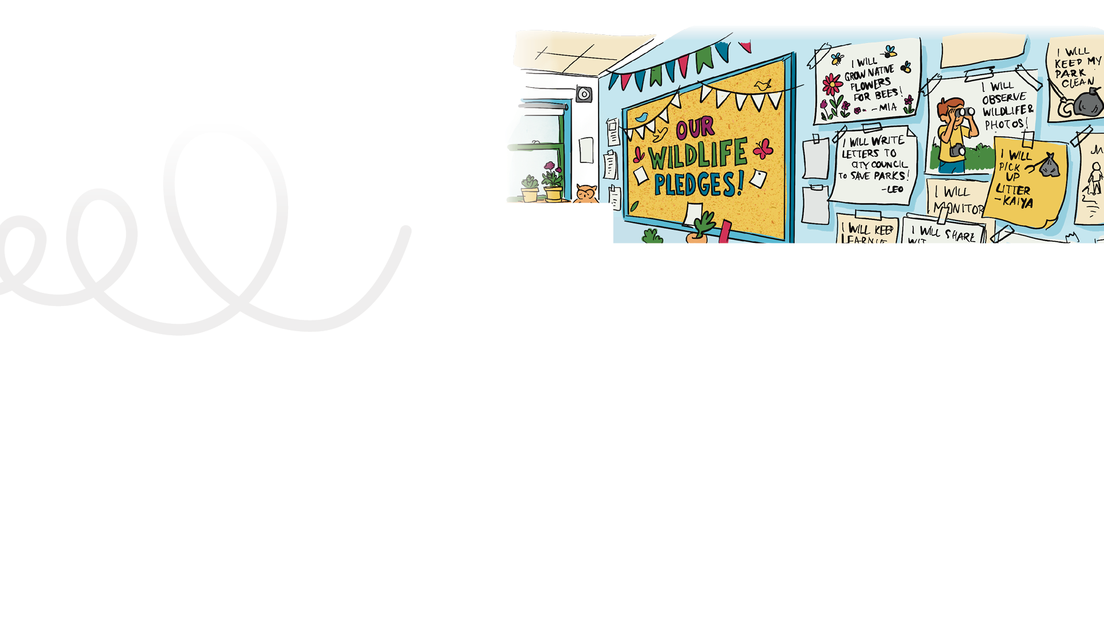
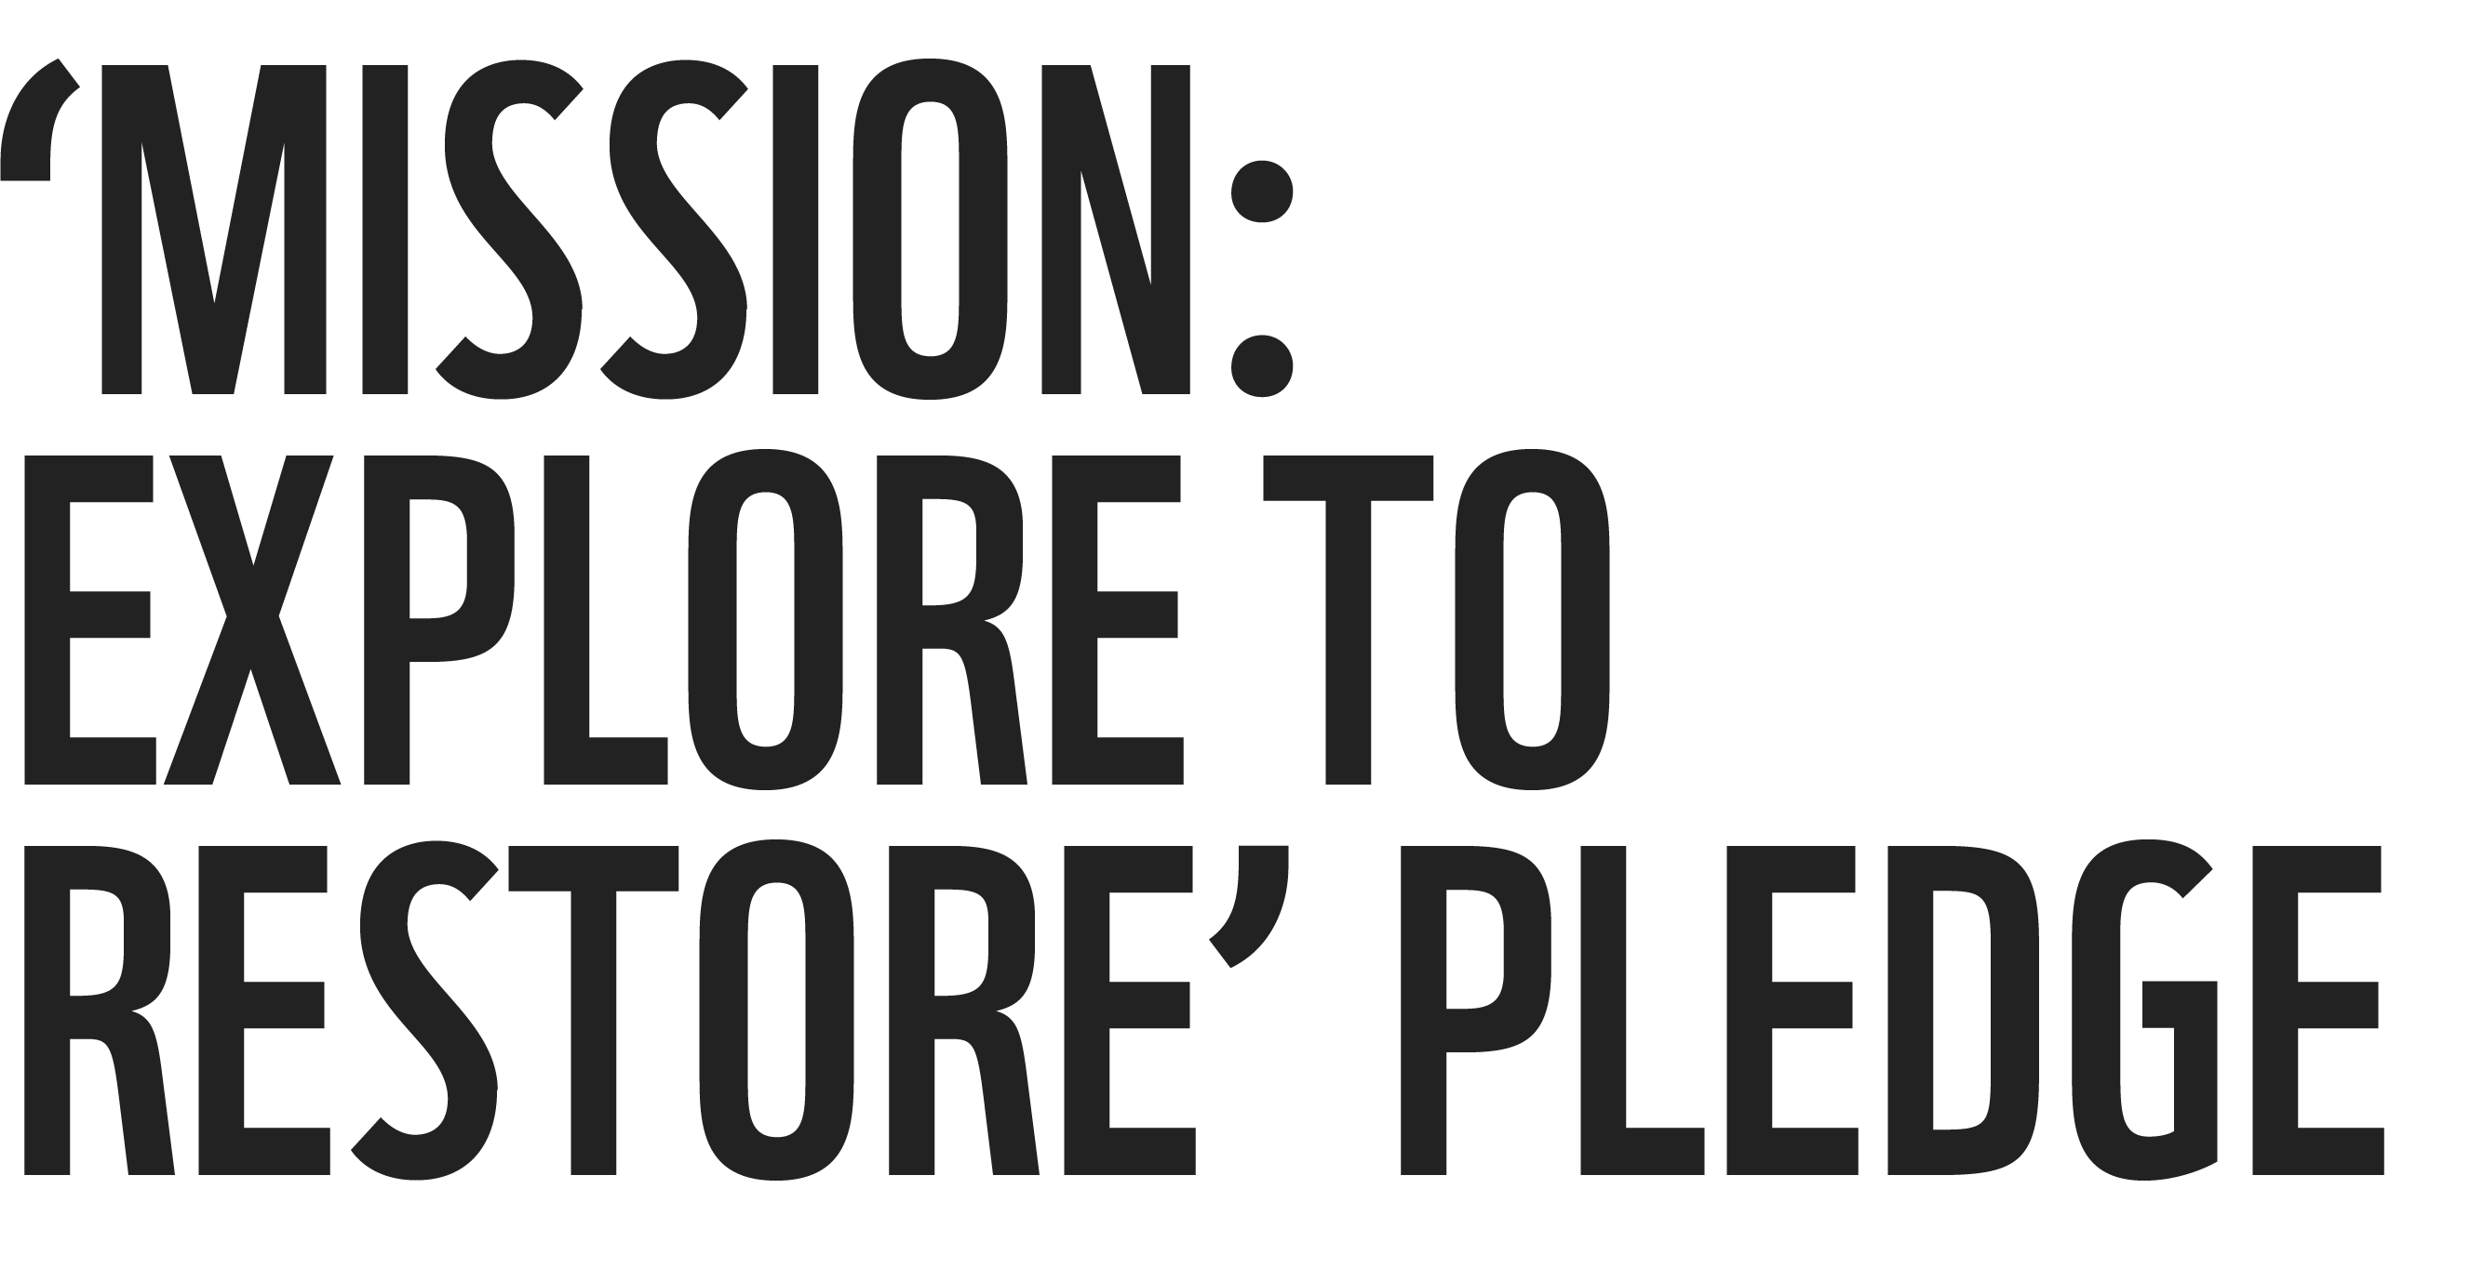
LESSON PLAN
Living Planet Report Canada for Kids
7
Grade levels: four to six
Skills developed:
Communication, co-operation, social skills, responsible citizenship, public speaking, critical thinking
Background information:
Building on the data collection that you introduced in Lesson 6, this activity invites your class to explore the “How you can help” section of the LPRC for Kids website (wwf.ca/lprckids) and choose an action to support wildlife and ecosystems. Students will create a class pledge for the action and promote it through the school, home and wider community. Students can act as ambassadors of the activity that they have chosen and present to other classes in their school.
LENGTH OF LESSON:
One or two language arts time blocks (40-90 minutes)
Main objective:
Students identify realistic actions they can take for wildlife and make a personal or collective pledge, reinforcing the idea that small actions add up when we work together.
ASSESSMENT TOOLS:
Student: Back of Mission #7 card
Teacher: Quick Assessment Rubric
MATERIALS REQUIRED:
Large chart paper for the teacher and 8 1/2” x 11” sheets of paper (one for each student)
General learning outcomes:
Please see Appendix 1 for general outcomes that apply to your province/ territory.

Slide 2
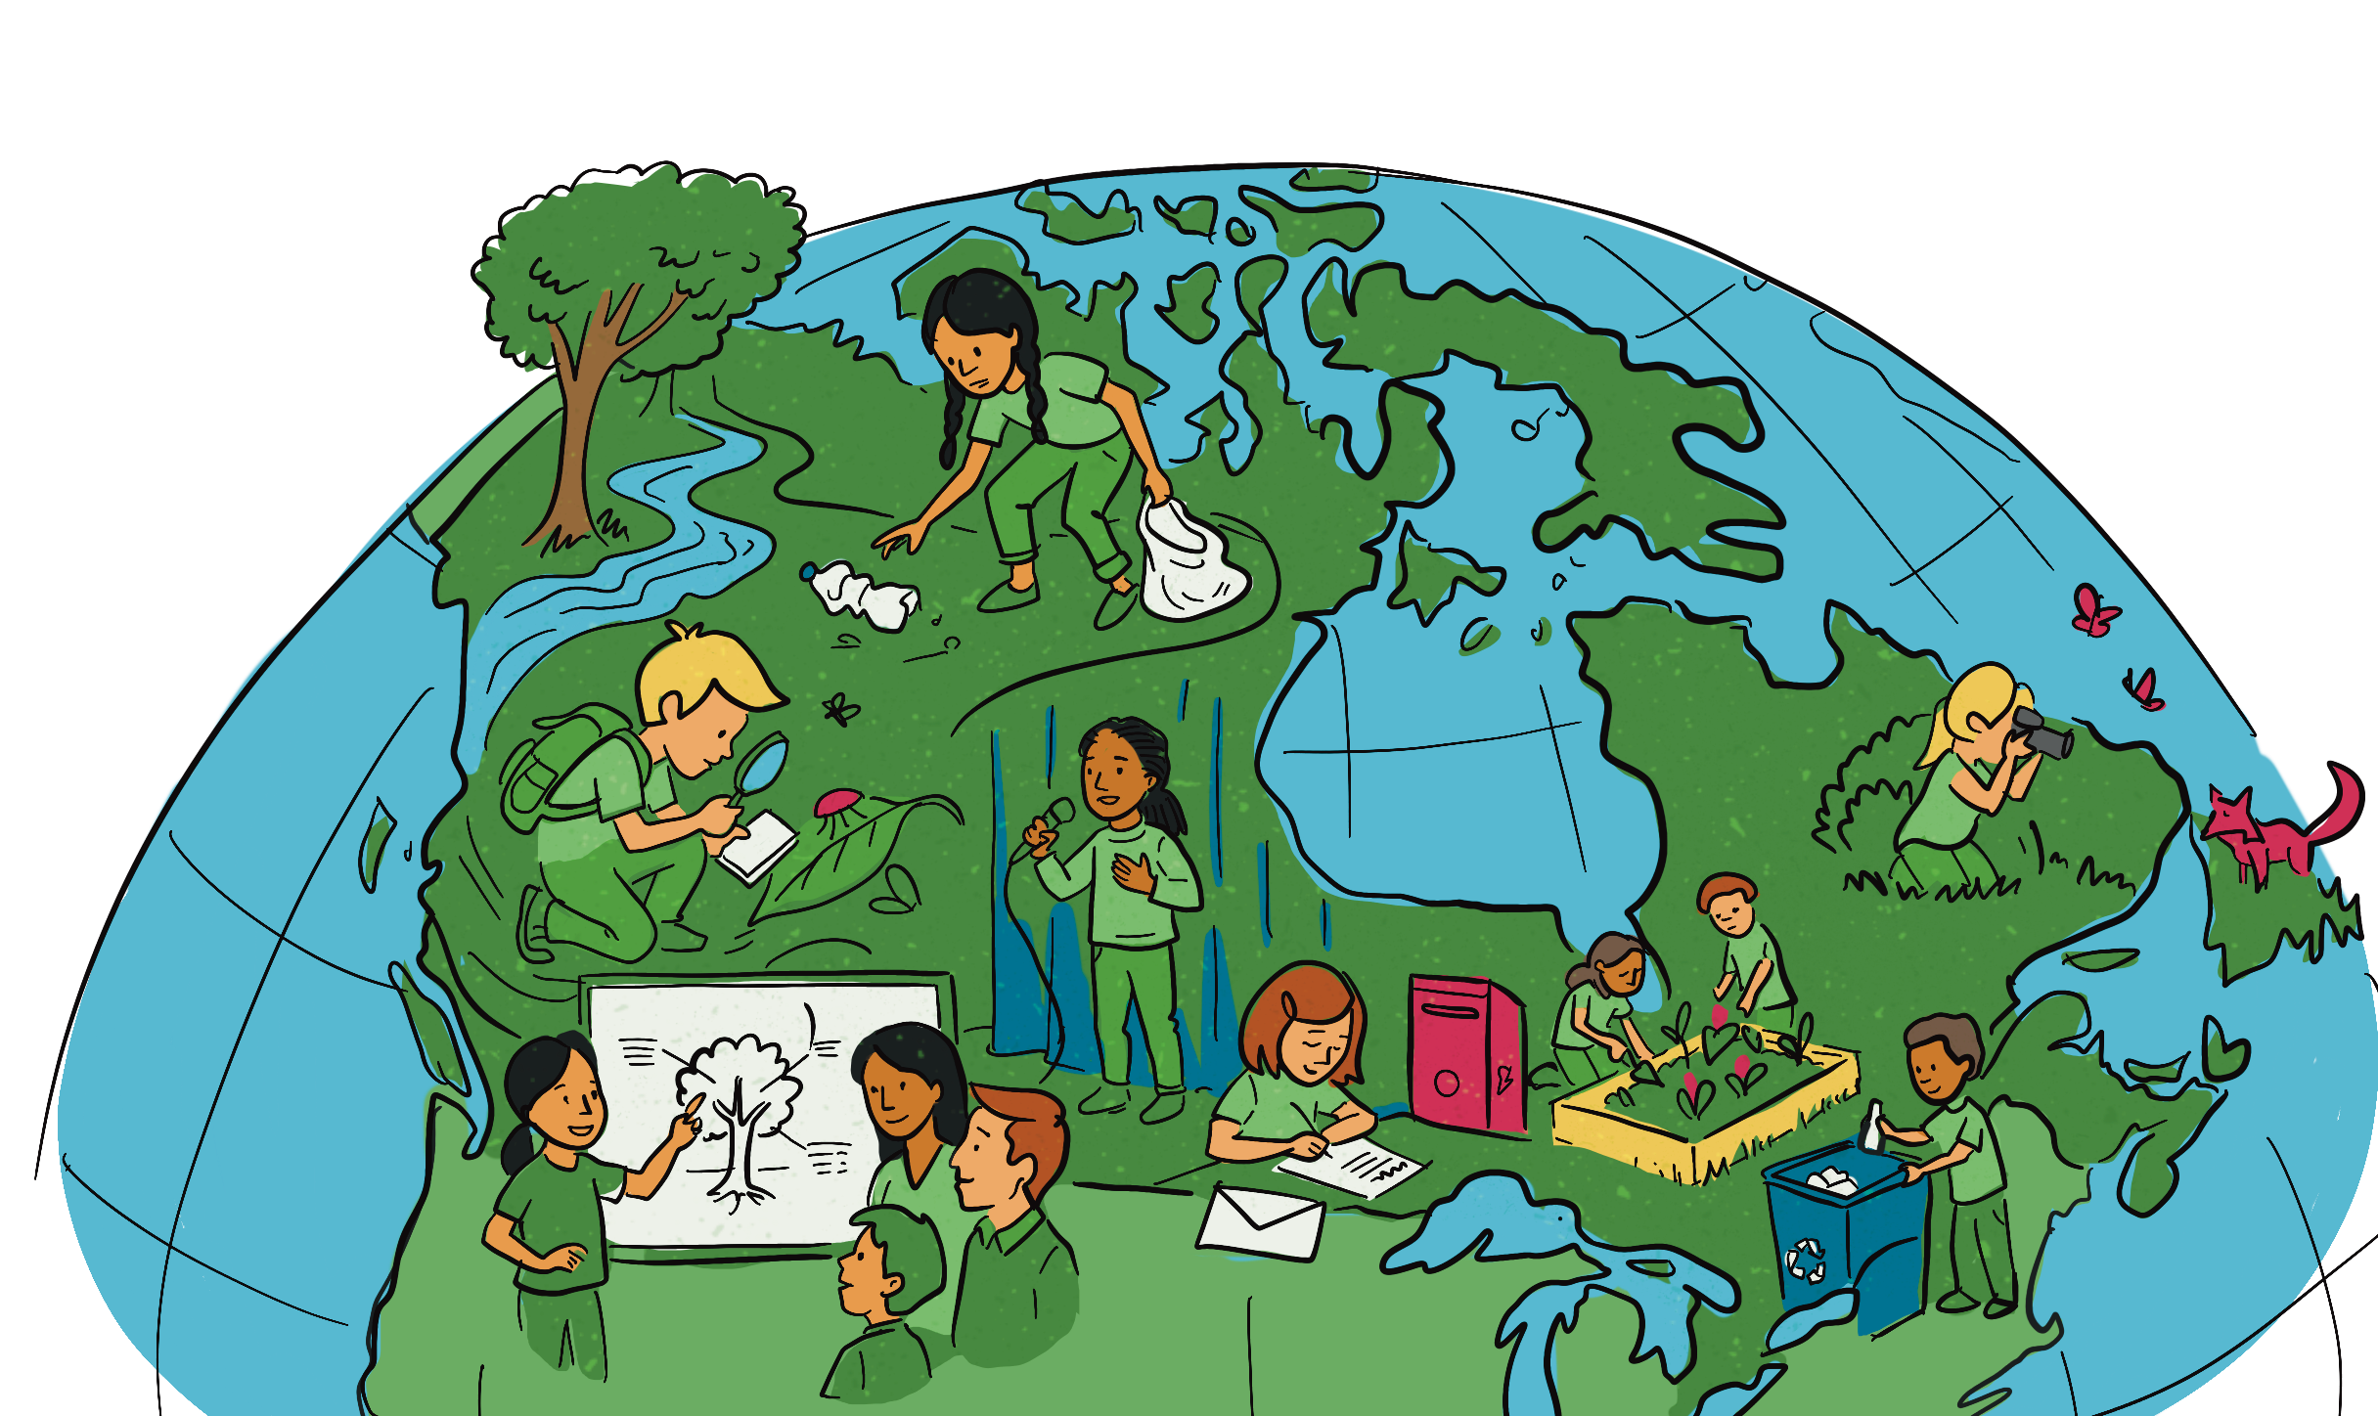
The importance of pledges
“Pledges act as written or spoken promises asserting an individual’s dedication to a specific cause, principle or organization. They play a vital role in reinforcing shared values and establishing accountability among community members. For students, pledges offer opportunities to experience the responsibility that comes with committing to a goal or promise.”
Source: www.pedagogue.app

Slide 3

Indigenous perspectives:
TEACHER NOTE
Read aloud this perspective by Kianna Bear-Hetherington, Water Guardian, from the Living Planet Report Canada 2025. If you have a map of Canada in your classroom, take a moment to locate Fredericton, New Brunswick.
Follow-up questions
Observation and connection: What connections does Kianna describe between the land, animals and people?
Reflection and impact: Why is protecting the land and water important for both ecosystems and communities?
Critical thinking / future- oriented: What can people do today to help ensure future generations can connect with the land and wildlife?
Kianna Bear-Hetherington, Water Guardian, Wolastoqey Nation (Page 24 of LPRC 2025)
Kianna Bear-Hetherington is a proud Wolastoqey woman from Sitansisk, also known as St. Mary’s First Nation, in Fredericton, NB. She grew up swimming and fishing in the lakes and rivers of her community and has always had a deep connection to the land and waters.
Listening to Elders and Knowledge Holders taught her a lot about the sacred relationship with the land and water, such as not to separate ourselves from nature — a teaching that eventually led her to work on fisheries in her community. Through her work with Wolastoqey Nation New Brunswick — the technical advisory body for the six Wolastoqey communities in the province — she has been able to deepen her understanding of her own identity.
Kianna: I know that these animals and medicines are a part of the balance in our ecosystem, and also deeply tied to our way of life. I am worried about how climate change and all these industrial activities and the continued disruption of our land and waters will really affect their populations in the future.
When we work to heal the waters, we’re not only healing the land but also our communities. My role is about ensuring that future generations will be able to connect with the land and waters and wildlife the way we always have. How much we’ve gone through as people and how much we’re still fighting for our inherent and treaty rights is what keeps me going in the work that I do for my nation.

Slide 4

Mission activity instructions
Step-by-step guides to planting habitat at school and at home are available through WWF-Canada's Living Planet @ School and re:grow programs.
Step 1
Highlight all of the excellent effort that the students have been putting into their
“Mission: Explore to Restore” lessons. At this point, they have learned a lot about how
to help wildlife, and that even small steps
taken together can make a tremendous difference. Remind them that humans feel better when they take action to help others. You can do a quick check-in with your students about how they are feeling about their monitoring project (Lesson 6) and their commitment to wildlife.
WWF-Canada initiative | Web link
Living Planet @ School: Hands-on actions schools and students can take to help nature thrive | https://schools.wwf.ca
Go Wild Grants: Apply for grants of up to $1,500 to help fund projects to protect and restore habitat on school grounds | https://wwf.ca/go-wild
re:grow: Learn how to grow native plants step by step, at home or any place where you have room for a few pots or a garden | https://regrow.wwf.ca
Step 2
Direct students to the “How you can help” section of the LPRC for Kids website (wwf. ca/lprckids). As a class or in small groups, review the different actions that young people can take to support wildlife, such as:
Write a letter to local government
Create habitat gardens at school or home using native plants
Share what they know with parents and friends

Slide 5

Encourage students to notice the variety of ways they can help (at home, at school and in their community), and to think about which actions feel realistic and meaningful to them.
You may wish to ask prompting questions such as, “Which of these actions have you already tried?”, “Which ones would you like to try?” or “Which actions could we do together as a class or group?”
Step 3 Pledge creation. A teacher prompt could be, “To show how important our class feels it is to help wildlife, we are going to make a pledge.” Ask the students to share examples of pledges. For example, most classrooms have a pledge on how they will treat each other, treat school property and treat themselves, showing respect for self, others and property. Girl Guides and Scout groups have pledges, etc. If the students need guidance, remind them that a pledge is a promise that a person or group of people make when they agree to work together towards a common goal.
Step 4 Depending on your class and the project(s) you selected, you can decide if you want the students to write their own individual pledge or to work together and create a class pledge. Either way, the students will need to sign the pledge. The class pledge should be specific in outlining what they want to achieve and how they will uphold these promises.
Wildlife pledge starters
“I promise to help wildlife by…”
“One thing I will do to protect animals is…”
“I will make the world better for animals by…”
“I will be a wildlife helper when I…”
“My class and I promise to…”
“I will show I care about animals by…”
“To help wildlife, I will remember to…”

Slide 6
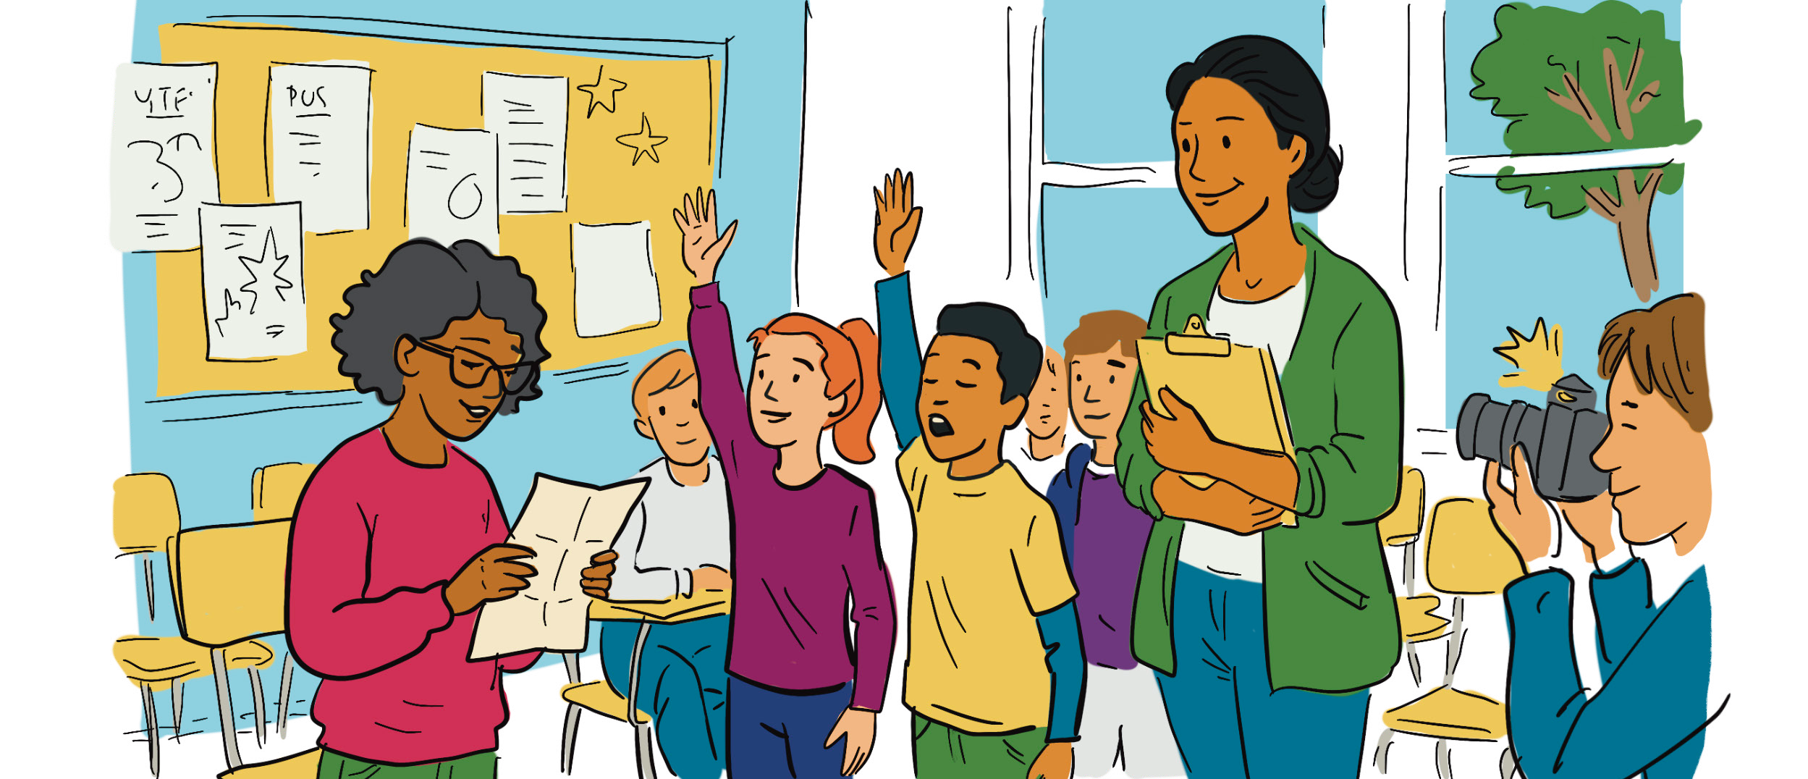
Step 5
In small groups, give the students time to make a pledge about their commitment to helping wildlife.
For example, if the class decided to plant wildflowers to support pollinators in the school yard, their pledge needs to name the project and the actions they will take to support it.
Build a pledge wall. Regardless of whether the students wrote individual pledges or worked together and made a class pledge, once they are signed, the class can make a pledge wall. Dedicating a space in the classroom creates a visual reminder to students and supports accountability. Anyone who visits the classroom (principal, vice-principal, guest, parent or other students and teachers)
will see this pledge wall. This will motivate the students to follow through on their commitments to wildlife.
Step 6
Step 7
Pledge ceremony
A short symbolic moment. The students have been doing serious, thoughtful work and it’s a good idea to mark this moment with a short ceremony. The teacher can be the emcee. The main steps:
Students sign the pledge poster.
One student reads it aloud.
Class says, “We promise!”, or
“We love Wildlife” or something similar.
Ensure that another teacher, or admin takes a moment to take a group photo.
Feel free to add extra elements that will make this ceremony more meaningful to your students.
Students complete their exit ticket on the back of the Mission #7 card.
Step 8

Slide 7
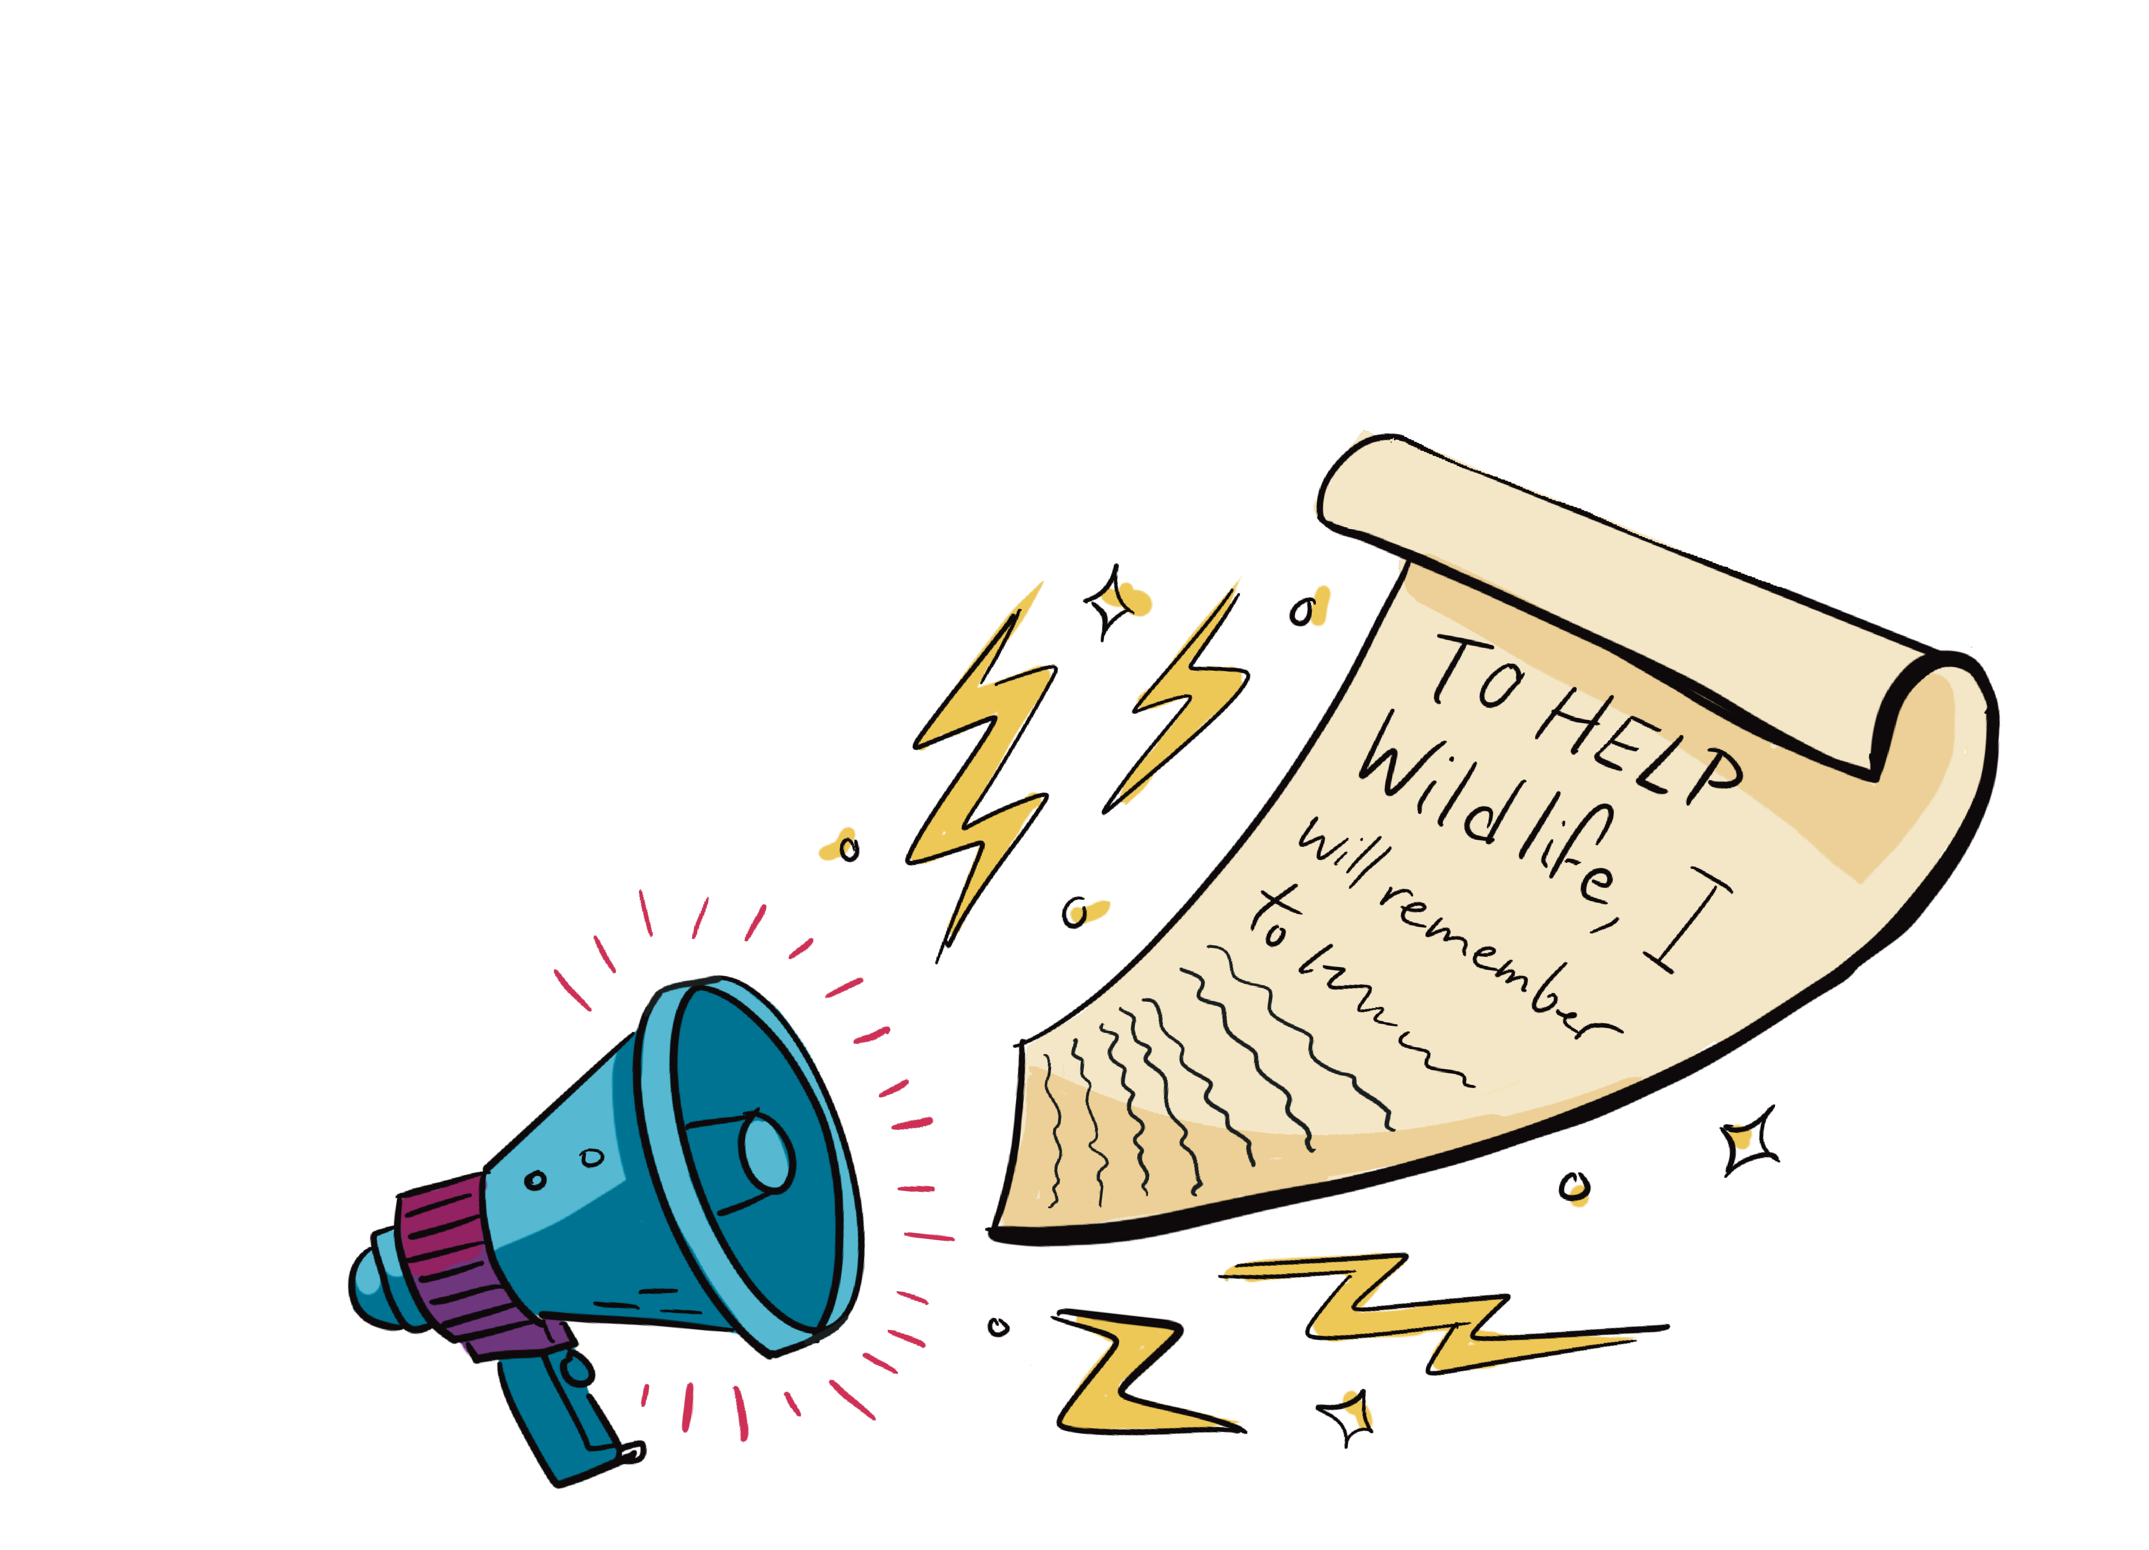
Extension activities
Extension idea
Once a month, the class revisits the pledge
Students share one thing they did that supports wildlife (at school or home)
The teacher adds tally marks or stickers to show progress
Authentic audience
Now that the students have picked a project and made a pledge to help wildlife, they should be encouraged to share this with others. Ask the students to think of different ways they can promote their project to other grades, in their school, in other schools in the area and in the community. In addition to posts on the school social media page, the class can visit other classes in the school, make a presentation to the school council (if asked, the school council might even sponsor the activity with some funds!), and if they are really feeling adventurous, they could present to the school board. School board trustees truly enjoy having informative student-led presentations. Leading by example is a powerful motivator for other students.
Monthly pledge check-in
Turn the pledge into something living instead of a one-time activity. This is a key strategy for keeping the students involved throughout the school year.

