Slide 1

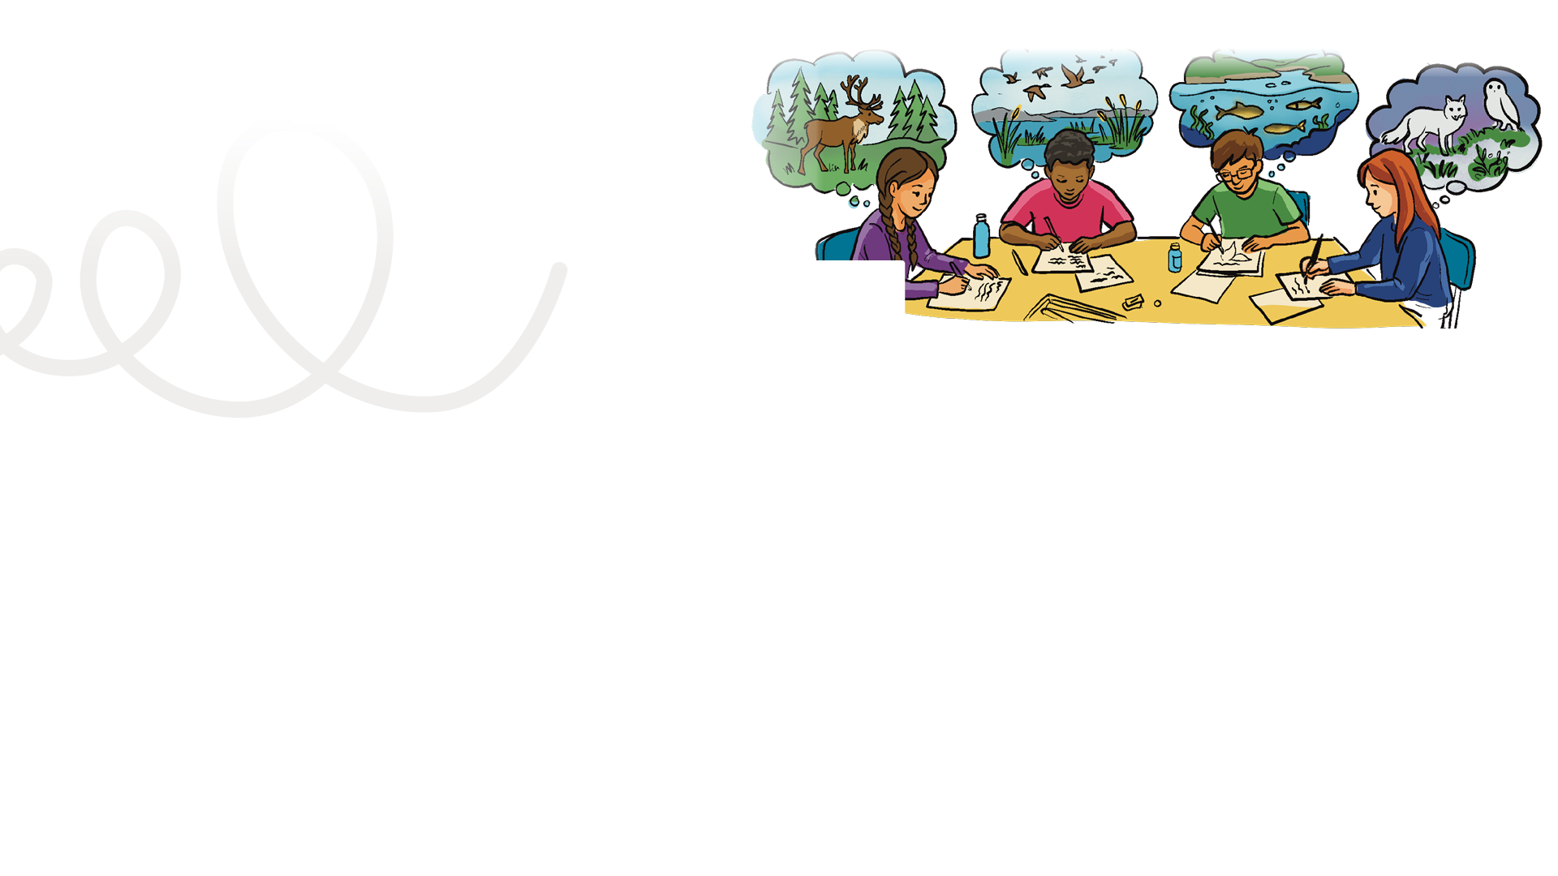


LESSON PLAN
Living Planet Report Canada for Kids
8
Grade levels: four to six
LENGTH OF LESSON:
Main objective:
One or two language arts classes (40-90 minutes). You can divide the lesson into two parts: during part one, you can draft the letter and during part two, you can polish and send.
Skills developed:
Writing to a specific audience, developing clear questions, learning formal letter structure and writing etiquette, connecting to current events and pursuing civic engagement.
Students reflect on what they learned from the LPRC for Kids website (wwf.ca/lprckids) about biodiversity, ecosystems and threats to wildlife.
They will translate that understanding into a personal or class letter, reinforcing the idea that small actions can make a difference when we work together.
ASSESSMENT TOOLS:
Student: Self Assessment Rubric and back of the Mission # 8 card
Teacher: Inquiry Learning Assessment Rubric
Background information:
This assignment is an opportunity for the students to use the writing prompts on the LPRC for Kids website to complete a letter writing (and sending!) activity. This supports reflection and discussion of human impacts and conservation solutions or actions.
MATERIALS REQUIRED:
Lined writing paper or large chart paper for the class letter option
General learning outcomes:
Please see Appendix 1 for general outcomes that apply to your province/ territory.

Slide 2
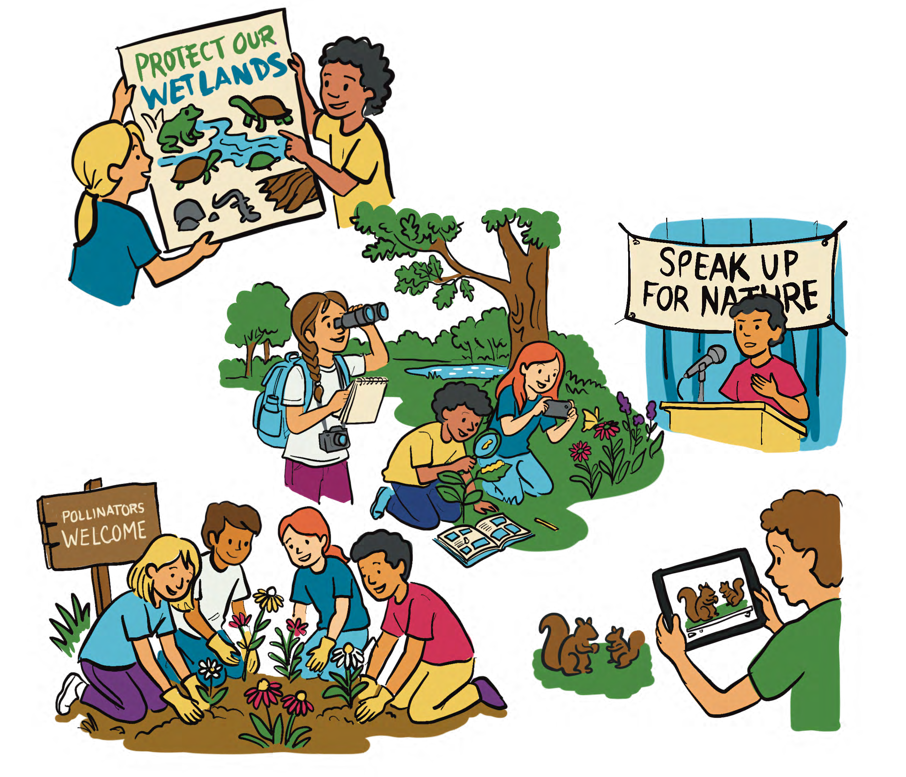

Teacher note – monitoring for eco-anxiety:
If the students seem to be feeling that the challenges impacting wildlife are too big for their actions to matter, refer to the “kids in action” stories on the LPRC for Kids website to remind students that they can make a difference! The most important take away for the students is that by taking action, it will help us to feel better and not lose hope. These actions are grounded in science and they will have a positive effect on wildlife.

Slide 3
Indigenous perspectives:
TEACHER NOTE
Read this perspective by Annie Buckle from the Living Planet Report Canada 2025. If you have a map of Canada in your classroom, take a moment to locate Aklavik, Northwest Territories.
Follow-up questions
Observation and connection: What changes does Annie describe in the land, animals and environment?
Reflection and impact: How are these changes affecting people and communities?
Critical thinking / future-oriented: What actions does Annie suggest, and how could people work together to protect the land in the future?
Annie Buckle, Gwich’in Tribal Council (Page 70 of LPRC 2025)
Annie Buckle has spent most of her life calling what we now know as the Northwest Territories home. The Gwich’in Elder was taught to live culturally and traditionally — being on the land is in her blood. Spending time at various family members’ cabins growing up, she now lives just outside of Aklavik in a cabin of her own.
A Gwich’in Elder, Buckle’s knowledge of the land and species that occupy it is vast. She’s spent her life accumulating knowledge and beliefs about the relationships between the species in her region and how to respectfully coexist. This knowledge she’s inherited has been passed down from generation to generation and is built on thousands of apeople’s direct contact with the environment.
Annie: Climate change is an issue with harvesting by the seasons here, the changes make animals confused. They’re coming closer to town and farther north.
I’m also noticing more impact from the fires down south; we’re having to breathe in the smoke and the heat is hard to tolerate.
What we need to do is protect, protest and start growing our own veggies, harvest more fish and meat to get people and the planet healthy again. I think the land is the key to a better, longer life.
…
Really what we need is unity, for people to go into environmental work and for opportunities to be created for them. We
need more people to get involved, to care and the world to be serious about tomorrow.

Slide 4

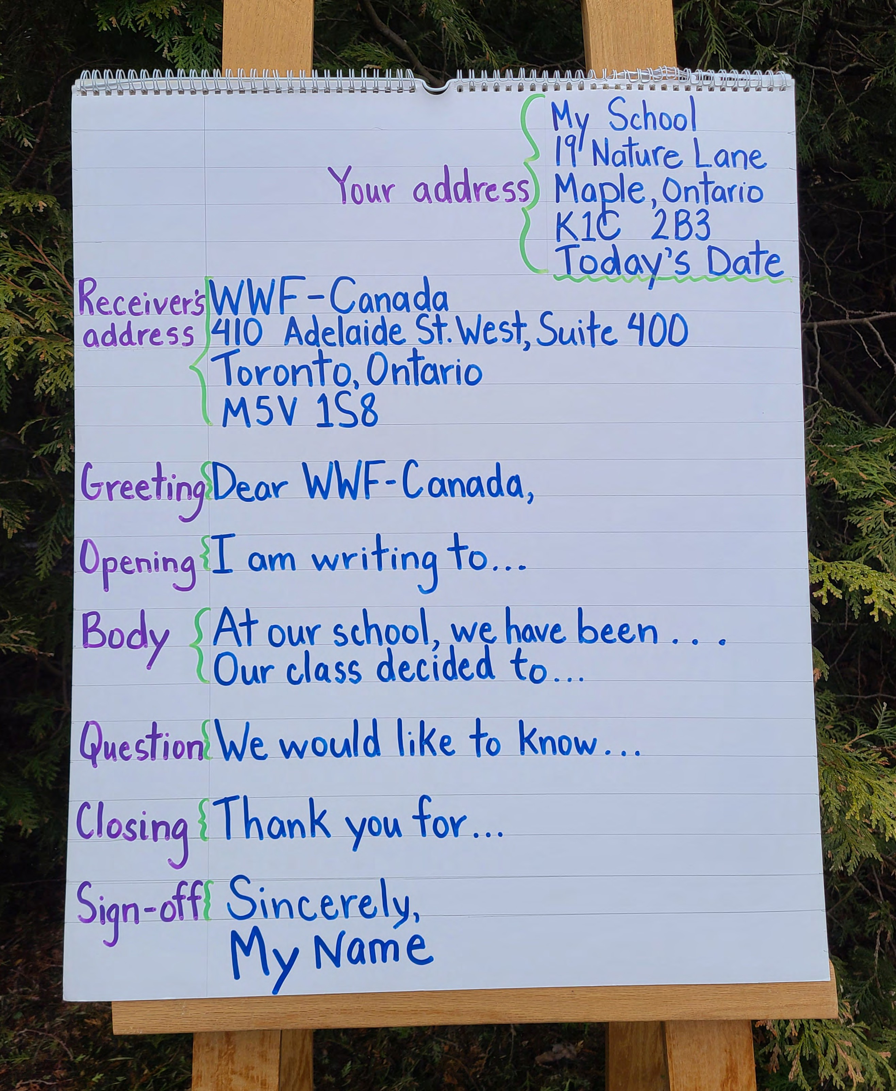

Mission activity instructions
Figure 1. Anchor chart example
Example script:
“Over the past lessons, you have explored Canadian wildlife, habitats and the challenges many species face. Now it’s time for your final mission.
First, we will review what you have learned about your species and the threats it faces. Next, you will reflect on why this animal is important and what could help protect it. Finally, you will write a letter to share your ideas with an audience who can help make a difference.
Your words can inform, inspire, and encourage others to care about wildlife. Scientists, conservationists and community members often write letters like this to raise awareness and promote change. Over these lessons, you’ve used your minds, your eyes, your bodies and your heart. Today, your voice becomes part of the effort to help protect wildlife.”
PART ONE
about the importance of protecting wildlife and restoring nature.
Review the steps in writing a letter and using the chart paper, create an anchor chart of a simple letter format (address, date, salutation, body, signature).
Step 1 Explain to the students that, as a class, you are going to send letters to a variety of people or organizations to raise awareness

Slide 5
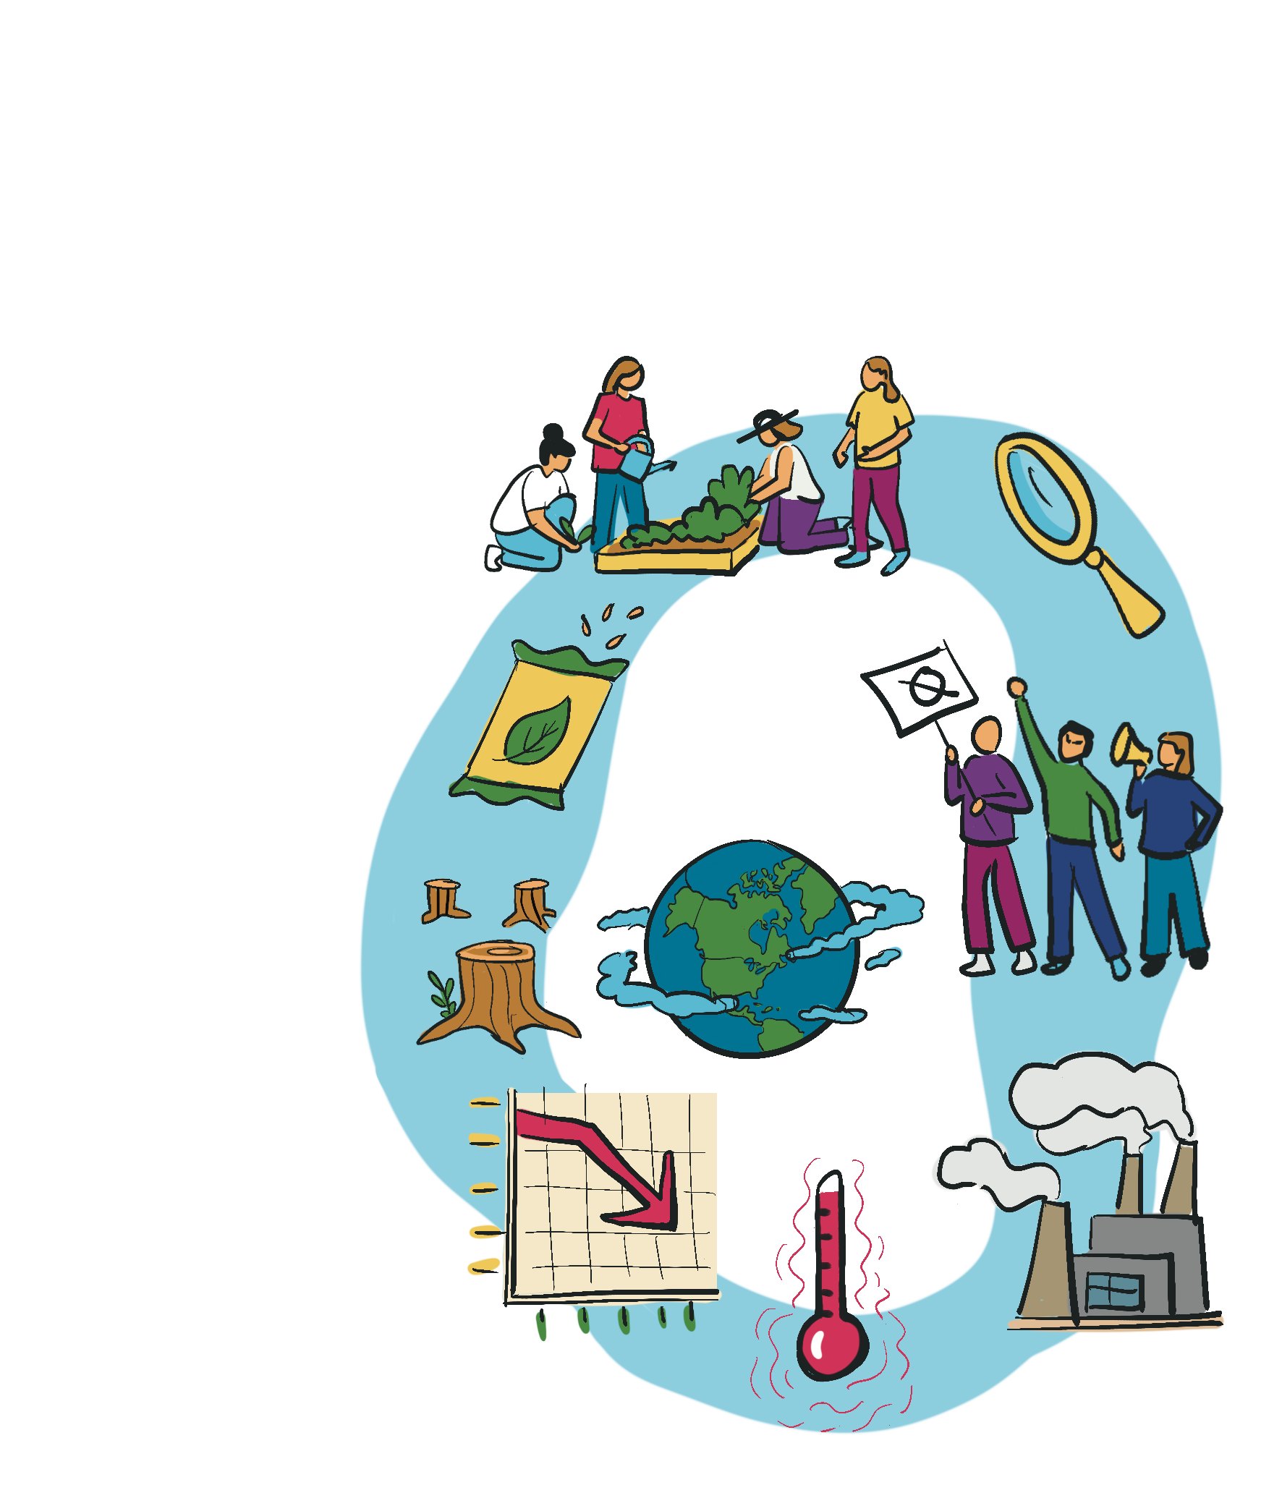
Review with the students some of the highlights of what they have learned throughout their mission. What information do they want to include? What can they share about the wildlife/ecosystem monitoring project and pledge that the class made? Do they have a request for the person they are writing to? For example, if they are writing to a town council, can they ask for more native plant gardens and less pesticide use? To their parents/guardians, can they ask their family to join them in helping nature by creating a small native plant garden at home? To their teacher/ principal, can they ask for a native plant garden to be started at school?
Brainstorm or mind map a list of facts that the students learned from the LPRC for Kids Website.
For example:
Ten per cent average decline in wildlife populations in the last 50 years
Biggest challenges to wildlife (habitat loss, pollution, climate change)
How humans can work to reverse this trend (remove invasive species, plant native species, protect land from future development, etc.)
Step 2: Ask the students to think about which group or person they would like to send their letter to. Brainstorm the different groups. Suggested recipients: their families, community centre, school and school board/district education authorities, WWF- Canada, local nature organizations or parks, conservation authorities, community garden organizations, local Indigenous councils, local town/ city councils, their future selves or for a class archive, and general public awareness (no direct sending required).

Slide 6
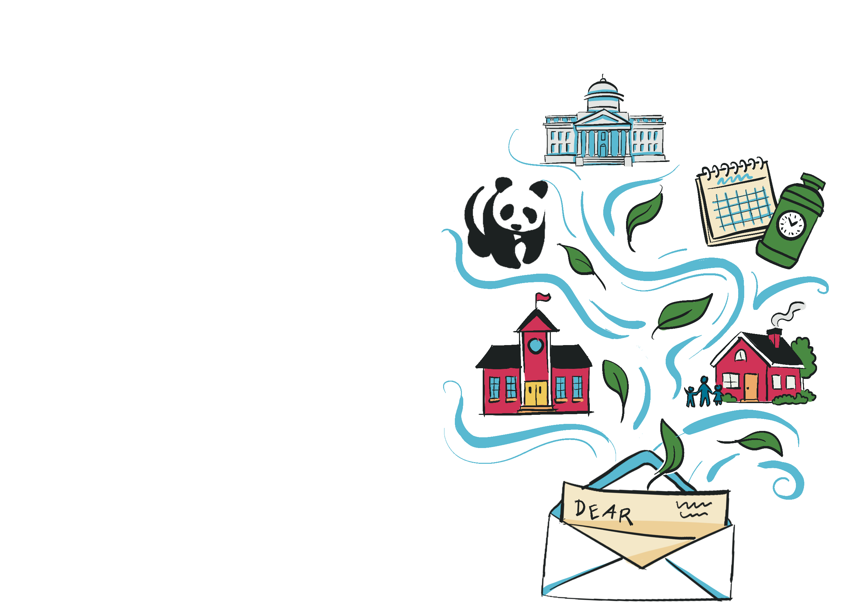
Step 3 Group students who have a similar interest in who they want to write to.
Suggestions for the groups are as follows:
School ⎯ Sharing learning within the school or community:
School principal or administration
School council or eco-club
Local library or community centre
Bulletin board / newsletter publication
Future self or class archive ⎯ Capturing learning and personal commitments:
Students write a short note to their future selves, then the teacher seals the letter and gives them back later in the year, the next year or when the student graduates from elementary. This reinforces the idea that their pledge lasts beyond the school year.
Prompt idea: “One thing I promise to do to help wildlife is….”
Letters can also be saved for a class time capsule.
Local nature organizations or parks ⎯
Connecting learning to local ecosystems:
Local conservation groups
Provincial or municipal parks
Nature centres
Public awareness (no direct sending required) ⎯ Practicing clear communication about environmental issues:
Display on a wall
Share during an assembly
Read aloud in small groups

Slide 7
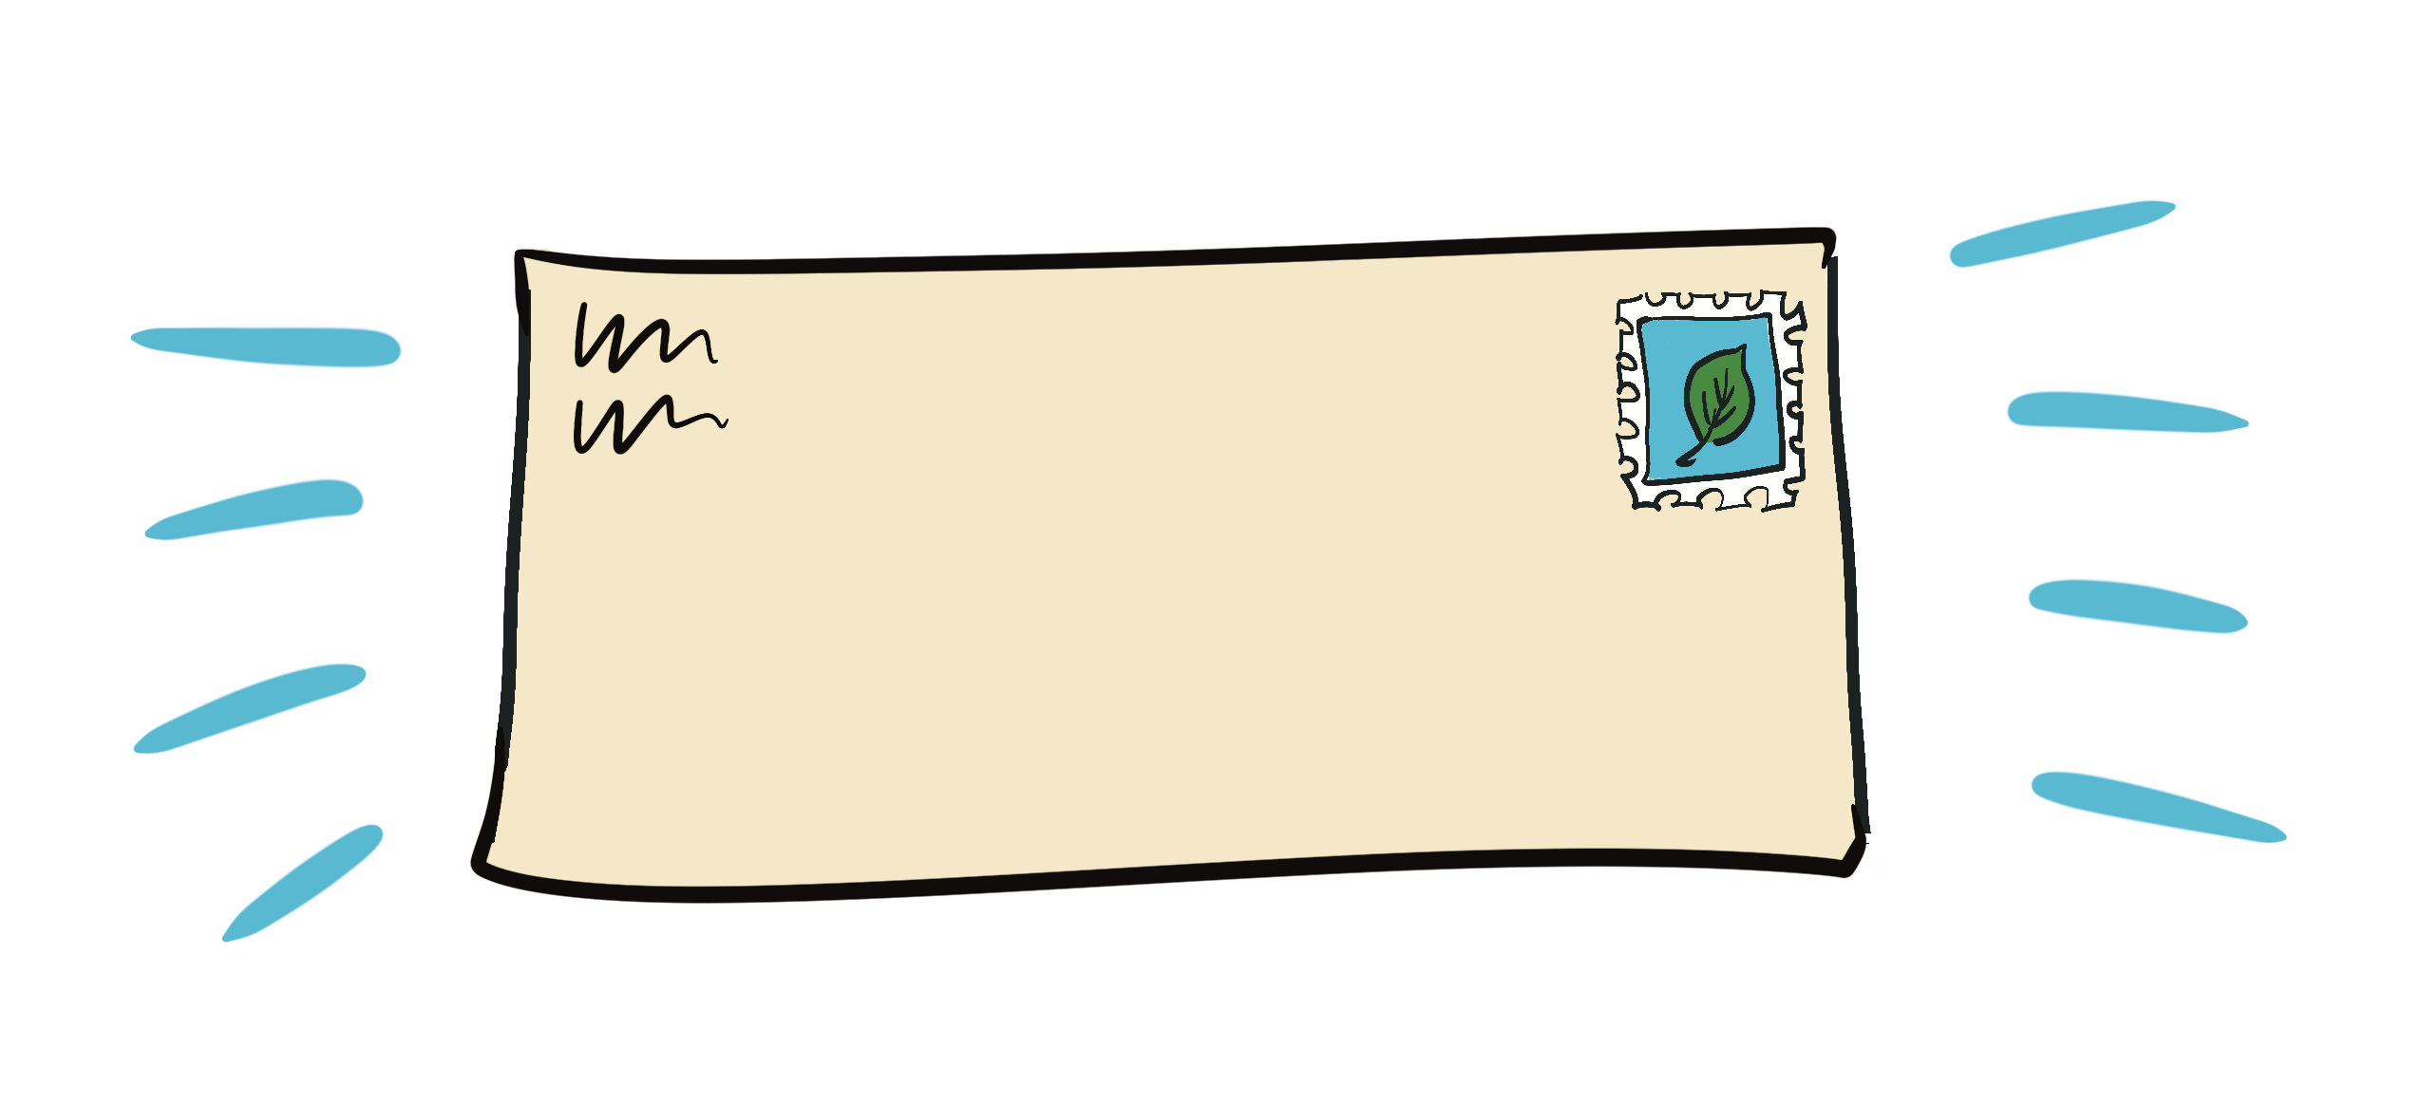
Write a message to WWF ⎯ Canada sharing what you learned
WRITING PROMPTS FROM THE LPRC FOR KIDS WEBSITE:
Picture a future where people and wildlife in Canada can live well together. In this future, we all get what we need to survive and stay healthy.
Everyone — including you — can be a part of creating that future. Choose a question to answer below. WWF-Canada might share your idea to inspire other Canadians to help wildlife!
What is one of your favourite wildlife species, and what do you like about it? Why do you think other people should care about protecting it?
What is something that you do to help wildlife, or that you
would like to do?
What do you think adults should do to help wildlife? What do you want to do to help when you’re older?
What is your favourite place in nature? What is special about it?
What role do you play in your local ecosystem? What does your ecosystem do for you?
What ways can you welcome more nature to your schoolyard?
If you’ve been given cultural teachings about how to live in relationship with nature, what is the most important part of these teachings to you?
Instructions for writing to WWF-Canada:
Students can individually submit a simple form on wwf.ca/lprckids, or they can send letters to:
WWF-Canada
410 Adelaide St. West, Suite 400
Toronto, ON M5V 1S8

Slide 8

Step 4 It’s time for the students to write their letters. Depending on your class, some students will work better as a team, while others will work better alone. Depending on the time required, it might be a natural stopping point to end the first part of this lesson after they finish their rough draft. Explain that their letters will need to be edited so that they are showing their best work to the person/ organization of their choice.
Opening the letter
I am writing to you because…
I want to tell you about an important wildlife species called…
Did you know that…? (interesting fact about the species)
I am concerned about…
Explaining the problem
One challenge this species faces is…
This is a problem because…
If this continues, it could…
Explaining why it matters
This species is important because…
Wildlife like this helps our environment by…
People should care about this species because…
Suggesting an action
One thing you could do to help is…
I encourage you to…
A small change that could help wildlife is…
Closing the letter
Thank you for taking the time to…
I hope you will consider helping…
Together we can help protect…

Slide 9

PART TWO
This opportunity to share:
reinforces student voice
celebrates the writing without reading entire letters
keeps the focus on advocacy
and action
Step 7 Send the letters! It is highly possible that the students in your class or group have not had the experience of sending a letter in the mail. Provide envelopes and stamps and ensure that the return address of the school is included on the envelope. Once all the letters are ready to be mailed, extend this experience by taking the class to the front office to drop the letters off with the school secretary.
Step 8 Students complete their last exit ticket on the back of the Mission #8 card! Well done!
Step 5 Edit the letters. Perhaps ask an older group of students to help with this process. As editing can be tedious, think of some incentives to encourage the students to do their best work (stickers, a little fresh-air break, etc). Then, ask your students to rewrite their letters in their neatest printing or on a computer and get ready for the final step. The students can use stickers or pencil crayons and markers to decorate their letters. Or, they could include a small drawing. Let them be creative!
Step 6 Class wildlife advocacy circle
Students gather in a circle and read one powerful sentence from their letter aloud — for example, the sentence explaining why their species matters or the action they are asking for.
After each student shares, the class briefly reflects on the many ways people can help wildlife.

Slide 10

Celebrate the completion of all the missions!
Extension activities
Mail the letters
If your school is within walking distance from a mailbox, take the students to mail their letters.
Follow the story
Students keep track of whether they receive a response to their letter. If a reply arrives, the class can:
read it together
discuss what the response means
reflect on how communication can influence decisions about wildlife protection
Even if no reply comes, students can discuss why speaking up for wildlife is still important. By writing to a
variety of audiences, hopefully at least one organization and individual will respond.
Optional prompt: “If you could tell a friend about one thing you did in these missions, what would it be?”
Class pledge highlight (5 minutes)
  Refer to the class pledge from Lesson 7.
  Students give a quick thumbs up or hand raise if they agree to keep caring for wildlife.
  Optional: Take a photo of the pledge as a keepsake and add it to their mission book.
Celebration (3–5 minutes)
  Give a small reward or treat (sticker, animal cracker or just a cheer).
  The cheer could be a simple “Three cheers for wildlife!” Ask your class for suggestions!
  Bring a small “wildlife snack” like animal crackers or trail mix (whatever is suitable given any
allergies in your class) and have a stretch or movement break outside.
  Optional: Play a nature soundscape while students share reflections and enjoy the snack.
Your class can now collect up all of their mission cards and staple them together to create a small book.
Working with your class, consider planning a small celebration to recognize all the time and effort they have committed to helping wildlife in Canada. As celebrations with students usually involve snacks, this might be
a good time for sharing some food together.
End-of-missions mini celebration (approximately 15 minutes)
Quick reflection circle (5–7 minutes)
  Students sit in a circle.
  Go around, with each student sharing one thing they learned or one favorite moment from the missions.

